Slide 1
Stress Ulcer Prophylaxis in the Intensive Care Unit (SUP-ICU) Trial medication
Søren Marker Jensen
Dept. of Intensive Care 4131
Copenhagen University Hospital Rigshospitalet, Denmark
soeren.marker.jensen.01@regionh.dk
www.sup-icu.com

Slide 2
Trial medication

Slide 3
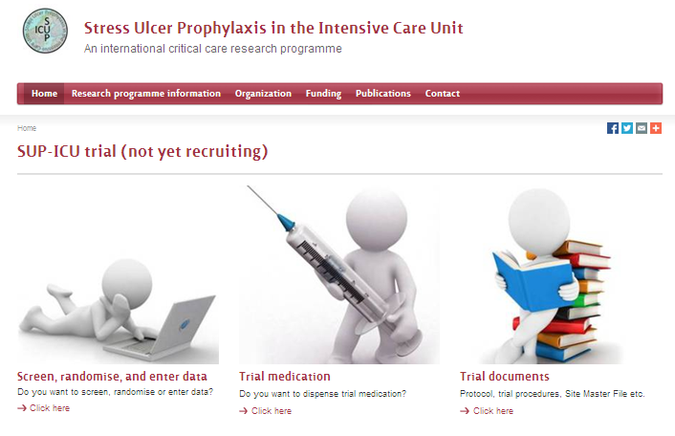
Go to www.sup-icu.com

Slide 4
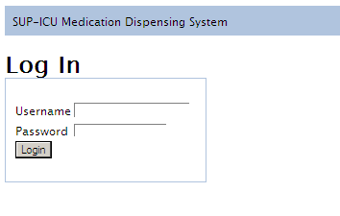
Login
Login with the shared login of your department

Slide 5
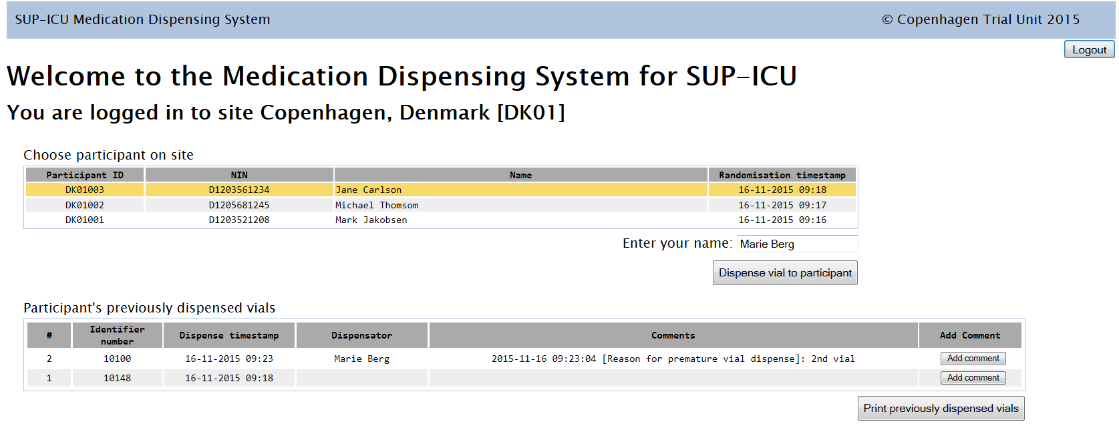
Dispense trial medication
Mark the relevant patient at the list
Enter your name
Press ‘Dispense vial to patient’

Slide 6
Confirm

Slide 7
Vial identifier number is allocated
Find the vial, add 10 ml of sodium chloride and administer the trial medication to the patient.
You have the option to print the vial identifier number.

Slide 8
Find previously allocated vials
Option to print the list.
A list of vial identifier numbers previously allocated to the patient will be shown in the bottom of the main screen.

Slide 9
If problems, use ‘add comment’
If you experience a problem with the vial or the medication administration, please use the ‘Add comment’ button in the right side.
If necessary, run through the procedure again to allocate a new vial identifier number.

Slide 10
Warning
If there are less than 20 hours between two medication allocations a warning will appear. A reason for this is required
This may happen if a patient is randomised prior to the normal time of medication administration in your department, e.g. randomised 10 AM and medication is administered at 2 PM.
Please write ‘2nd vial’ or similar sentence.

Slide 11
Summary
A new vial has to be allocated every day at www.sup-icu.com
Mark the patient, write your name, press dispense trial medication
Add 10 ml of sodium chloride to the vial
Use ‘Add comment’ if you identify a problem with the vial and allocate a new one if necessary
If less than 20 hours between 2 allocations please write a reason (e.g. 2nd vial).

