Slide 1
Coordinating investigator:
Olav Lilleholt Schjørring, MD
Department of Anaesthesia and Intensive Care Medicine
Aalborg University Hospital
Centre for Research in Intensive Care, CRIC
V1.2, June 6th 2017
hot-icu@cric.nu
www.cric.nu/hot-icu

Slide 2
Background
Oxygen supplementation is standard treatment in ICUs worldwide
(Oxygen is a drug but is not regarded as such)
Large proportions of ICU patients are hyperoxaemic⁽¹⁻⁶⁾
1. Suzuki et al; J Crit Care 2013, Oct;28(5):647-54
2. Eastwood et al; Intensive Care Med 2012, Jan;38(1):91-8
3. de Graaff et al; Intensive Care Med 2011 Jan;37(1):46-51
4. de Jonge et al; Crit Care 2008, 12(6):R156
5. Zhang et Ji; Sci Rep. 2016 Oct 13;6:35133
6. Dahl et al; Acta Anaesthesiol Scand 2015, 2015 Aug;59(7):859-69

Slide 3
Background
ICU Cohort, North Denmark Region
261.355 PaO₂ values from 7001 patients
Mean PaO₂: 12.4 kPa (95 % reference interval 7.3-23.4 kPa)
Mean FiO₂ (during mechanical ventilation): 0.47 (0.30-0.95)
A PaO₂ of 8.0 kPa is generally considered above the limit of hypoxia^{1,2}
No documented positive effect of PaO₂ above 8.0 kPa¹
1. O’driscoll et al; Thorax 2008 Oct;63 Suppl 6:vi1-68
2. Bein et al.; Intensive Care Med. 2016 May;42(5):699-711

Slide 4
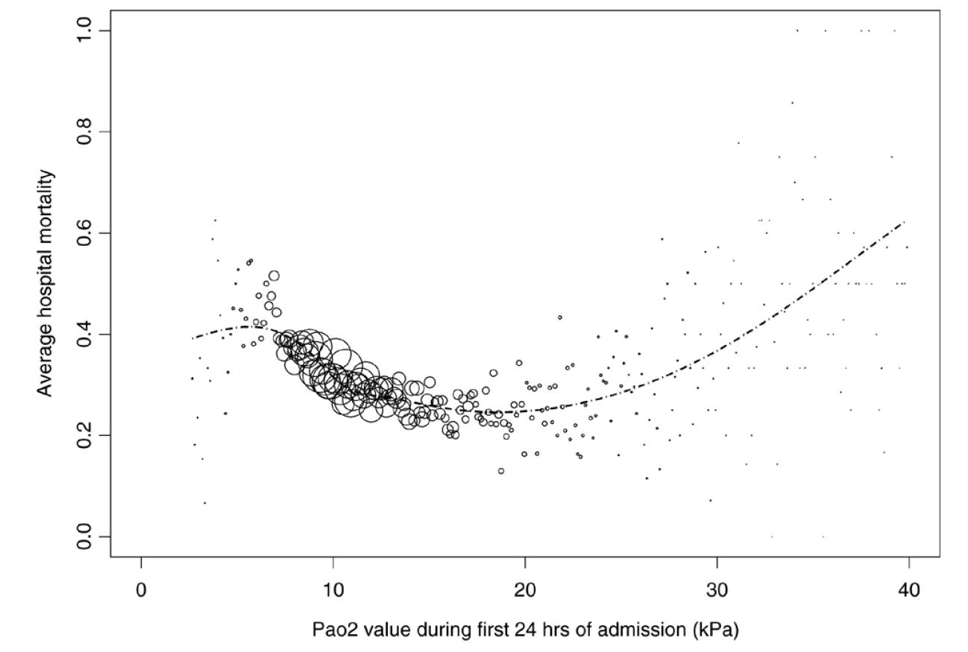
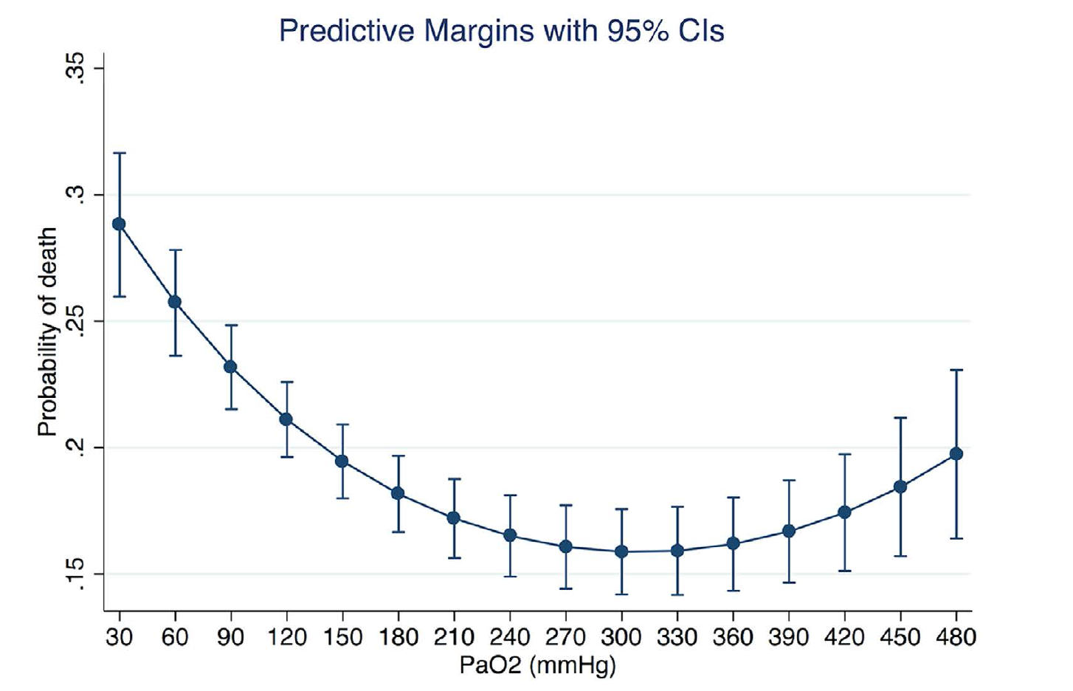
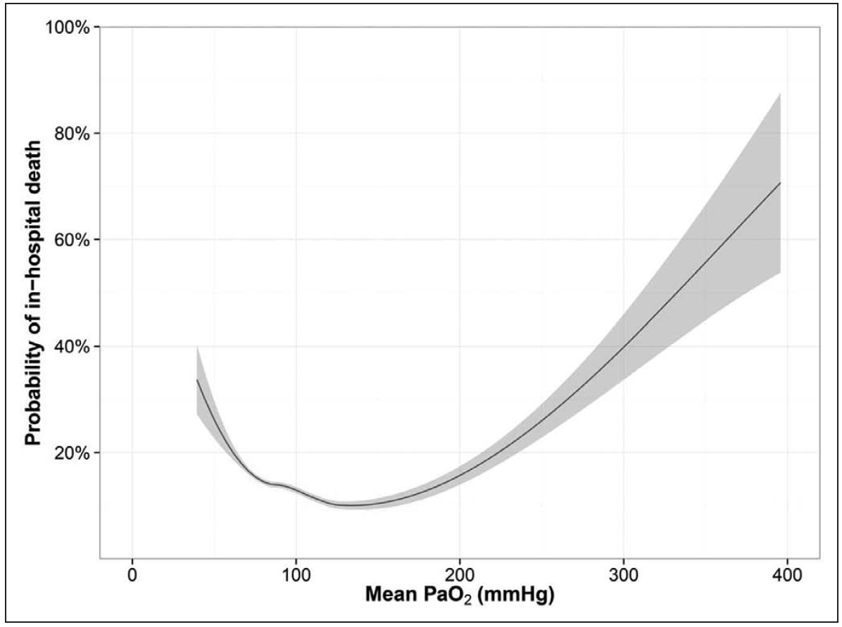
Background
Hyperoxaemia and mortality
de Jonge et al.; Crit Care. 2008;12(6):R156
Zhang, Z et Ji, X; Sci Rep. 2016 Oct 13;6:35133
Helmerhorst et al; Crit Care Med. 2016 Oct 19. [Epub ahead of print]

Slide 5
Background
Hyperoxia - adverse reactions
- Increased formation of reactive oxygen species (ROS)^{1,2}
- Hyperoxaemic vasoconstriction^{3,4} → Potential paradox tissue hypoxia⁵
- Absorbtion atelectasis^{6,7,8}
1. Kallet et al; Respir Care 2013 Jan;58(1):123-41
2. Helmerhorst et al; Crit Care 2015 Aug 17;19:284
3. Floyd et al.; J Appl Physiol (1985). 2003 Dec;95(6):2453-61
4. Bak et al.; Acta Physiol (Oxf). 2007 Sep;191(1):15-24
5. Stub et al.; Circulation. 2015 Jun 16;131(24):2143-50.6
6. Rothen et al.; Lancet. 1995 Jun 3;345(8962):1387-91
7. Rothen et al.; Br J Anaesth. 1998 Nov;81(5):681-6
8. Aboab et al.; Intensive Care Med. 2006 Dec;32(12):1979-86

Slide 6
Background
No solid evidence (large RCTs) supports specific targets of oxygenation in patients admitted to the ICU
(this includes patients with COPD and ARDS)
No guidelines exists addressing optimal oxygenation targets for patients admitted to the ICU

Slide 7
Background
Metaanalysis
Barbateskovic M, Schjørring OL, Jakobsen JC, Meyhoff CS, Dahl RM, Rasmussen BS, Perner A, Wetterslev J; Higher versus lower inspiratory oxygen fraction or targets of arterial oxygenation for adult intensive care patients (Protocol); Cochrane Database of Systematic Reviews 2017, Issue 4

Slide 8
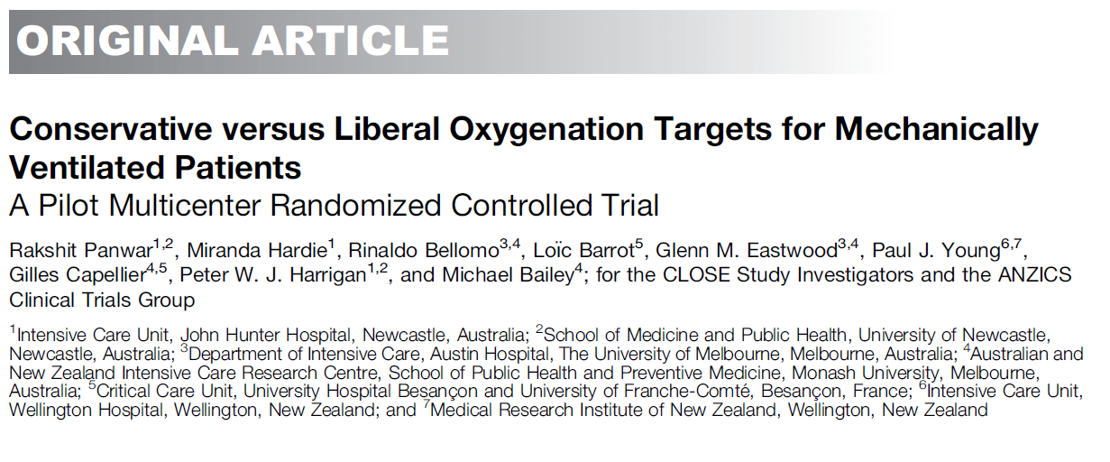
Background
Pilot trial
- 103 patients, SpO₂ ≥ 96% vs SpO₂ = 88-92%
- No difference in clinical outcome
- Trend towards lower mortality in the conservative group (after adjustment for baseline variables)
Panwar et al; Am J Respir Crit Care Med. 2016 Jan 1;193(1):43-51

Slide 9
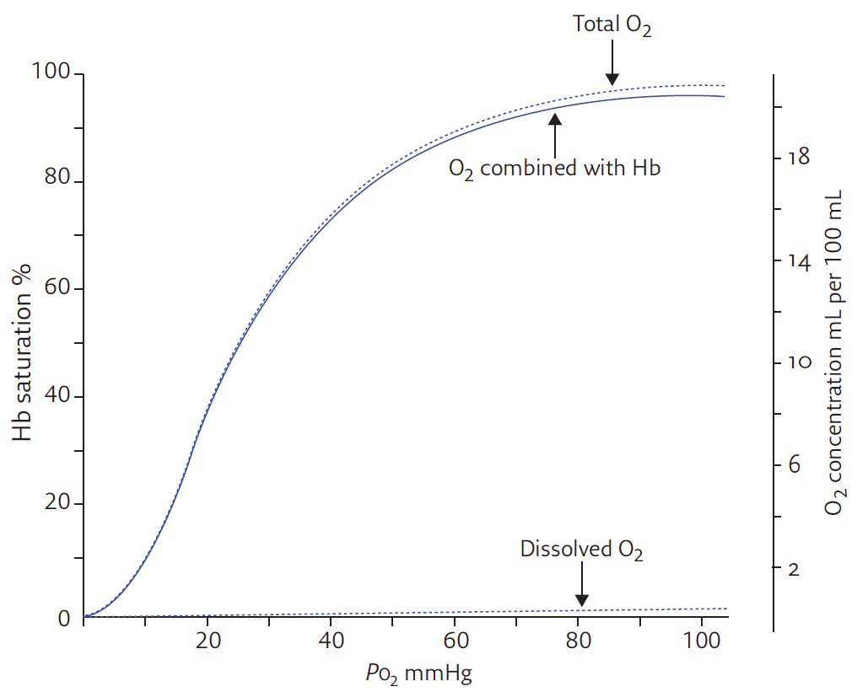
Background
8 kPa
2.7
5.3
8.0
10.7
13.3
PO₂ kPa
1. Collins et al; Breathe 2015 Sep;11(3):194-201

Slide 10
Aim
To assess the benefits and harms of two targets of PaO₂ in guiding the oxygen administration in acutely ill adults with hypoxaemic respiratory failure in the ICU
Benefits
Harms
Mortality

Slide 11
Design
Investigator initiated, randomised, outcome-assesment blinded, parallel group trial of two separate PaO₂ targets throughout the ICU admission
Setting: aprox. 50 European ICUs
Start June 2017, Aalborg University Hospital

Slide 12
Design
2928 Patients
Control
Intervention
PaO₂ = 12.0 kPa
PaO₂ = 8.0 kPa
n = 1464
n = 1464
Primary endpoint 90-day mortality (all cause)

Slide 13
Organisation

Slide 14
Screening - Inclusion Criteria
Acutely admitted to the ICU, and
Aged 18 years or above, and
One of the following:
Closed system with an FiO₂ ≥ 0.50 (invasive mechanical ventilation, non-invasive ventilation or CPAP)
Open system with an oxygen flow ≥ 10 litres pr. minute (includes high-flow systems)
and
Oxygen supplementation in the ICU, expected duration ≥ 24 hours. If in doubt answer ’YES’, and
Intra-arterial catheter in place

Slide 15
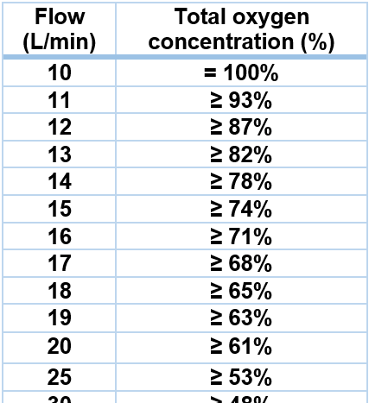
Screening - Inclusion Criteria
Open systems with automatic mixers:
eg. certain humidifiers and high-flow systems

Slide 16
Screening
When a patient fulfils all inclusion criteria, go to
www.cric.nu/hot-icu
Where you acces the electronic CRF (eCRF)
Personalised username and password

Slide 17
Screening
When a patient fulfils all inclusion criteria, go to
www.cric.nu/hot-icu

Slide 18
Randomisation
ALWAYS REMEMBER TO OBTAIN CONSENT FROM THE PRIMARY TRIAL GUARDIAN (‘FØRSTE FORSØGSVÆRGE’) BEFORE RANDOMISATION
Can initially be orally
State the full name of the primary trial guardian in the patient’s medical journal
Informed consent should be obtained as soon as possible from the patient’s next of kin and the second trial guardian

Slide 19
Exclusion criteria
> 12 hours since ICU admission
Chronic mechanical ventilation
Use of home oxygen
Previous treatment with bleomycin
Organ transplant during current hospital admission
Withdrawal from active therapy or brain death deemed imminent
Fertile woman with positive urine or plasma hCG
- In all fertile woman < 50 years of age, a negative hCG-test must be
Carbon monoxide, cyanide or paraquat poisoning

Slide 20
Exclusion criteria
Methaemoglobinaemia
Expected use of hyperbaric oxygen therapy
Sicle cell disease
Consent not obtainable
Previously randomised into the HOT-ICU trial

Slide 21
Randomisation
Eligible patients will be randomised automatically to an oxygenation target (PaO₂) of:
8.0 kPa or 12.0 kPa
Prescribe the allocated oxygenation target in the patient’s ICU chart
Write a note of inclusion in the patient’s medical journal stating the allocated oxygenation target

Slide 22
Interventions
The allocated oxygenation target applies throughout the ICU stay to a maximum duration of 90 days
ICU Readmisions within 90 days continue the allocated intervention

Slide 23
Adherence to oxygenation target
FiO₂ is titrated from 0.21 to 1.00 to achieve the allocated PaO₂ in both interventional groups
When the oxygenation is stabilised, the SpO₂ can be used for continous FiO₂ titration

Slide 24
Adherence to oxygenation target
Procedural oxygen supplementation within the ICU above targets should be restricted to the minimally required (in both groups)
The oxygenation target should be upheld at all means possible during transportation, radiological examination and surgical procedures

Slide 25
Withdrawal
A patient can be withdrawn from the trial if:
Consent is withdrawn or not given
A suspected unexpected serious adverse reaction (SUSAR) occurs
Fill in the withdrawal form in the eCRF (www.cric.nu/hot-icu)
Continue data registration (daily forms) unless consent for this is also withdrawn

Slide 26
SUSAR
Suspected Unexpected Serious Adverse Reaction (SUSAR)
Is defined as serious adverse reactions directly related to oxygen which is not described in the summary product characteristics of oxygen (ARDS or atelectasis)
If SUSAR occurs, withdraw the patient from the trial and contact the sponsor or coordinating investigator immediately (hot-icu@cric.nu or +45 2118 2543)
Fill in the SUSAR report form (#14 in the Site Master File) and e-mail it to sponsor: hot-icu@cric.nu

Slide 27
Daily forms
In eCRF at www.cric.nu/hot-icu
An ICU day is defined to be from 06.00h to 06.00h
Daily forms should be fulfilled continuously throughout ICU admission
To note:
12-hour highest and lowest PaO₂ (with SaO₂ and FiO₂)
-Obs. Use specified conversion table to calculate FiO₂ in ‘open systems’
TV, PEEP and P_{peak} every day at 08.00h (if mechanically ventilated)

Slide 28
Discharge, transfer and death
When a patient is discharged from the ICU or dies within the ICU, complete the Discharge and Readmission form at www.cric.nu/hot-icu

Slide 29
90-day follow up
Complete the 90-day follow-up form at www.cric.nu/hot-icu
Mortality (including date of death)
Discharge from hospital (date of discharge)
Readmission to hospital (days readmitted within the 90-day period)
Use of dialysis within the regular ward?

Slide 30
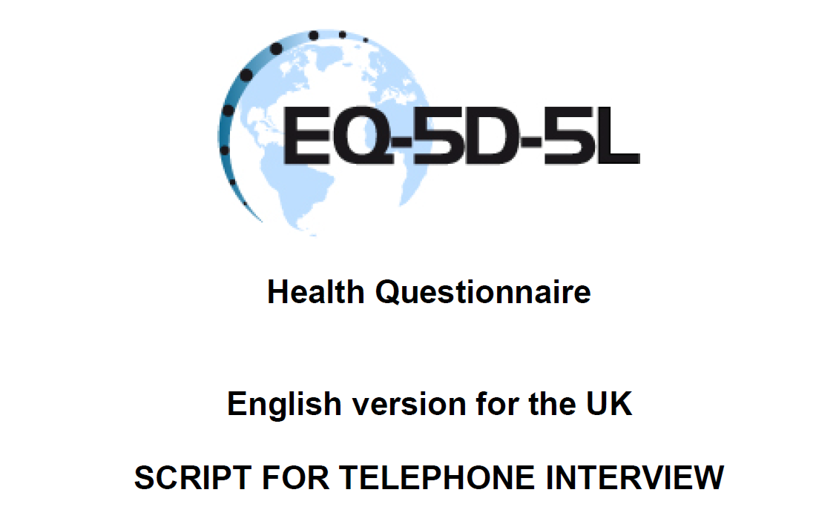
One-year follow up
Complete the one-year follow-up form at www.cric.nu/hot-icu
Mortality (Drawn from the CPR registry in Denmark)
EuroQoL (EQ-5D-5L + EQ-VAS)
RBANS (Cognitive function score) in selected sites

Slide 31
Trial Documents
www.cric.nu/hot-icu

Slide 32
Contact
Do you need help?
Call the HOT-ICU hotline at:
+45 2118 2543
Available 24/7
or
hot-icu@cric.nu

Slide 33
Thank you
hot-icu@cric.nu www.cric.nu/hot-icu

