Slide 1


Coordinating investigator:
Olav Lilleholt Schjørring, MD
Department of Anaesthesia and Intensive Care Medicine
Aalborg University Hospital
Centre for Research in Intensive Care, CRIC
V1.3, August 24th 2017
hot-icu@cric.nu
www.cric.nu/hot-icu

Slide 2
Background
Oxygen supplementation is standard treatment in ICUs worldwide
(Oxygen is a drug but is not regarded as such)
Large proportions of ICU patients are hyperoxaemic⁽¹⁻⁶⁾
1. Suzuki et al; J Crit Care 2013, Oct;28(5):647-54
2. Eastwood et al; Intensive Care Med 2012, Jan;38(1):91-8
3. de Graaff et al; Intensive Care Med 2011 Jan;37(1):46-51
4. de Jonge et al; Crit Care 2008, 12(6):R156
5. Zhang et Ji; Sci Rep. 2016 Oct 13;6:35133
6. Dahl et al; Acta Anaesthesiol Scand 2015, 2015 Aug;59(7):859-69

Slide 3
Background
  ICU Cohort, North Denmark Region
261.355 PaO₂ values from 7001 patients
Mean PaO₂: 12.4 kPa (95 % reference interval 7.3-23.4 kPa)
Mean FiO₂ (during mechanical ventilation): 0.47 (0.30-0.95)
  A PaO₂ of 8.0 kPa is generally considered above the limit of hypoxia^{1,2}
  No documented positive effect of PaO₂ above 8.0 kPa¹
1. O’driscoll et al; Thorax 2008 Oct;63 Suppl 6:vi1-68
2. Bein et al.; Intensive Care Med. 2016 May;42(5):699-711

Slide 4
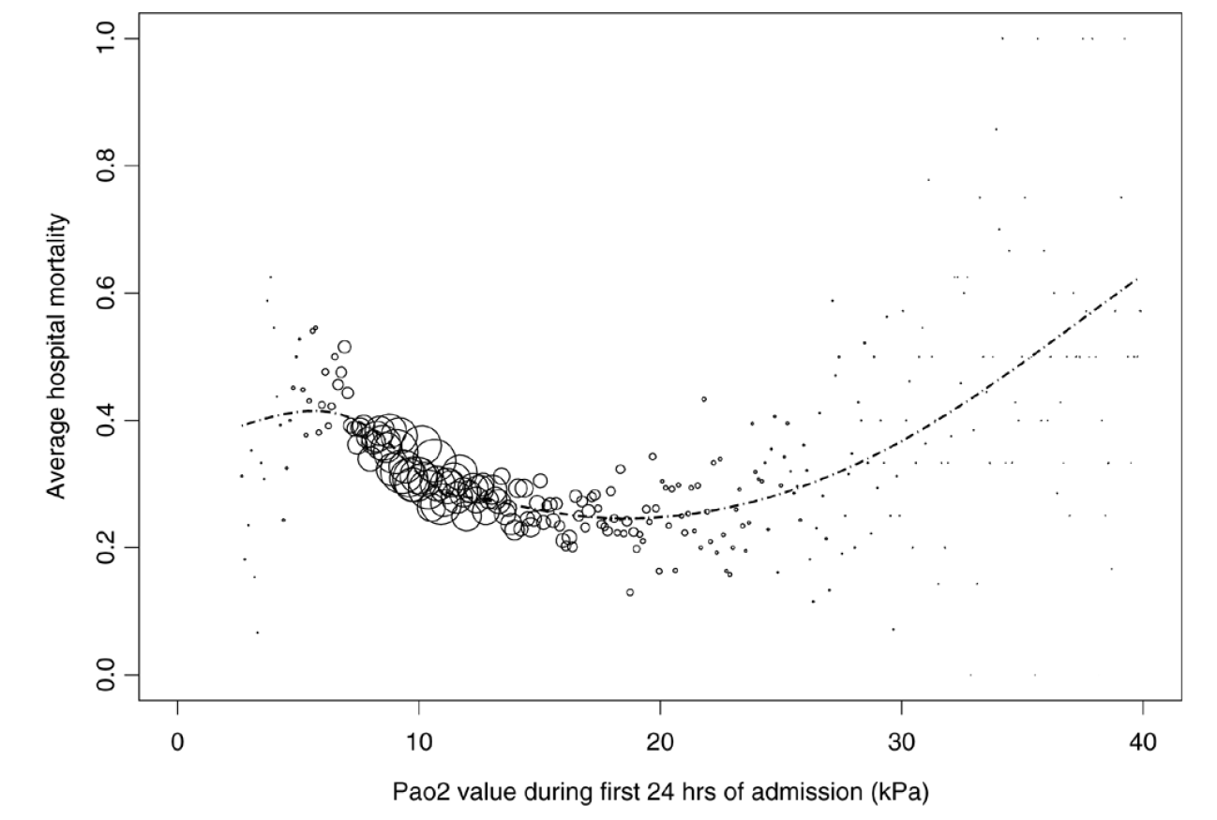
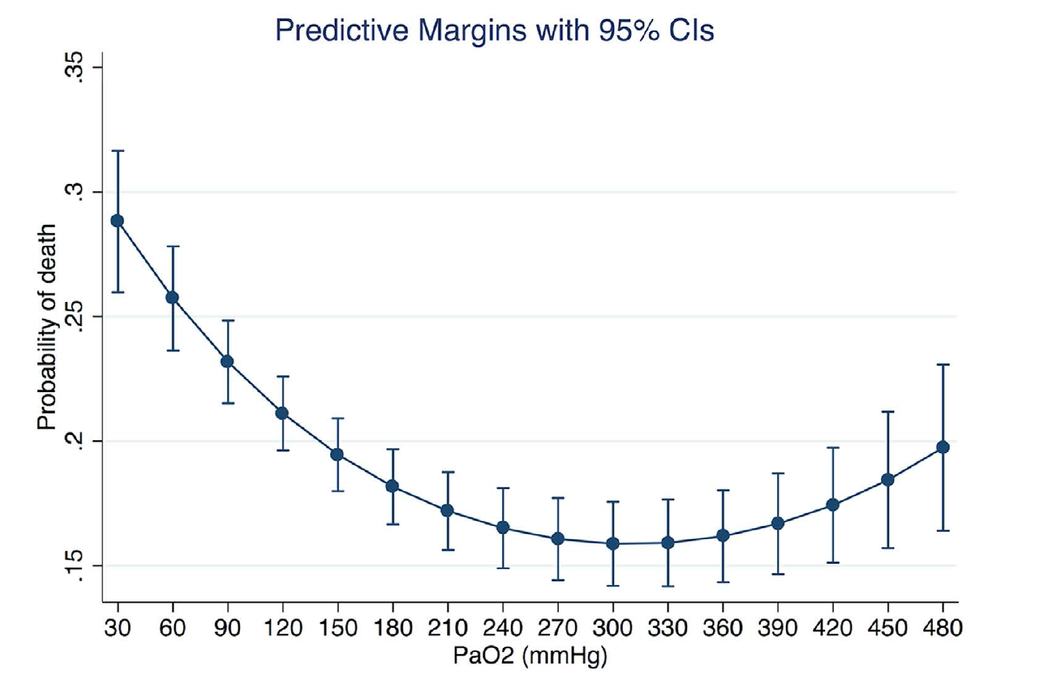
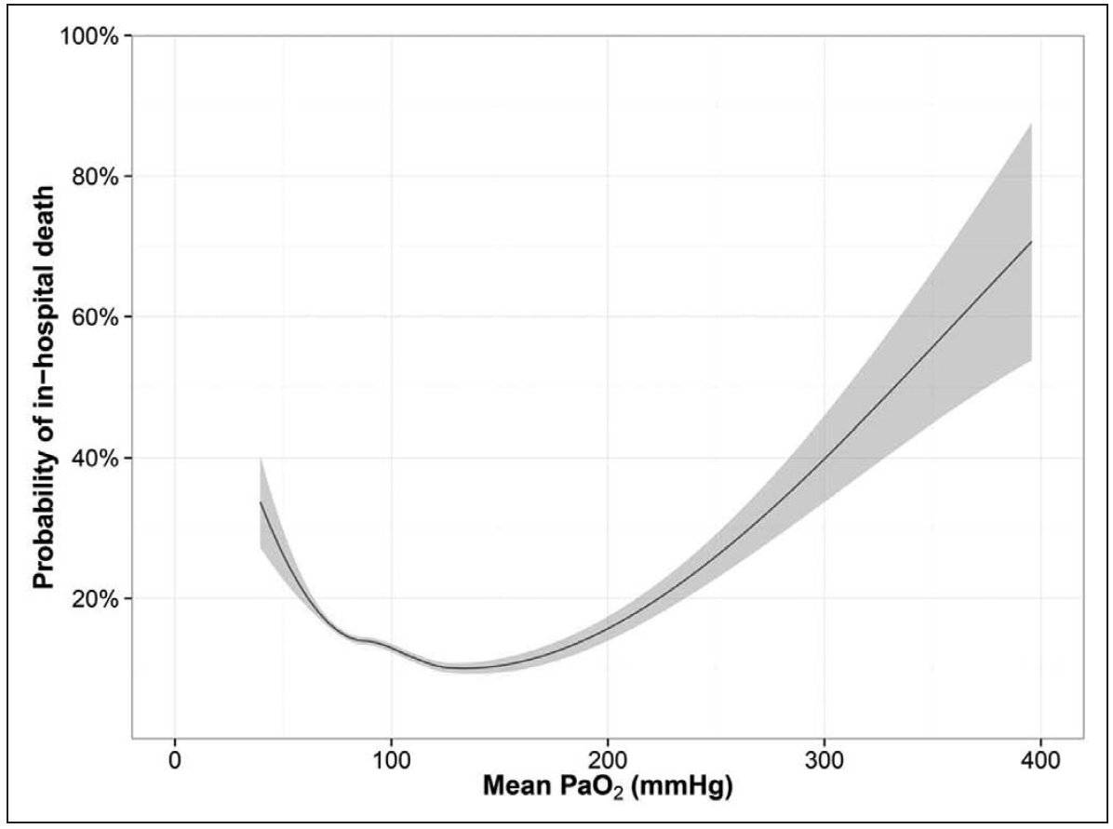
Background
  Hyperoxaemia and mortality
de Jonge et al.; Crit Care. 2008;12(6):R156
Zhang, Z et Ji, X; Sci Rep. 2016 Oct 13;6:35133
Helmerhorst et al; Crit Care Med. 2016 Oct 19. [Epub ahead of print]

Slide 5
Background
  Hyperoxia - adverse reactions
- Increased formation of reactive oxygen species (ROS)^{1,2}
- Hyperoxaemic vasoconstriction^{3,4} → Potential paradox tissue hypoxia⁵
- Absorbtion atelectasis^{6,7,8}
1. Kallet et al; Respir Care 2013 Jan;58(1):123-41
2. Helmerhorst et al; Crit Care 2015 Aug 17;19:284
3. Floyd et al.; J Appl Physiol (1985). 2003 Dec;95(6):2453-61
4. Bak et al.; Acta Physiol (Oxf). 2007 Sep;191(1):15-24
5. Stub et al.; Circulation. 2015 Jun 16;131(24):2143-50.6
6. Rothen et al.; Lancet. 1995 Jun 3;345(8962):1387-91
7. Rothen et al.; Br J Anaesth. 1998 Nov;81(5):681-6
8. Aboab et al.; Intensive Care Med. 2006 Dec;32(12):1979-86

Slide 6
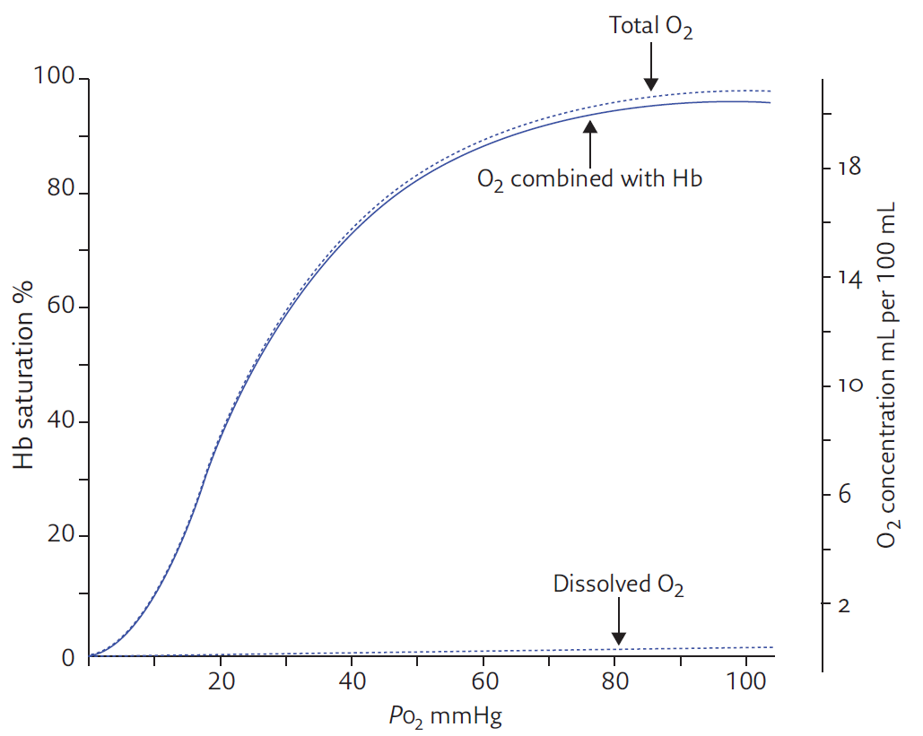
Background
8 kPa
2.7
5.3
8.0
10.7
13.3
PO₂ kPa
1. Collins et al; Breathe 2015 Sep;11(3):194-201

Slide 7
Background
No solid evidence (large RCTs) supports specific targets of oxygenation in patients admitted to the ICU
(this includes patients with COPD and ARDS)
No guidelines exists addressing optimal oxygenation targets for patients admitted to the ICU

Slide 8
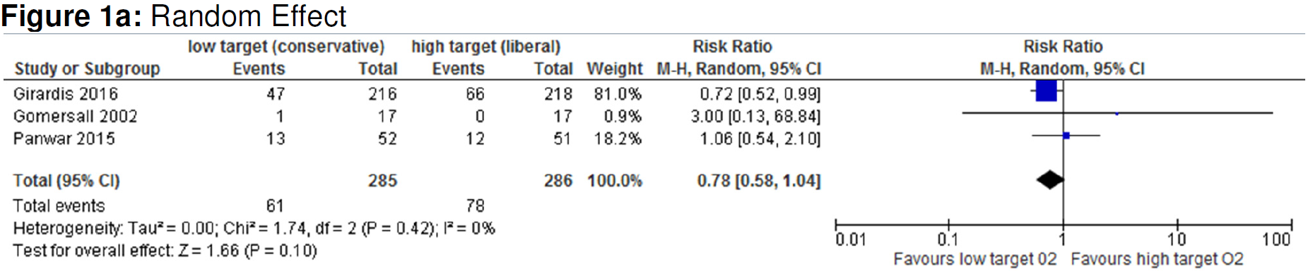
Background
Metaanalysis
Barbateskovic M, Schjørring OL, Jakobsen JC, Meyhoff CS, Dahl RM, Rasmussen BS, Perner A, Wetterslev J; Higher versus lower inspiratory oxygen fraction or targets of arterial oxygenation for adult intensive care patients (Protocol); Cochrane Database of Systematic Reviews 2017, Issue 4

Slide 9
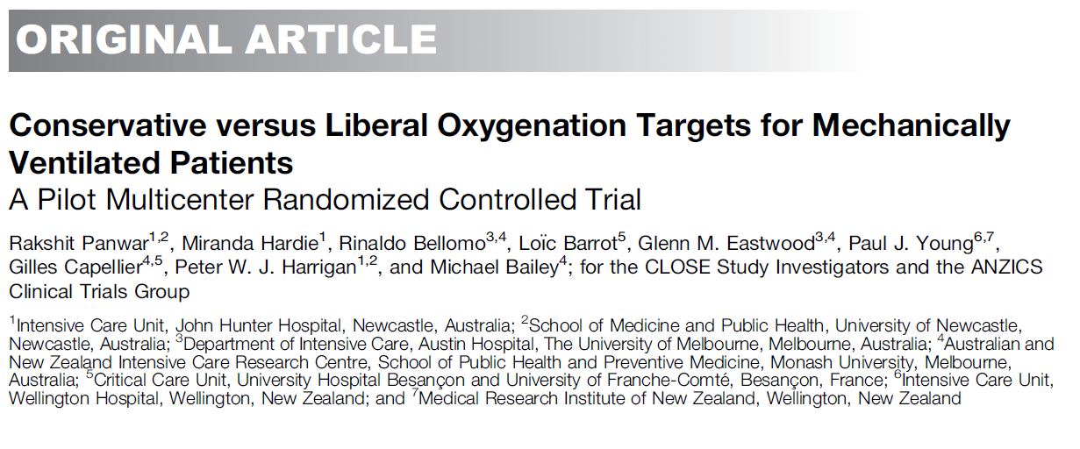
Background
  Pilot trial
- 103 patients, SpO₂ ≥ 96% vs SpO₂ = 88-92%
- No difference in clinical outcome
- Trend towards lower mortality in the conservative group (after adjustment for baseline variables)
Panwar et al; Am J Respir Crit Care Med. 2016 Jan 1;193(1):43-51

Slide 10

Aim
To assess the benefits and harms of two targets of PaO₂ in guiding the oxygen administration in acutely ill adults with hypoxaemic respiratory failure in the ICU
Benefits
Harms
Mortality

Slide 11








Design
Investigator initiated, randomised, outcome-assesment blinded, parallel group trial of two separate PaO₂ targets throughout the ICU admission
Setting: aprox. 50 European ICUs
Start June 2017, Aalborg University Hospital

Slide 12

Design
2928 Patients
Control
Intervention
PaO₂ = 12.0 kPa
PaO₂ = 8.0 kPa
n = 1464
n = 1464
Primary endpoint 90-day mortality (all cause)

Slide 13
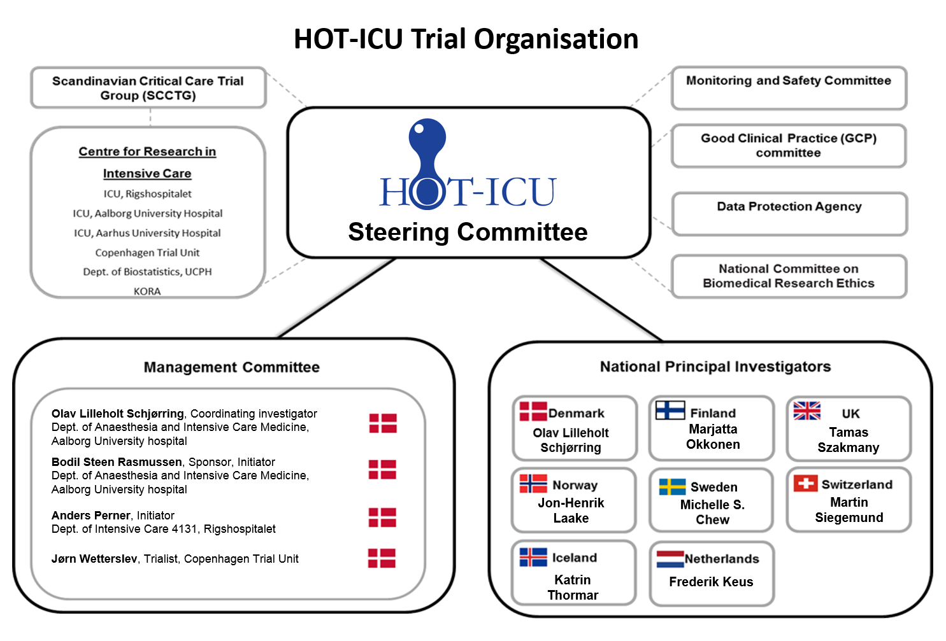
Organisation

Slide 14
Screening - Inclusion Criteria
Acutely admitted to the ICU, and
Aged 18 years or above, and
One of the following:
    Closed system with an FiO₂ ≥ 0.50 (invasive mechanical ventilation, non-invasive ventilation or CPAP)
    Open system with an oxygen flow ≥ 10 litres pr. minute (includes high-flow systems)
    and
Oxygen supplementation in the ICU, expected duration ≥ 24 hours. If in doubt answer ’YES’, and
Intra-arterial catheter in place

Slide 15
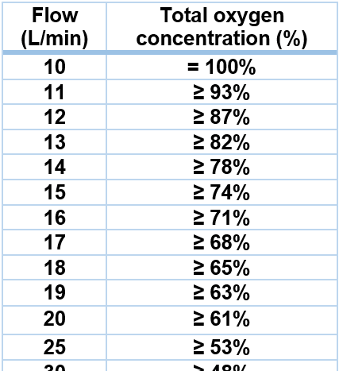
Screening - Inclusion Criteria
  Open systems with automatic mixers:
  eg. certain humidifiers and high-flow systems

Slide 16
Screening - Inclusion Criteria
Acutely admitted to the ICU, and
Aged 18 years or above, and
One of the following:
    Closed system with an FiO₂ ≥ 0.50 (invasive mechanical ventilation, non-invasive ventilation or CPAP)
    Open system with an oxygen flow ≥ 10 litres pr. minute (includes high-flow systems)
    and
Oxygen supplementation in the ICU, expected duration ≥ 24 hours. If in doubt answer ’YES’, and
Intra-arterial catheter in place

Slide 17
Screening
  When a patient fulfils all inclusion criteria within 12 hours from ICU admission, go to
  www.cric.nu/hot-icu
  Where you access the electronic CRF (eCRF)
  Personalised username and password

Slide 18

Screening
  When a patient fulfils all inclusion criteria within 12 hours from ICU admission, go to
  www.cric.nu/hot-icu
  Where you access the electronic CRF (eCRF)
  Personalised username and password

Slide 19
Randomisation
  ALWAYS REMEMBER TO OBTAIN CONSENT FROM THE PRIMARY TRIAL GUARDIAN (‘FØRSTE FORSØGSVÆRGE’) BEFORE RANDOMISATION
  Can initially be orally
  State the full name of the primary trial guardian in the patient’s medical journal
  Informed consent should be obtained as soon as possible from the patient’s next of kin and the second trial guardian

Slide 20
Exclusion criteria
  > 12 hours since ICU admission
  Chronic mechanical ventilation
  Use of home oxygen
  Previous treatment with bleomycin
  Organ transplant during current hospital admission
  Withdrawal from active therapy or brain death deemed imminent
  Fertile woman with positive urine or plasma hCG
  - In all fertile woman < 50 years of age, a negative hCG-test must be
  Carbon monoxide, cyanide or paraquat poisoning

Slide 21
Exclusion criteria
  Methaemoglobinaemia
  Expected use of hyperbaric oxygen therapy
  Sicle cell disease
  Consent not obtainable
  Previously randomised into the HOT-ICU trial

Slide 22
Randomisation
Eligible patients will be randomised automatically to an oxygenation target (PaO₂) of:
8.0 kPa or 12.0 kPa
Prescribe the allocated oxygenation target in the patient’s ICU chart
Write a note of inclusion in the patient’s medical journal stating the allocated oxygenation target

Slide 23
Interventions
The allocated oxygenation target applies throughout the ICU stay to a maximum duration of 90 days
ICU Readmisions within 90 days continue the allocated intervention

Slide 24
Adherence to oxygenation target
FiO₂ is titrated from 0.21 to 1.00 to achieve the allocated PaO₂ in both interventional groups
When the oxygenation is stabilised, the SpO₂ can be used for continous FiO₂ titration

Slide 25
Adherence to oxygenation target
  Procedural oxygen supplementation within the ICU above targets should be restricted to the minimally required (in both groups)
  The oxygenation target should be upheld at all means possible during transportation, radiological examination and surgical procedures

Slide 26
Withdrawal
  A patient can be withdrawn from the trial if:
  Consent is withdrawn or not given
  A suspected unexpected serious adverse reaction (SUSAR) occurs
        Fill in the withdrawal form in the eCRF (www.cric.nu/hot-icu)
        Continue data registration (daily forms) unless consent for this is also withdrawn

Slide 27
SUSAR
Suspected Unexpected Serious Adverse Reaction (SUSAR)
Is defined as an adverse reaction directly related to oxygen which is both serious and unexpected (not described in the summary product characteristics of oxygen - ARDS or atelectasis)
If SUSAR occurs, withdraw the patient from the trial and contact the sponsor or coordinating investigator immediately (hot-icu@cric.nu or +45 2118 2543)
Fill in the SUSAR report form (#14 in the Site Master File) and e-mail it to sponsor: hot-icu@cric.nu

Slide 28
Daily forms
In eCRF at www.cric.nu/hot-icu
An ICU day is defined to be from 06.00h to 06.00h
Daily forms should be fulfilled continuously throughout ICU admission
To note:
12-hour highest and lowest PaO₂ (with SaO₂ and FiO₂)
-Obs. Use specified conversion table to calculate FiO₂ in ‘open systems’
TV, PEEP and P_{peak} every day at 08.00h (if mechanically ventilated)

Slide 29
Discharge, transfer and death
When a patient is discharged from the ICU or dies within the ICU, complete the Discharge and Readmission form at www.cric.nu/hot-icu

Slide 30
90-day follow up
Complete the 90-day follow-up form at www.cric.nu/hot-icu
Mortality (including date of death)
Discharge from hospital (date of discharge)
Readmission to hospital (days readmitted within the 90-day period)
Use of dialysis within the regular ward?

Slide 31
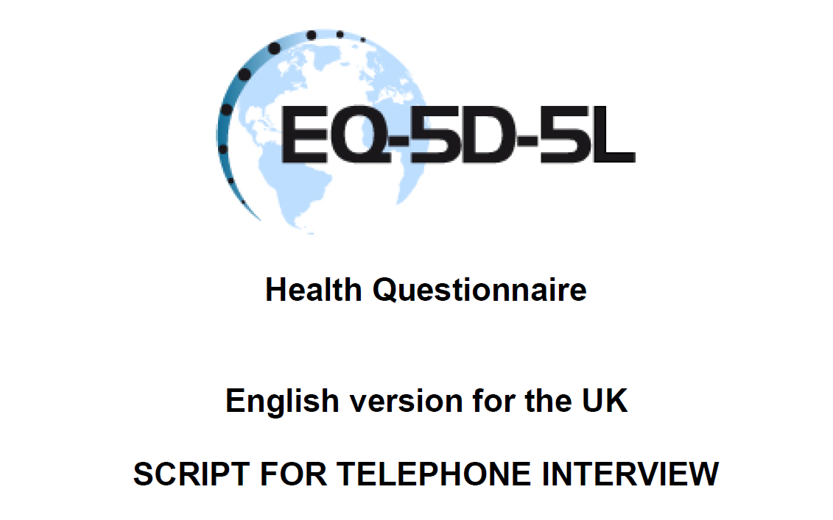
One-year follow up
Complete the one-year follow-up form at www.cric.nu/hot-icu
Mortality (Drawn from the CPR registry in Denmark)
EuroQoL (EQ-5D-5L + EQ-VAS)
RBANS (Cognitive function score) in selected sites

Slide 32

Trial Documents
www.cric.nu/hot-icu

Slide 33
Contact
  Do you need help?
  Call the HOT-ICU hotline at:
+45 2118 2543
Available 24/7
or
hot-icu@cric.nu

Slide 34

Thank you
hot-icu@cric.nu
www.cric.nu/hot-icu

