Slide 1


Agents Intervening against Delirium in the Intensive Care Unit (AID-ICU)
Nina Christine Andersen-Ranberg (coordinating investigator)
Lone Musaeus Poulsen (sponsor)
Department of Anaesthesiology and Intensive Care Medicine
Zealand University Hospital, Koege
Email: aid-icu@cric.nu
www.cric.nu/aid-icu

Slide 2

Delirium in the Intensive Care Unit
Critically ill patients are at risk of developing delirium during ICU stay
incidence: 32-84%^{1,2}
Delirium is associated with:
      Increased morbidity^{3,4}
      Increased days on mechanical ventilation
      Longer hospital admittances
      Long-term cognitive impairment
      Long-term disability
      Higher cost of care
      And is an independent predictor of mortality⁵
Delirium is expensive to the individual and society
1) Salluh, J.I., et al., Outcome of delirium in critically ill patients: systematic review and meta-analysis. BMJ, 2015. 350: p. h2538.
2) Brummel, N.E., et al., Delirium in the ICU and subsequent long-term disability among survivors of mechanical ventilation. Crit Care Med, 2014. 42(2): p. 369-77.
3) Pandharipande, P.P., et al., Long-term cognitive impairment after critical illness. N Engl J Med, 2013. 369(14): p. 1306-16.
4) Lat, I., et al., The impact of delirium on clinical outcomes in mechanically ventilated surgical and trauma patients. Crit Care Med, 2009. 37(6): p. 1898-905.
5) Ely, E.W., et al., Delirium as a predictor of mortality in mechanically ventilated patients in the intensive care unit. JAMA, 2004. 291(14): p. 1753-62.

Slide 3
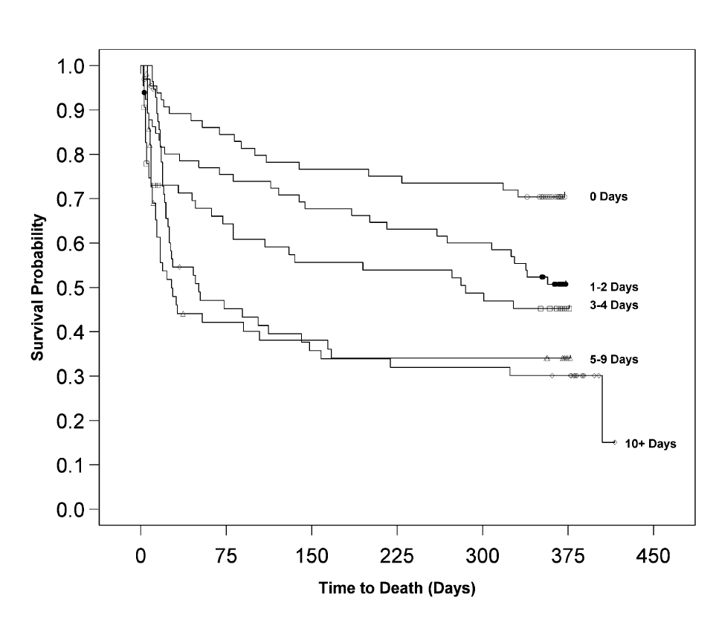
Delirium and mortality
Kaplan-Meier survival curve for 1-year mortality post-intensive care unit (ICU) admission (ICU delirium days predictor).
Pisani, Kong, Kasl, et al.: Delirium and Mortality in Older ICU Patients. American Journal of respiratory and critical care 2009.

Slide 4
Current guidelines
The Danish society of Anaesthesiology and Intensive Care Medicine
The Intensive Care Society in the UK
German guidelines
Haloperidol
Olanzapin
Risperidon
The American College of Critical Care Medicine and the Society of Critical Care Medicine (USA)
No evidence of haloperidol
Olanzapin may reduce delirium duration

Slide 5

Aim of the AID-ICU trial
To assess the benefits and harms of haloperidol treatment in critically ill adults with delirium
Benefits
Harms
Mortality

Slide 6
Methods
Design: Investigator-initiated, randomised multicentre placebo-controlled clinical trial with blinding
Setting: approx. 25 ICUs in Europe
Population: Adult ICU patients with diagnosed delirium
Start June 2018, Zealand University Hospital Køge

Slide 7
Design
1000 patients
Intervention
Control
Haloperidol 2.5mg x 3 daily
Placebo: isotonic saline
Primary outcome: Days alive out of the hospital within 90 days

Slide 8
Delirium screening is essential!
Screening for delirium twice daily should be implemented as standard care
  1 time during the morning shift
  1 time during the evening shift
Screen with validated screening tool → CAM-ICU or ICDSC
When a patient is diagnosed with delirium → check if the patient comply with inclusion criteria.

Slide 9
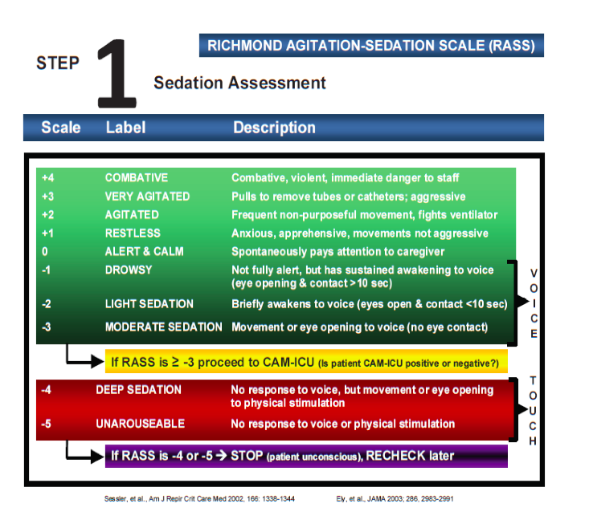
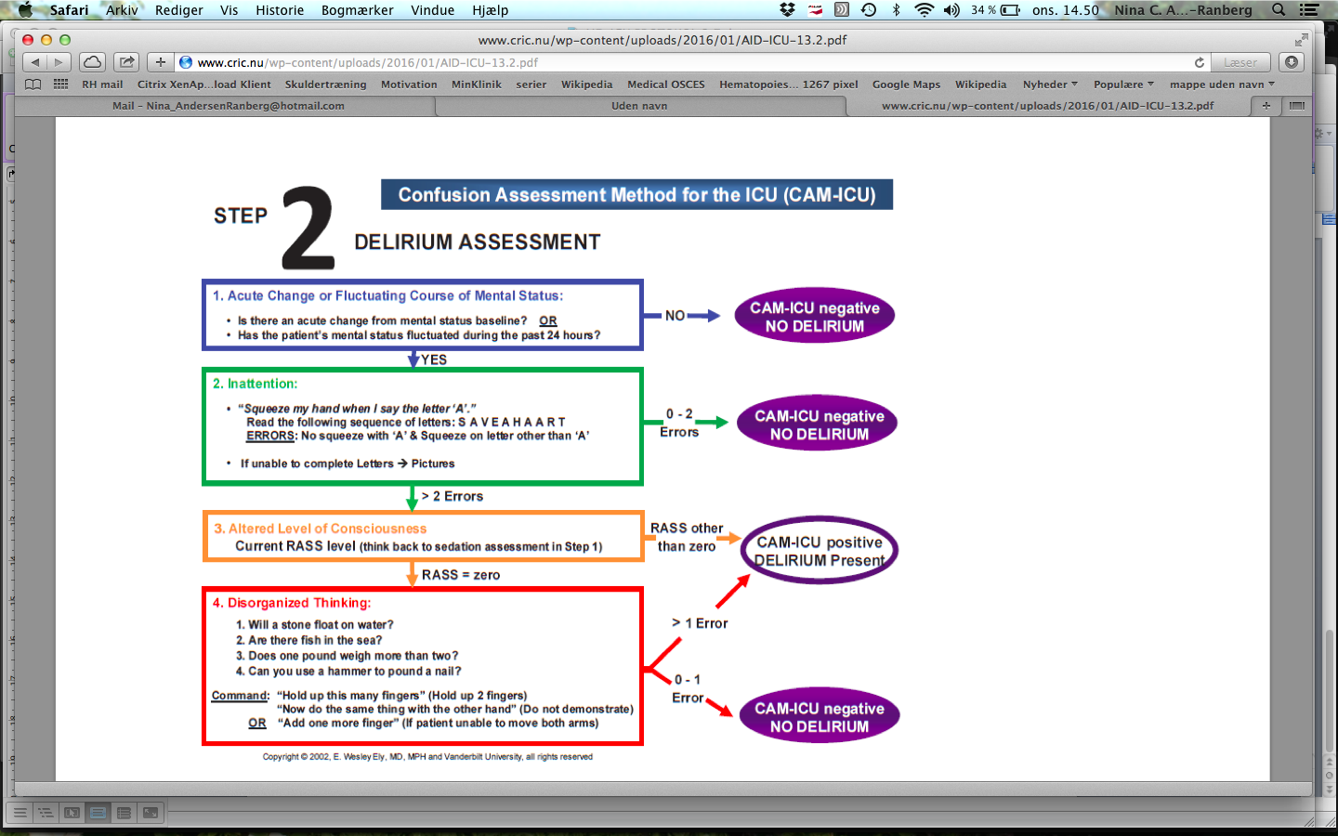
CAM-ICU

Slide 10
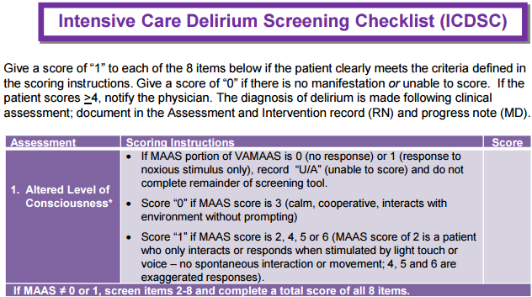
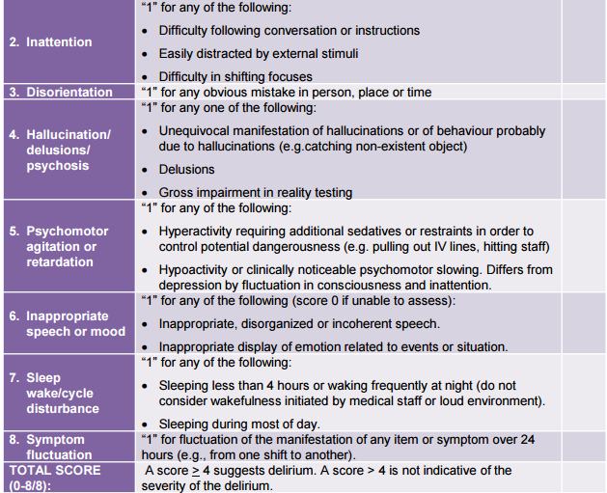
ICDSC

Slide 11
Inclusion criteria
Acute (unplanned) admission to the ICU
Aged 18 years or above
Diagnosed delirium with validated screening tool (CAM-ICU, ICDSC)
All patients that fulfil inclusion criteria are screened for inclusion in the AID-ICU database. If the patient fulfil one or more exclusion criteria this is registered in the screening process and the patient is not included

Slide 12
Exclusion criteria
Contraindications to haloperidol
Habitual treatment with any antipsychotic medication or treatment with antipsychotics in the ICU prior to inclusion
Permanently incompetent (e.g. dementia, metal retardation)
Delirium assessment non-applicable (language barriers, blind, deaf)
Withdrawal from active therapy or brain death
Fertile women (<50 years) with positive urine hCG or plasma hCG
Patients under coercive measures by regulatory authorities
Patients with alcohol induced delirium (delirium tremens)
Consent unobtainable according to national regulations

Slide 13
Interventions
Acute ICU admittance
Positive for delirium
Delirium screening x 2 daily
Screening
Haloperidol 2.5 mg (0.5ml) x 3
Does not meet exclusion criteria
Randomisation
Placebo: NaCl 0.5 ml x 3
P.n. haloperidol/placebo to a total of 20 mg daily
(5 additional administrations)
Escape medicine:
Propofol sedation, benzodiazepines and dexmedetomidine/α2-agonist

Slide 14
Pausing and stopping
Pausing criteria: 2 consecutive negative delirium scores in the same day
OR unexplained coma (and all other relevant medication stopped)
Stopping criteria:
Discharge from the ICU
Transfer to another ICU (non AID-ICU trial site)
Maximum of 90 day intervention period
Death

Slide 15
Administration of trial medicine
Dispensed from the database with a common login
Packs of 3 vials, all of which are used for a single patient
Extra packs can be drawn as needed
Educational material is available from www.cric.nu/aid-icu

Slide 16
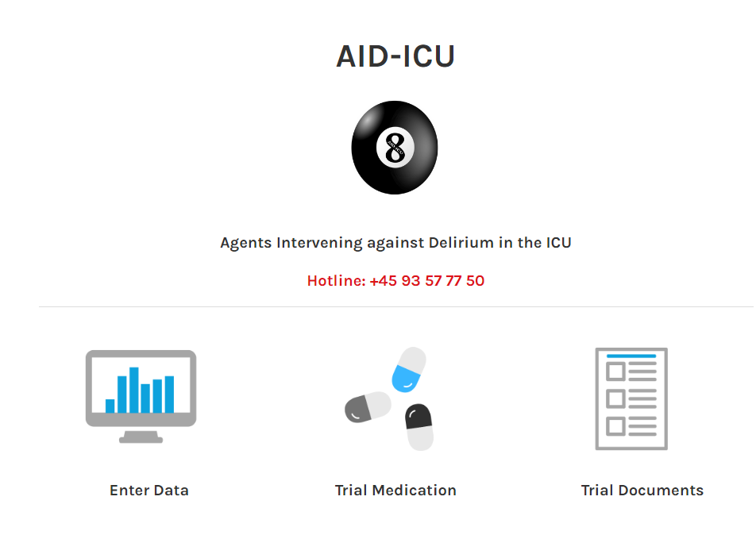
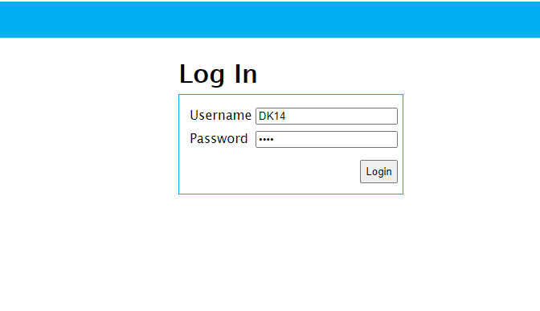
Administration of trial medicine
Go to www.cric.nu
Click on AID-ICU trial
Click on Trial Medication
Common login with site ID and password

Slide 17
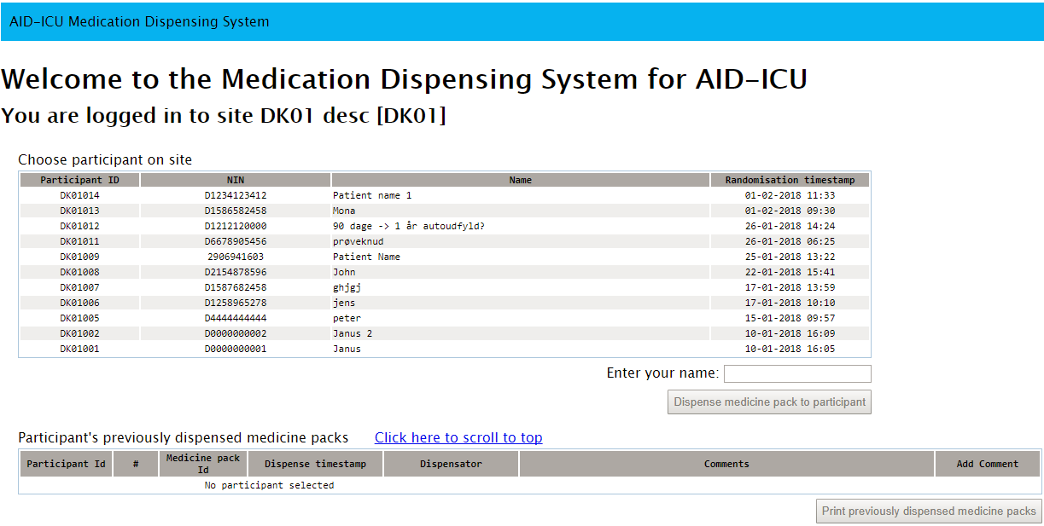
Administration of trial medicine

Slide 18
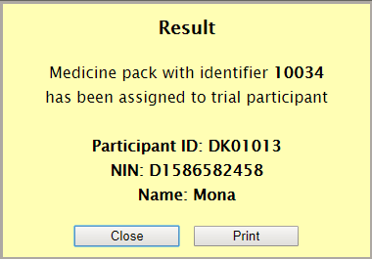
Administration of trial medicine

Slide 19
Withdrawal
A patient can be withdrawn from the trial if:
  Consent is withdrawn or not given
  The patient experiences intolerable adverse reactions (including SAR and SUSAR) suspected to be related to the trial intervention.
  Clinicians discretion in conjunction with the coordinating investigator decide it is in the patient’s interest
  The patient after inclusion is subject to involuntary hospitalization (coercive measures)
  The patient after inclusion experiences QTc prolongation.
        Fill in the withdrawal form in the eCRF (www.cric.nu/aid-icu)
        Continue data registration (daily forms) unless consent for this is also withdrawn

Slide 20
90-day follow-up
www.cric.nu/aid-icu
Mortality (including date of death)
Discharge from hospital (date of discharge)
Readmission to hospital (days readmitted within the 90-day period)

Slide 21
One-year follow-up
www.cric.nu/aid-icu
Mortality (also drawn from the CPR registry in Denmark)
EuroQoL (EQ-5D-5L + EQ-VAS)
RBANS (Cognitive function score) at selected sites

Slide 22
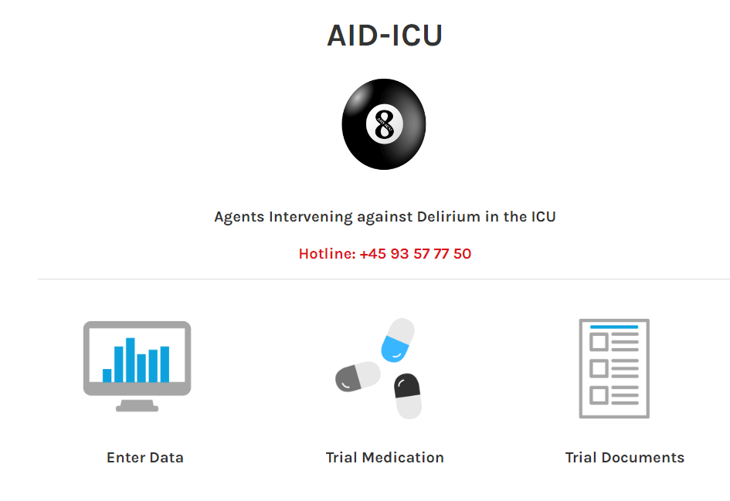
Trial documents
www.cric.nu/aid-icu

Slide 23
Contact
  Do you need help?
  Call the AID-ICU hotline at:
+45 9357 7750
Available 24/7

Slide 24
Thank you!
AID-ICU@CRIC.NU
WWW.CRIC.NU/AID-ICU

