Slide 1

Goal directed fluid removal with furosemide in intensive care patients with fluid overload – A randomised, blinded, placebo-controlled trial (GODIF)
Trial medication dispensing
9c_Presentation_trial_medication_dispensing_V1.1_03.01.2022
Sine Wichmann(coordinating investigator)
Intensive care unit
Nordsjællands hospital, Hillerød, DK
godif@cric.nu
www.cric.nu/godif

Slide 2

Trial drug
The patient is included in GODIF trial
You want to get trial drug for your patient
Go to the homepage www.cric.nu/godif/

Slide 3

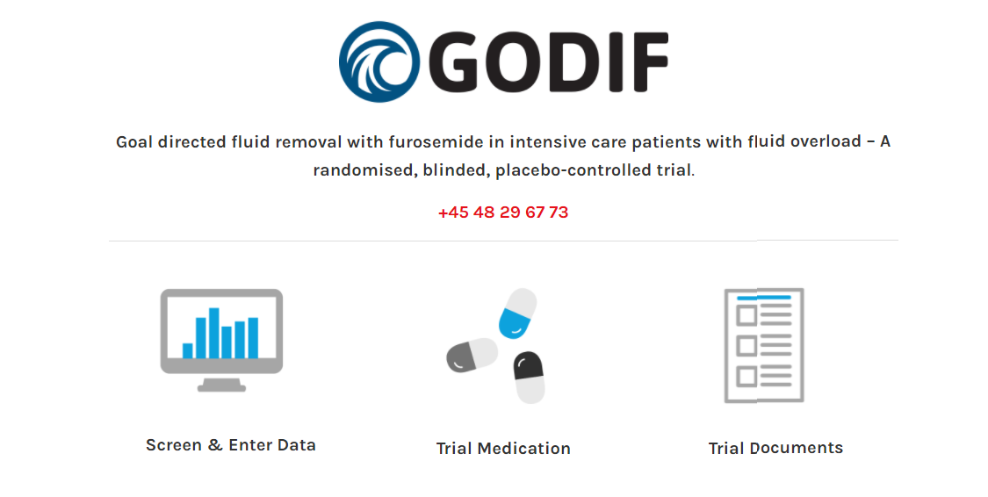
www.cric.nu/godif/

Slide 4

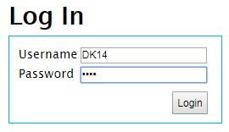
  Log in
Use the department’s common username and password

Slide 5

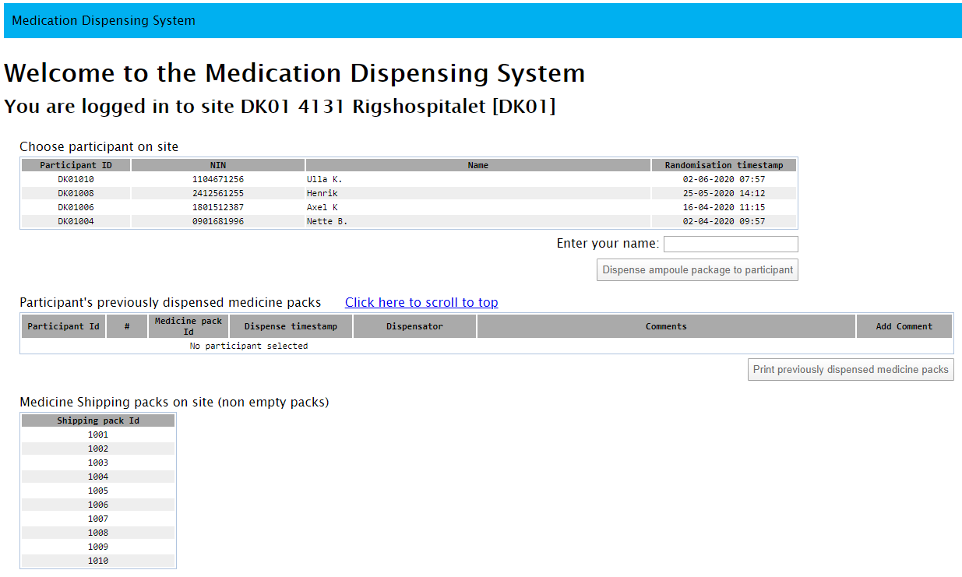
How to get trial drug for your patient
Mark the participant by clicking on the name/ID of your participant

Slide 6

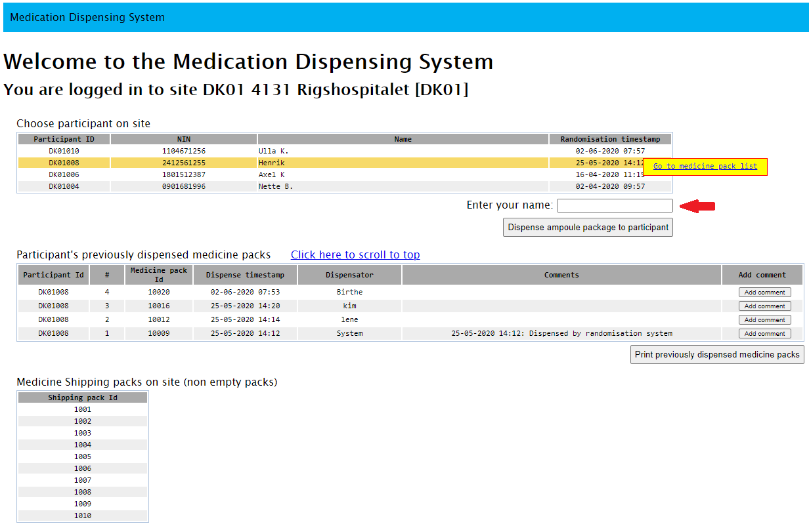
How to get trial drug for your patient
2. Write your name ind the box

Slide 7
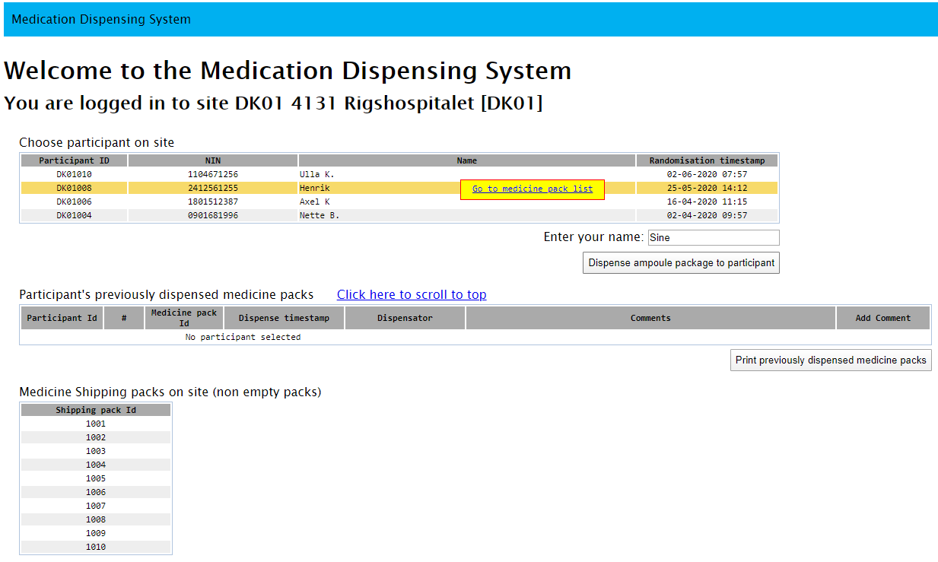
How to get trial drug for your patient
3. Click ‘Dispense ampoule package to participant’

Slide 8

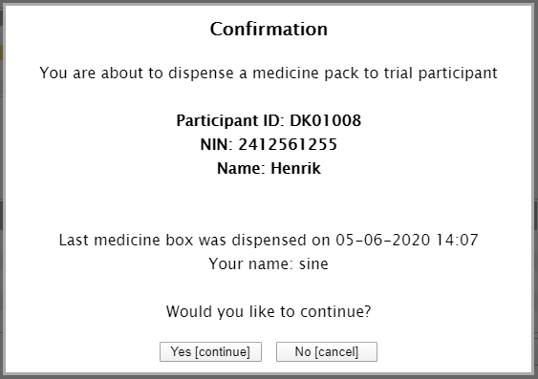
Confirm

Slide 9
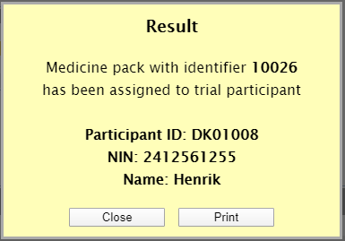
Vial ID of the allocated vial/ampoule
Find the allocated vial/ampoule and administer the trial drug according to protocol
You can print this result with the unique vial ID for the patient (if you need it)

Slide 10

Problem 1
  You find an ampoule with GODIF medicine by the computer.
  You want to check if the medicine is allocated for your patient.

Slide 11

You can look up all allocated vials/ampoules
Mark the relevant patient and click on the line

Slide 12

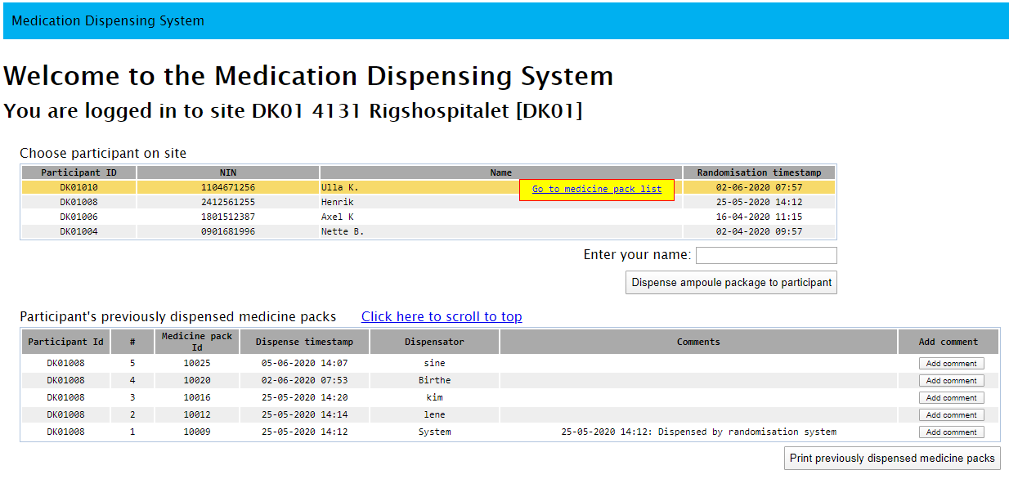
Former allocated ampoules/vials
A list of vials/ampoules allocated your patient can be seen in this list below.
You can choose to print the list

Slide 13

Click ‘Add comment’ if you experience problems
If you experience a problem with an ampoule e.g. one breaks, one cannot be found etc. You can write a comment for the ampoule in question. You can dispense a new ampoule when ever needed.

Slide 14

Summary
Trial drug must be dispensed online at www.cric.nu/godif/
Log in with your department’s username and password
Mark the patient, write your name, click ”Dispense ampoule package to participant”
When needed more ampoules can be dispensed
Add a comment if you experience a problem

