Slide 1

Stress Ulcer Prophylaxis in the Intensive Care Unit (SUP-ICU)
Background
Søren Marker Jensen
Dept. of Intensive Care 4131
Copenhagen University Hospital Rigshospitalet, Denmark
soeren.marker.jensen.01@regionh.dk
www.sup-icu.com

Slide 2

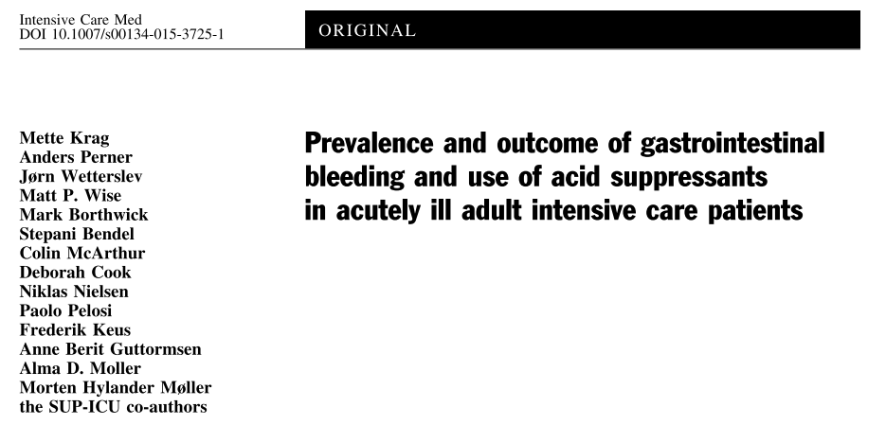
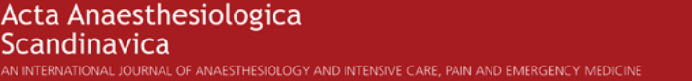
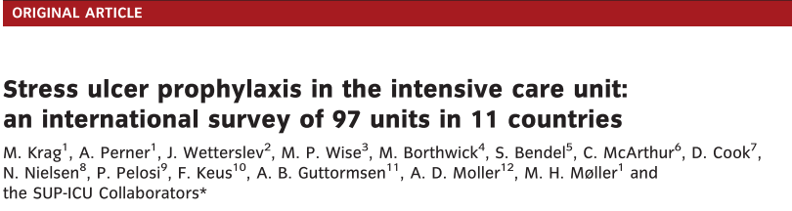
Background
  Critically ill patients are at risk of gastrointestinal (GI) bleeding
  Stress ulcer prophylaxis (SUP) is recommended and widely used

Slide 3
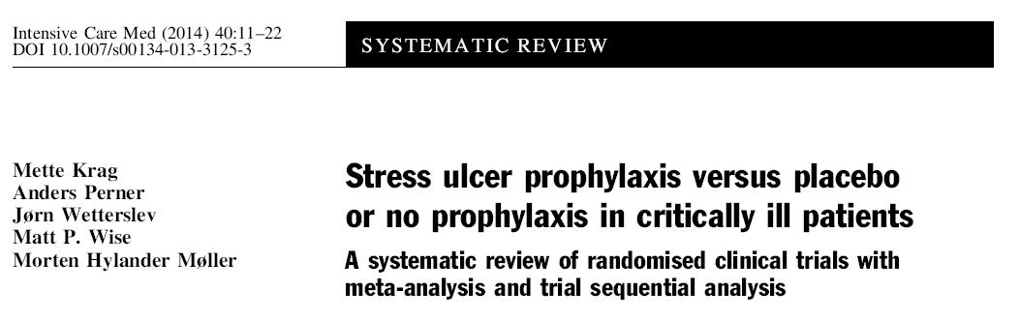
Background
  Conclusion from a systematic review with meta-analysis:
  Low quality and quantity of evidence supporting the use of SUP in adult ICU patients

Slide 4
Background
  There is a lack of evidence of SUP reducing the risk of GI bleeding in critically ill patients in the intensive care unit
  Increased risk of pneumonia, clostridium difficile infection and cardiovascular events has been suggested

Slide 5


Aim of the SUP-ICU trial
To assess the benefits and harms of SUP in critically ill adult patients
Potential benefit
GI bleeding
Potential harm
Pneumonia
Clostridium difficile
Cardiovascular events
Mortality

Slide 6
Methods
Design: randomised multicentre placebo-controlled clinical trial with blinding
Setting: 50 ICUs in Europe
Population: Adult ICU patients (n=3350) with risk factors for GI bleeding

Slide 7
Inclusion criteria
Acute (unplanned) admission to the ICU
Aged 18 years or above
One or more of the following risk factors:
    Shock (continuous infusion with vasopressor or inotrope, mean arterial blood pressure < 70 mmHg, systolic blood pressure < 90 mmHg or lactate > 4 mmol/l)
    Acute or chronic intermittent or continuous renal replacement therapy
    Invasive mechanical ventilation which is expected to last > 24 hours. When in doubt of the forecast, the patient should be enrolled
    Coagulopathy (platelets < 50 x 10^9/l, INR > 1.5 or PT > 20 seconds)
    Ongoing treatment (not prophylaxis) with anticoagulant medication
    History of coagulopathy (platelets < 50 x 10^9/l or INR > 1.5 or PT > 20 seconds within 6 months prior to this hospital admission)
    History of chronic liver disease (history of portal hypertension, variceal bleeding or hepatic encephalopathy or cirrhosis proven by biopsy, CT scan or ultrasound)

Slide 8

Exclusion criteria
  Contraindications to PPI (including intolerance of PPI and treatment with atazanavir (HIV medication))
  Current daily treatment with PPI and/or H2RA
  GI bleeding of any origin during current hospital admission
  Diagnosed with peptic ulcer during current hospital admission
  Organ transplant during current hospital admission
  Withdrawal from active therapy or brain death
  Fertile woman with positive urine human chorionic gonadotropin (hCG) or plasma-hCG
  Consent according to national regulations not obtainable

Slide 9
Methods
Intervention: Pantoprazole 40 mg x 1 (10 ml) intravenously from randomisation until discharge from ICU or death (maximum 90 days)
Comparator: Placebo (sterile vial added 10 ml of sodium chloride 0.9%)
Primary outcome: 90-day mortality (please find rationale for this choice in the protocol)
Status: Recruiting from October 2015

Slide 10
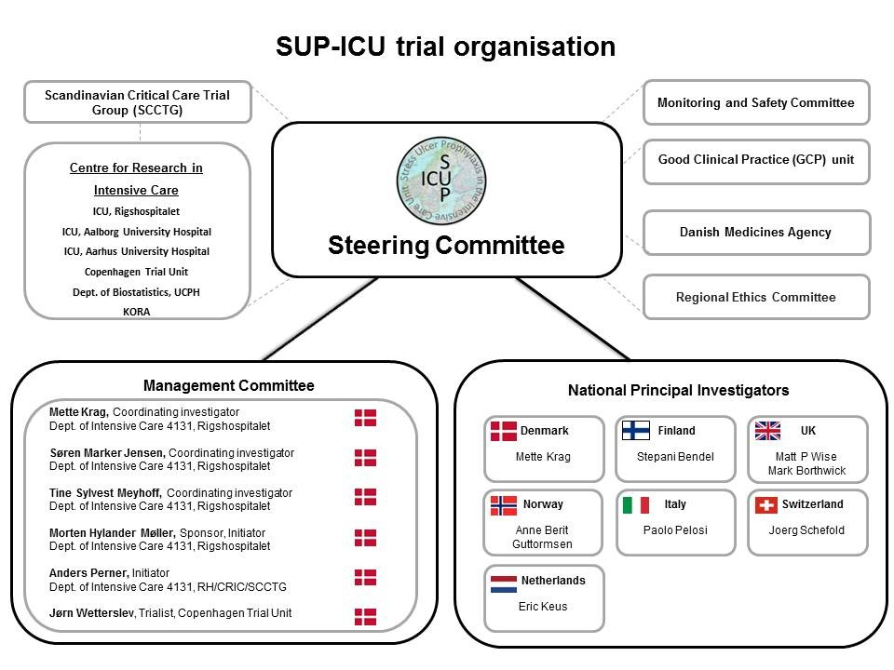
Trial organisation

Slide 11
Contacts
Søren Marker Jensen, MD, coordinating investigator
Dept. of Intensive Care 4131
Copenhagen University Hospital Rigshospitalet, Denmark
Phone: +45 3545 7450 (available 24/7)
E-mail: soeren.marker.jensen.01@regionh.dk
Morten Hylander Møller, MD, PhD, sponsor
Dept. of Intensive Care 4131
Copenhagen University Hospital Rigshospitalet, Denmark
Phone: +45 3545 8685
E-mail: mortenhylander@gmail.com
www.sup-icu.com

