Slide 1

Stress Ulcer Prophylaxis in the Intensive Care Unit (SUP-ICU)
Screening and randomisation
Mette Krag
Dept. of Intensive Care 4131
Copenhagen University Hospital Rigshospitalet, Denmark
contact@sup-icu.com
www.sup-icu.com

Slide 2

Screening

Slide 3
Screening
  All adults acutely admitted to the ICU with one or more risk factors (inclusion criteria) should be screened for inclusion

Slide 4
Screening
  Always remember to obtain consent according to your national regulations before randomisation!

Slide 5
Inclusion criteria
Acute (unplanned) admission to the ICU
Aged 18 years or above
One or more of the following risk factors:
    Shock (continuous infusion with vasopressor or inotrope, mean arterial blood pressure < 70 mmHg, systolic blood pressure < 90 mmHg or lactate > 4 mmol/l)
    Acute or chronic intermittent or continuous renal replacement therapy
    Invasive mechanical ventilation which is expected to last > 24 hours. When in doubt of the forecast, the patient should be enrolled
    Coagulopathy (platelets < 50 x 10^9/l, INR > 1.5 or PT > 20 seconds)
    Ongoing treatment (not prophylaxis) with anticoagulant medication
    History of coagulopathy (platelets < 50 x 10^9/l or INR > 1.5 or PT > 20 seconds within 6 months of this hospital admission)
    History of chronic liver disease (history of portal hypertension, variceal bleeding or hepatic encephalopathy or cirrhosis proven by biopsy, CT scan or ultrasound)

Slide 6
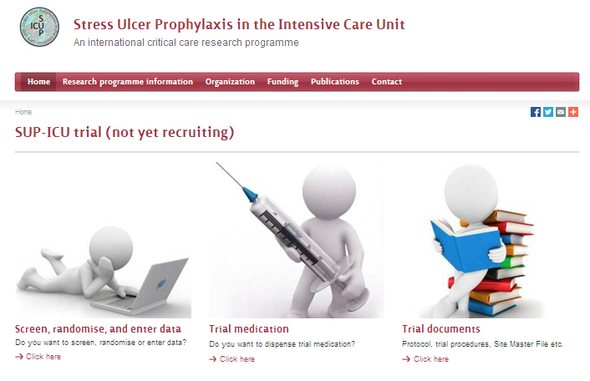
Go to www.sup-icu.com

Slide 7

Login

Slide 8
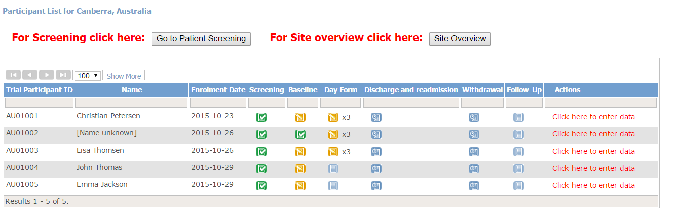
Click ‘Go to patient screening’
Even if you know one or more exclusion criteria are met, please always complete the screening form (if the patient fulfils the inclusion criteria)

Slide 9
Exclusion criteria
  Contraindications to PPI (including intolerance of PPI and treatment with atazanavir (HIV medication))
  Current daily treatment with PPI and/or H2RA
  GI bleeding of any origin during current hospital admission
  Diagnosed with peptic ulcer during current hospital admission
  Organ transplant during current hospital admission
  Withdrawal from active therapy or brain death
  Fertile woman with positive urine human chorionic gonadotropin (hCG) or plasma-hCG
  Consent according to national regulations not obtainable

Slide 10
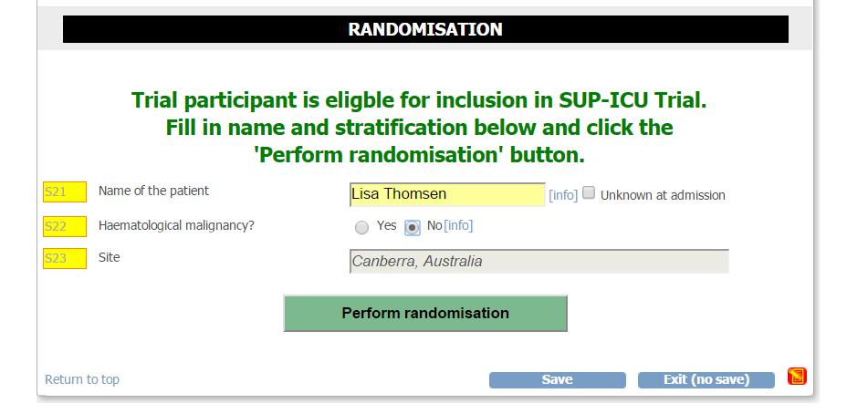
Randomise
Red text if the patient is not eligible for inclusion

Slide 11
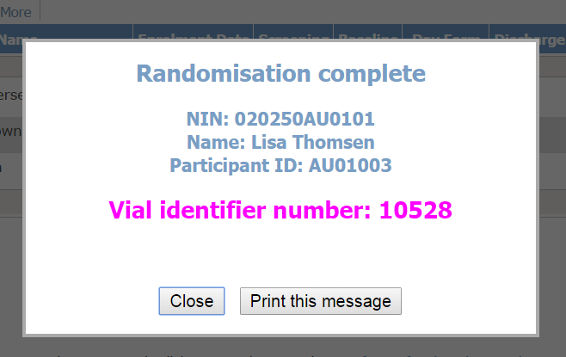
Option to print the vial identifier number

Slide 12
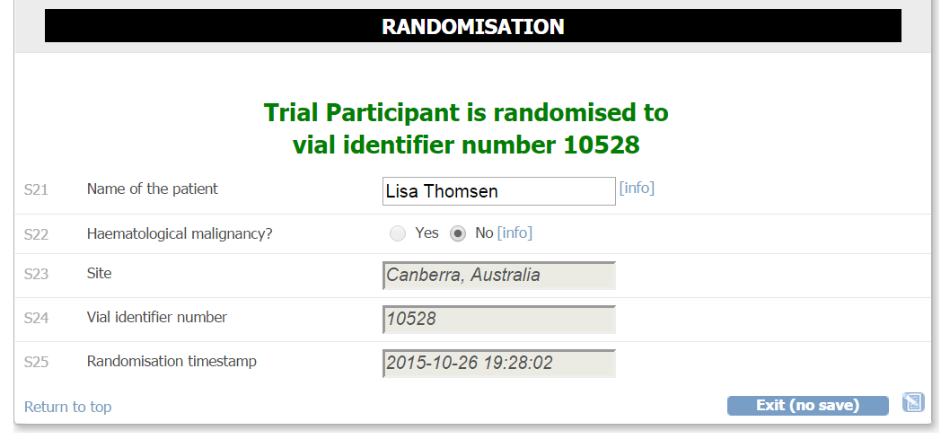
Vial identifier number
The vial identifier number is shown in the screening form
You can also find the vial identifier number by opening the email send to the email account used when signing up
Notes:
Man kan ect screene senere under indlæggelsen

Slide 13
Prescribe and administer
  Prescribe the trial medication for the patient once daily in your medical chart/ICU chart
  Administer the trial medication by adding 10 ml of sodium chloride 0.9% to the vial (see the trial document ‘Trial medication’)

