Slide 1
Stress Ulcer Prophylaxis in the Intensive Care Unit (SUP-ICU) Data entry
Søren Marker Jensen, MD, coordinating investigator
Dept. of Intensive Care, Rigshospitalet
soeren.marker.jensen.01@regionh.dk
www.sup-icu.com

Slide 2
Data entry

Slide 3
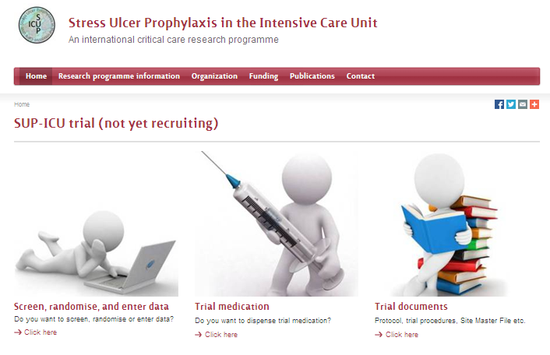
Go to www.sup-icu.com

Slide 4
Log in
Enter your personal credentials.
If you have not received your credentials, please send an email to soeren.marker.jensen.01@regionh.dk

Slide 5
Front page – 3 options
1. Screening and randomisation
2. Site overview
ICONS:
Not started, data entry not possible (day forms, follow-up form)
Form is scheduled. In this state data entry is possible if necessary (discharge/withdrawal)
Data entry possible/started but incomplete
Completed
3. Go to ‘participant details’ for data entry

Slide 6
1. Front page – screening
For more information, please see the presentation about screening and randomisation

Slide 7
2. Front page – site overview

Slide 8
Site overview
Click the participant ID to highlight the row
Point at (without clicking) to see start and end date of the form
Click to enter the incomplete form

Slide 9
3. Front page – data entry
Press the link to go to ‘participant details’ and data entry in forms.

Slide 10
Participant details
Option to
1. Enter data
2. View data (read only)
3. Edit already submitted data (Administrative edit)
3
2
1

Slide 11
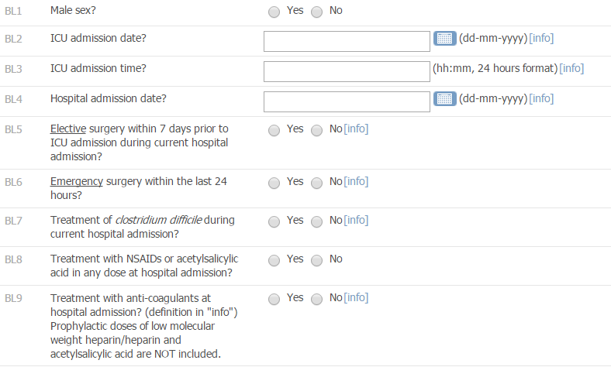
Data entry – general information
Please always read the info box
Date format is dd-mm-yyyy
Time format is 24 hours hh:mm
2
1
3

Slide 12
Data entry – general information
At the bottom of each form you will have the opportunity to:
Exit (no save)
Use this bottom if you have entered the form without changing data
Save entered information
This will only be an option when data has been entered
Submit the form
This will only be an option when the form is complete

Slide 13
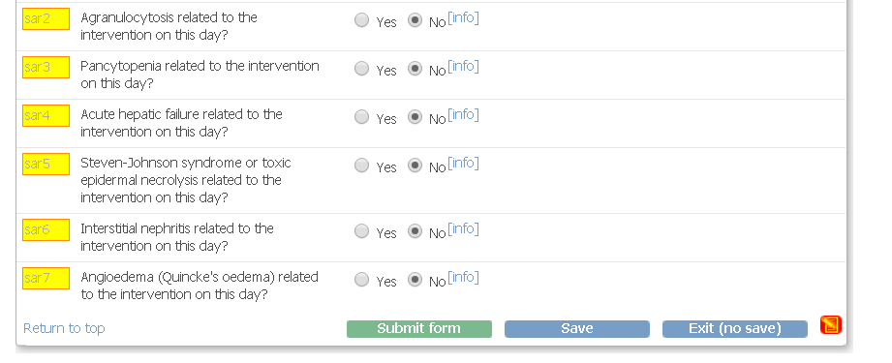
Data entry – general information

Slide 14
Data entry – general information
IMPORTANT!!
‘SUBMIT’ is only possible in a complete form.
Icons at the participant list and in the overview will turn green when a complete form has been submitted.
If the form is complete and only saved the icon will be still be yellow .

Slide 15
Data entry – unobtainable data
In some of the questions you will have the opportunity to check the ‘unobtainable’ box.

Slide 16
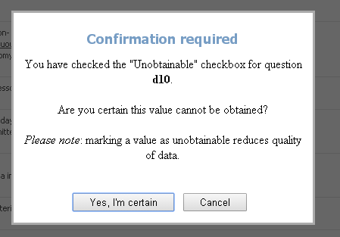
Data entry – unobtainable data
Missing data will reduce the quality of data and we kindly ask you to confirm that the information requested is unobtainable before checking this box.

Slide 17
Day form
The first day form will be available when the day starts in your department e.g. 6 AM (decided by the local investigator)
Hereafter a day form is generated once a day (maximum 90 days)
The first and last day form will often be less than 24 hours

Slide 18
Day form
Questions turn yellow when complete. Makes it easy to find an incomplete question

Slide 19
Bleeding form
I ‘YES’ in b1 additional questions about the bleeding has to be answered.

Slide 20
Day form - SARs
Every day serious adverse reactions (SARs) have to be recorded as part of the day form (7 questions).
To be considered a SAR the event has to be related to the trial medication!
If a SAR occurs please report the SAR to the coordinating centre within 24 hours (see the trial document ‘Instructions - SAR/SUSAR’) or the SAR/SUSAR presentation

Slide 21
Day form
Remember: if a day form does not turn green in the overview despite it is complete, please make sure the form has been submitted (and not just saved).

Slide 22
Discharge/readmission form
When the patient is discharged from the ICU or dies in the ICU, please complete the discharge/readmission form
As this form is an ongoing form, it will not turn green unless the patient dies.
The form can only be saved – submit is not an option!!!
Completing this form will stop the generation of day forms and remove the patient from the list of active participants in the medication dispensing system

Slide 23
Discharge/readmission form
TIP:
If you enter data retrospectively and the patient has been discharged or is dead it may be advantageous to complete this form before day forms, as the system will remove irrelevant day forms

Slide 24
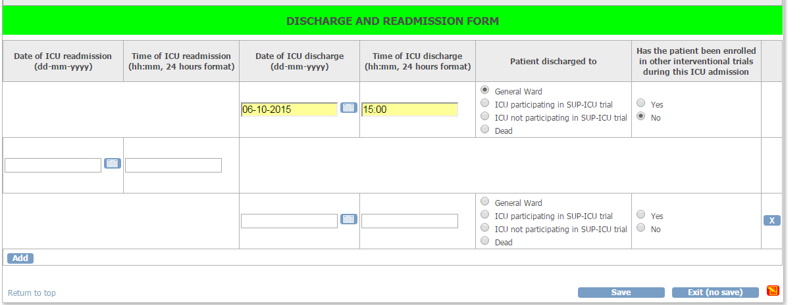
Readmission
If a patient is readmitted to the ICU go to the discharge/readmission form again and click ‘add’. This will generate a new row.
Please complete date and time for readmission.
If an additional row by accident is generated, please remove it by clicking the X in the right side.

Slide 25
Readmission
If PPI or H2RA has been prescribed in the ward, please consider the indication:
If the withdrawal form is completed the patient will be removed from the medication dispensing system.
Please continue daily data collection.
If there is a clinical indication to continue treatment with PPI/H2RA, please complete the withdrawal form
If the clinical decision is to discontinue PPI/H2RA at ICU admission, please continue trial medication

Slide 26
Transferral of patients
Patients transferred from/to other ICUs
ICUs not participating in SUP-ICU:
If a patient is transferred to your ICU please screen the patient for inclusion in SUP-ICU.
If you transfer a patient to another ICU not participating in SUP-ICU the patient will be regarded discharged from ICU. Please complete the discharge form. Follow-up still has to be completed at day 90.
ICUs participating in SUP-ICU:
If a patient is transferred from your ICU, the patient will be moved to a ‘transferral site’ in the system accessible by you and the receiving department. Please complete all forms soon as possible. Hereafter the patient will be moved to the receiving department. Please inform the receiving department that the patient participates in the SUP-ICU trial.
If a patient is transferred to your ICU and has not been transferred in the electronic system, please contact the coordinating centre soon as possible.

Slide 27
Withdrawal
The patient can be withdrawn from the trial for the following reasons:
Indication for treatment with open label PPI/H2RA
Clinical decision other than the above mentioned
SAR/SUSAR
Consent not given or withdrawn
Please complete the
withdrawal form
Daily allocation of trial medication will be stopped. Please continue completing day forms.
If consent is withdrawn from further registration of data please mark this in the withdrawal form. Allocation of trial medication will be stopped and day forms will no longer be generated. Otherwise day forms will continue to be generated.

Slide 28
Follow-up
Ninety days after randomisation the follow-up form will be activated.
If the patient dies in the ICU and this is marked in the discharge form, the follow-up form will automatically be completed.

