Slide 1
Stress Ulcer Prophylaxis in the Intensive Care Unit (SUP-ICU) Withdrawal
Mette Krag
Dept. of Intensive Care 4131
Copenhagen University Hospital Rigshospitalet, Denmark
contact@sup-icu.com
www.sup-icu.com

Slide 2
Withdrawal
A patient can be withdrawn from the trial of the following reasons:
Indication for treatment with PPI/H2RA
Clinical decision other than above mentioned
SAR/SUSAR
Withdrawal of consent

Slide 3
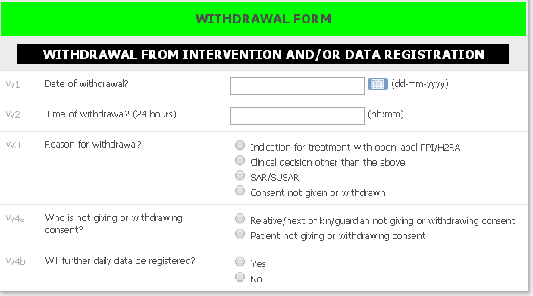
Withdrawal
If the patient is withdrawn from the trial, please complete the withdrawal form

Slide 4
Withdrawal
After completing the withdrawal form the patient will be removed from the medication distribution system.
Remember to discontinue trial medication in the patient charts!!!
Please continue completing day forms
unless…..

Slide 5
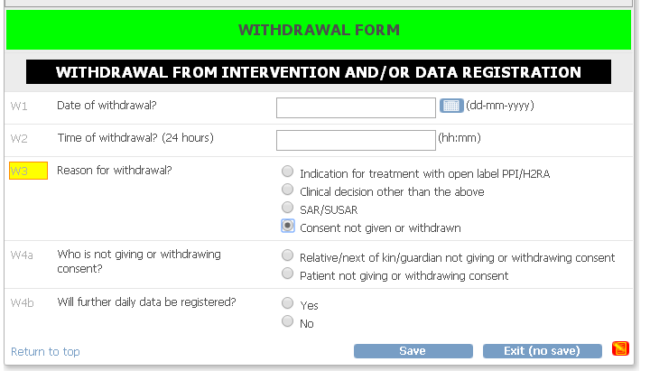
Withdrawal
…consent is withdrawn from further collection of data.
If consent is withdrawn from trial intervention only, please continue daily data registration
Day forms will no longer be generated

