Slide 1
Stress Ulcer Prophylaxis in the Intensive Care Unit (SUP-ICU) Information for nursing staff
Søren Marker Jensen
Dept. of Intensive Care 4131
Copenhagen University Hospital Rigshospitalet, Denmark
soeren.marker.jensen.01@regionh.dk
www.sup-icu.com

Slide 2
Background
Critically ill patients are at risk of gastrointestinal (GI) bleeding
Stress ulcer prophylaxis (SUP) is recommended and widely used, but the evidence supporting this is lacking and potential side effects have been suggested in terms of:
Pneumonia
Clostridium difficile infection
Cardiovascular complications

Slide 3
Aim of the SUP-ICU trial
To assess the benefits and harms of SUP in critically ill adult patients
Potential benefit
GI bleeding
Potential harm
Pneumonia
Clostridium difficile
Cardiovascular events
Mortality

Slide 4
Methods
Design: randomised multicentre placebo-controlled clinical trial with blinding
Setting: 50 ICUs in Europe
Population: Adult ICU patients (n=3350) with risk factors for GI bleeding

Slide 5
Methods
Intervention: Pantoprazole 40 mg x 1 (10 ml) intravenously from randomisation until discharge from ICU or death (maximum 90 days)
Comparator: Placebo (sterile vial added 10 ml of sodium chloride 0.9%)
Primary outcome: 90-day mortality

Slide 6
Screening and randomisation

Slide 7
Screening
All adults acutely admitted to the ICU with one or more risk factors (inclusion criteria) should be screened for inclusion
Proton pump inhibitor as SUP should not be administered before screening

Slide 8
Screening
Always remember to obtain consent according to your national regulations before randomisation!

Slide 9
Inclusion criteria
Acute (unplanned) admission to the ICU
Aged 18 years or above
One or more of the following risk factors:
Shock (continuous infusion with vasopressor or inotrope, mean arterial blood pressure < 70 mmHg, systolic blood pressure < 90 mmHg or lactate > 4 mmol/l)
Acute or chronic intermittent or continuous renal replacement therapy
Invasive mechanical ventilation which is expected to last > 24 hours. When in doubt of the forecast, the patient should be enrolled
Coagulopathy (platelets < 50 x 10^9/l, INR > 1.5 or PT > 20 seconds)
Ongoing treatment (not prophylaxis) with anticoagulant medication
History of coagulopathy (platelets < 50 x 10^9/l or INR > 1.5 or PT > 20 seconds within 6 months prior to this hospital admission)
History of chronic liver disease (history of portal hypertension, variceal bleeding or hepatic encephalopathy or cirrhosis proven by biopsy, CT scan or ultrasound)

Slide 10
Exclusion criteria
Contraindications to PPI (including intolerance of PPI and treatment with atazanavir (HIV medication))
Current daily treatment with PPI and/or H2RA
GI bleeding of any origin during current hospital admission
Diagnosed with peptic ulcer during current hospital admission
Organ transplant during current hospital admission
Withdrawal from active therapy or brain death
Fertile woman with positive urine human chorionic gonadotropin (hCG) or plasma-hCG
Consent according to national regulations not obtainable

Slide 11
If the patient is eligible he/she will be randomised electronically to receive pantoprazole or placebo

Slide 12
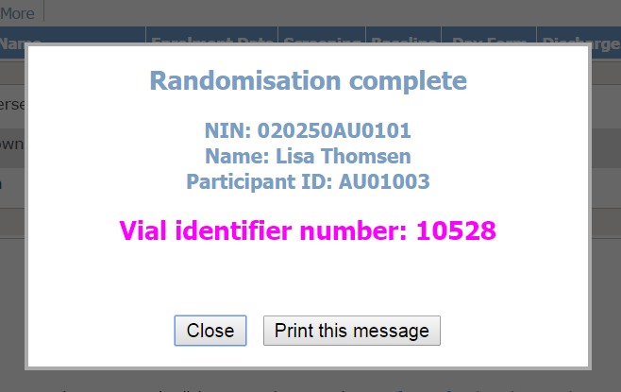
The electronic system allocates a unique number for the first vial
Option to print the vial identifier number

Slide 13
Nurses can always find the vial identifier number in the medication dispensing system (see the following slides)

Slide 14
Prescribe and administer
The doctor prescribes the trial medication for the patient once daily in your medical chart/ICU chart
Administer the trial medication by adding 10 ml of sodium chloride 0.9% to the vial (see the trial document ‘Trial medication’)

Slide 15
Medication dispensing system

Slide 16
Go to www.sup-icu.com

Slide 17
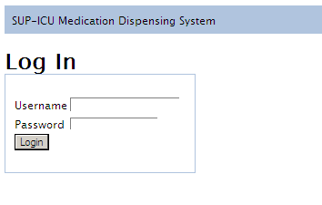
Login
Login with the shared login of your department

Slide 18
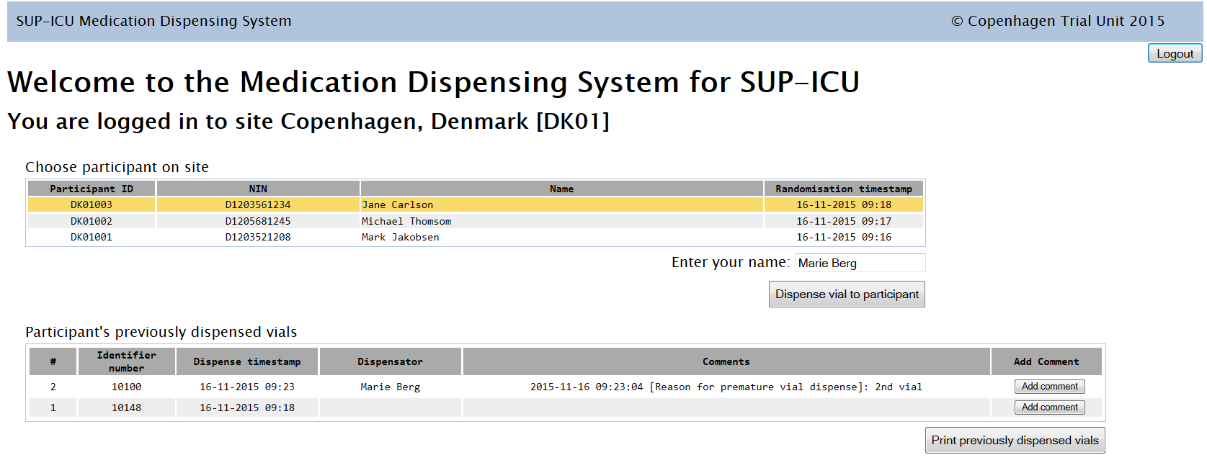
Dispense trial medication
Mark the relevant patient at the list
Enter your name
Press ‘Dispense vial to patient’

Slide 19
Confirm

Slide 20
Vial identifier number is allocated
Find the vial, add 10 ml of sodium chloride and administer the trial medication to the patient.
You have the option to print the vial identifier number.

Slide 21
Find previously allocated vials
Option to print the list.
A list of vial identifier numbers previously allocated to the patient will be shown in the bottom of the main screen.

Slide 22
If problems, use ‘add comment’
If you experience a problem with the vial or the medication administration, please use the ‘Add comment’ button in the right side.
If necessary, run through the procedure again to allocate a new vial identifier number.

Slide 23
Warning
If there are less than 20 hours between two medication allocations a warning will appear. A reason for this is required
This may happen if a patient is randomised prior to the normal time of medication administration in your department, e.g. randomised at 10 AM and medication is administered at 2 PM.
Please write ‘2nd vial’ or similar sentence.

Slide 24
Withdrawal
A patient can be withdrawn from the trial of the following reasons:
Indication for treatment with PPI/H2RA
Clinical decision other than above mentioned
SAR/SUSAR
Withdrawal of consent

Slide 25
Unblinding
If an adverse reaction is considered to be a SAR or a SUSAR you may need to unblind the trial medication
If the situation allows it please always call the coordinating centre before unblinding the trial medication
Unblinding:
Pulling of the blinding label (only if the situation requires immediate unblinding)
Active drug: original label of pantoprazole will be visible at the vial after removing the blinding label
Placebo: Empty label at the vial after removing the blinding label
Contact the coordinating centre by email: soeren.marker.jensen.01@regionh.dk OR call the SUP-ICU hotline +45 3545 7450.Please refer to the identifier number at the vial (to be found in the medication distribution system).

Slide 26
Trial documents

Slide 27
Go to www.sup-icu.com

Slide 28
Trial documents
Here you can find:
Instructions
Pocket cards
Documents for notice boards
… and other helpful documents.

