Slide 1

Agents Intervening against Delirium in Intensive Care Unit (AID-ICU):
An international inception cohort study
Primary investigator: Marie Oxenboell-Collet
Email: marie.oxenboell-collet@regionh.dk
Hotline: +4540741009

Slide 2

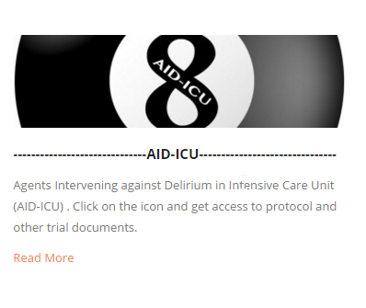
Data entry
Go to http://www.cric.nu/aid-icu-national-principal-investigators/

Slide 3
HINT
Use Google Chrome to open the link.

Slide 4

Log in
Enter your user name which is your email eg. xx@xxx.xx.
Your password is 12345678, when first logged in please change your password as the program instructs you to.
If you have not received your credentials, please send an email to: marie.oxenboell-collet@regionh.dk

Slide 5
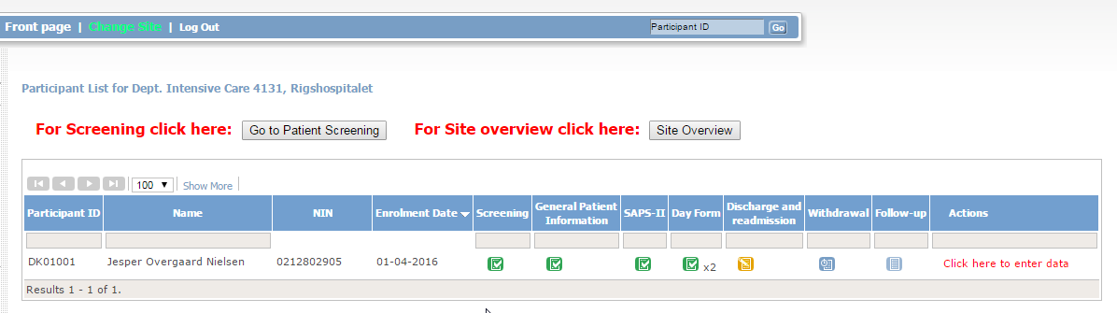
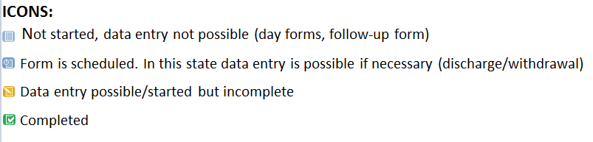
Front page

Slide 6
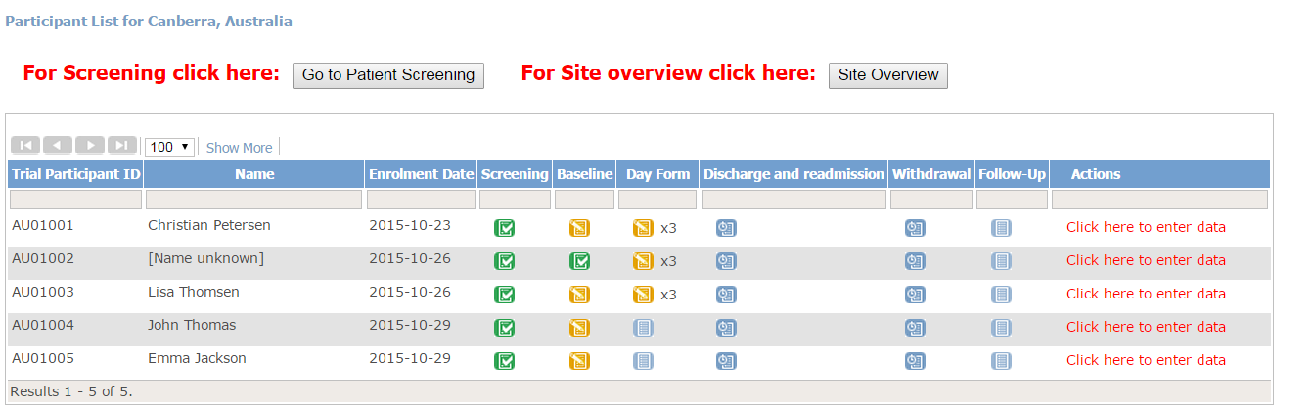
Step 1 - Screening
All adult patient (> 17 years old) acutely admission to the ICU within the inception period must be screened.
Even if you know that one ore more of the exclusion criteria are met, please always complete the screening form (if the patient fulfills the inclusion criteria)

Slide 7
Informed consent
  Please make sure you have obtained Informed consent if necessary.
  Your site might not have to obtain Informed consent prior inclusion of the patient
  If you are in doubt, what is applicable to your site, please contact site investigator or country coordinator.

Slide 8
Exclusion criteria
Pre-diagnosed mental illness of schizophrenia and/or psychosis and/or major depression (ICD 10; F20-29; F30, F31, F32, F33)
Terminal status (i.e., expected to survive < 24 hr. and/or withdrawal of life-support)
Pre-diagnosed neurodegenerative disorders Dementia and Parkinson (ICD 10; F02-04)
Mental illness recurring institutionalization or acquired or congenital mental retardation
Patients with congenital or acquired brain damage, i.e.; stroke in the past 2 weeks, transient cerebral ischemic in the past 2 weeks, subarachnoid haemorrhage, cerebral cancer, meningitis, encephalopathies, ongoing seizures and suspected anoxic brain injury or traumatic brain injury
Patients admitted with hepatic coma, drug overdose or suicide attempt (within the past 6 months necessitating hospitalization)
Blind and/or deaf

Slide 9
Data entry – genereal information
At the bottom of each form you will have the opportunity to:
  Exit (no save)
    Use this bottom if you have entered the form without changing data
  Save entered information
    This will only be an option when data has been entered
  Submit the form
    This will only be an option when the form is complete

Slide 10
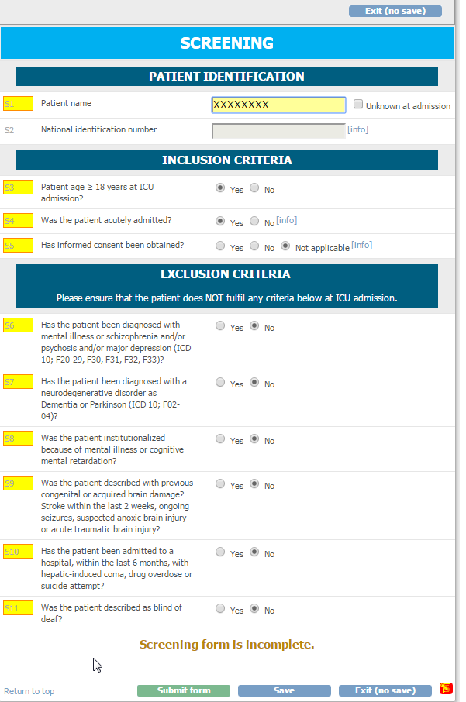
When all information is complete. The submit button will appear (not before).

Slide 11
  All patients screened will be given an ID number.
  If the patient meets any exclusion criteria they will be excluded and only appear under
  ”site overview”

Slide 12
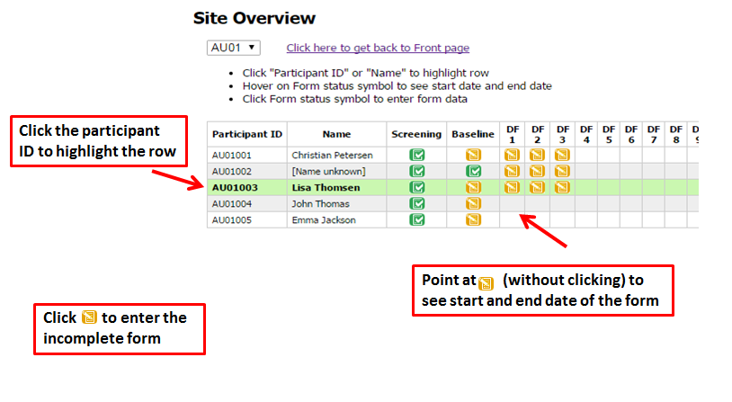
Site overview
  Under Construction (mangler ekskluderet)

Slide 13
Step 2 – patient included
  If the patient do not meets any exclusion critatier they are now included in the study.
  Press the to go to ‘participant details’ and data entry in forms.
link

Slide 14
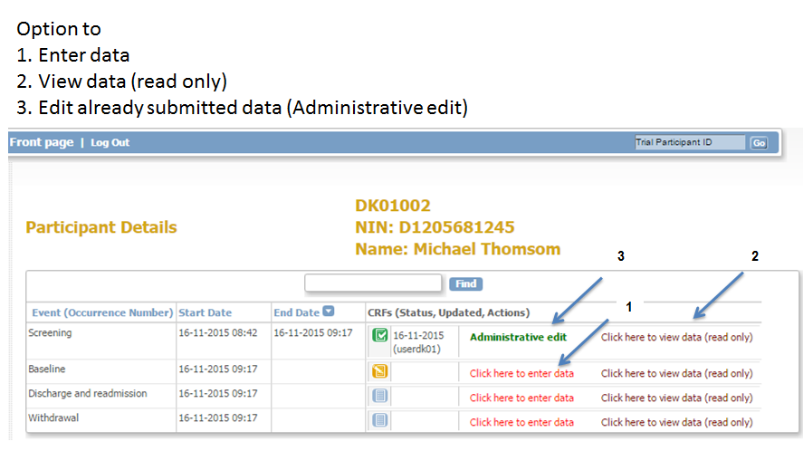
Participants details

Slide 15
Step 3 – data entry
There are 7 forms for this study
1 – AID-ICU SCREENING
2 – AID-ICU GENERAL PATIENT INFORMATION
3 – AID-ICU SAPS II
4 – AID-ICU DAYFORM
5 – AID-ICU DISCHARGE AND READMISSION
6 – AID-ICU WITHDRAWAL
7 - AID-ICU FOLLOW UP 90 DAY

Slide 16
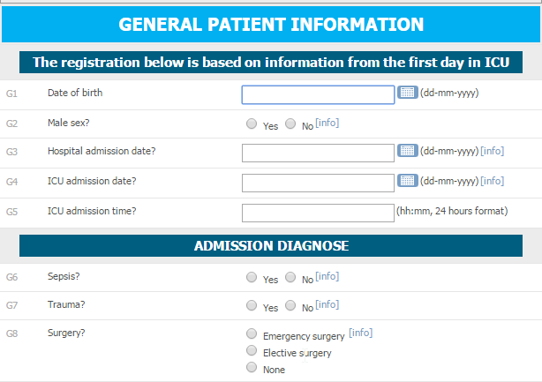
Data entry - generalinformation
Please always read the info box
Date format is dd-mm-yyyy
Time format is 24 hours hh:mm
2
3
1

Slide 17
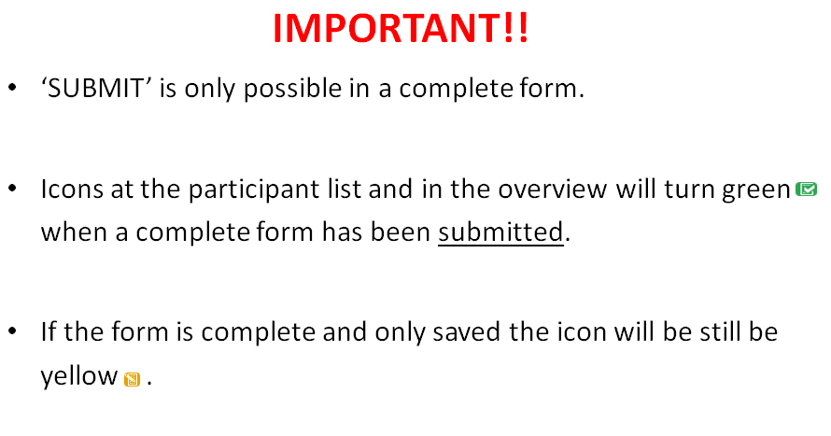
Data entry – general information

Slide 18
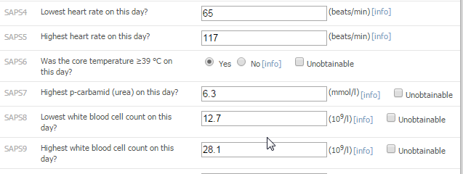
Data entry – unobtainable data
In some of the questions you will have the opportunity to check the ‘unobtainable’ box.

Slide 19
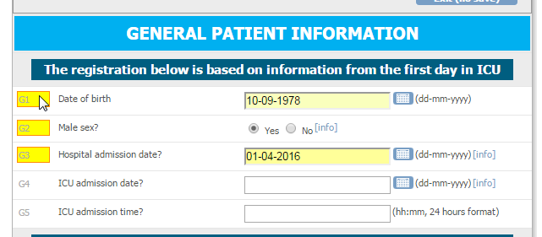
GENERAL PATIENT INFORMATION
Questions turn yellow when complete. Makes it easy to find an incomplete question
“Date and time of ICU and hospital admission”: If the patient has been transferred from another ICU/hospital please enter data and time of the first admission.
HINT: You have to fill in this part of the PGI form before SAPS II and Day forms

Slide 20
SAPS II
  When entering values for SAPS II scores please report the most deranged values obtained within the first 24 hours of ICU admission.
  If values are missing within the first 24 hours, please use the value of the next ICU day.

Slide 21
Day form
The first day form will be available when the day starts in your department e.g. 6 AM (decided by the local investigator)
Hereafter a day form is generated once a day (maximum 90 days)
The first and last day form will often be less than 24 hours

Slide 22
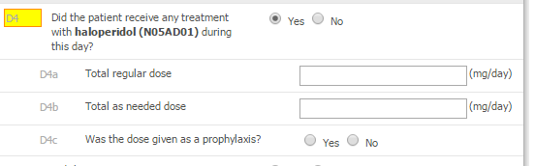
Day form
  HINT
Remember: if a day form does not turn green in the overview despite it is complete, please make sure the form has been submitted (and not just saved).
If a Day form do not turn green, please make sure you have put an value all boxes. If no dose have been administrated please write “0”

Slide 23
Importance
  If a patient is readmitted to your ICU and included to the AID-ICU study, you will have to follow the patient during this admission to. Until the 90 day follow up period is over.

Slide 24
Discharge/readmission form
When the patient is discharged from the ICU or dies in the ICU, please complete the discharge/readmission form
As this form is an ongoing form, it will not turn green unless the patient dies.
The form can only be saved – submit is not an option!!!
Completing this form will stop the generation of day forms.

Slide 25
  HINT
If you enter data retrospectively and the patient has been discharged or is dead it may be advantageous to complete this form before day forms, as the system will remove irrelevant day forms

Slide 26
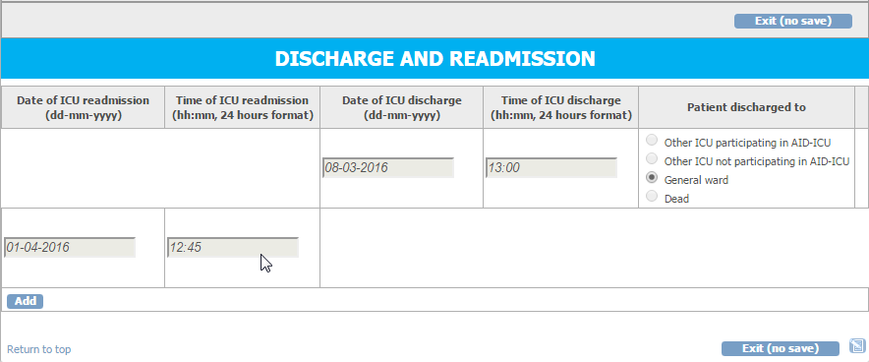

Readmission
  - If a patient is readmitted to the ICU go to the discharge/readmission form again and click ‘add’. This will generate a new row.
  - Please complete date and time for readmission.
  - If an additional row by accident is generated, please remove it by clicking the X in the right side.

Slide 27
Transferral of patients
Patients transferred from/to other ICUs
ICUs not participating in AID-ICU:
  If a patient is transferred to your ICU please screen the patient for inclusion in AID-ICU.
  If you transfer a patient to another ICU not participating in AID-ICU the patient will be regarded discharged from ICU. Please complete the discharge form. Follow-up still has to be completed at day 90.
ICUs participating in AID-ICU:
  If a patient is transferred from your ICU, the patient will be moved to a ‘transferral site’ in the system accessible by you and the receiving department. Please complete all forms soon as possible. Hereafter the patient will be moved to the receiving department. Please inform the receiving department that the patient participates in the AID-ICU trial.
  If a patient is transferred to your ICU and has not been transferred in the electronic system, please contact the coordinating centre soon as possible.

Slide 28
Withdrawal
  Under construction

Slide 29
Follow-up
Ninety days after randomisation the follow-up form will be activated.
If the patient dies in the ICU and this is marked in the discharge form, the follow-up form will automatically be completed.

Slide 30
Test site
It is now possible to get access to a test site, so you can get familiar with the electronic CRF before start.
Please contact
marie.oxenboell-collet@regionh.dk

