Slide 1
Stress Ulcer Prophylaxis in the Intensive Care Unit (SUP-ICU) Discharge, Transfer and Death
Søren Marker Jensen
Dept. of Intensive Care 4131
Copenhagen University Hospital Rigshospitalet, Denmark
soeren.marker.jensen.01@regionh.dk
www.sup-icu.com

Slide 2
Discharge, transfer and death .
A patient can be discharged to three different locations:
General ward
ICU participating in SUP-ICU trial
ICU not participating in SUP-ICU trial
Additionally, a discharge formula has to be completed if a patient dies.

Slide 3
Discharge, Transfer, Death
If a patient is discharged, transferred or dies, please complete a Discharge and Readmission form:
Remember to register whether the patient has been enrolled in other interventional trials during the ICU admission!

Slide 4
Discharge or death
If a patient is discharged to a general ward or an ICU not participating in SUP-ICU, no further day forms will be generated
If a patient dies, the follow-up form will automatically be completed

Slide 5
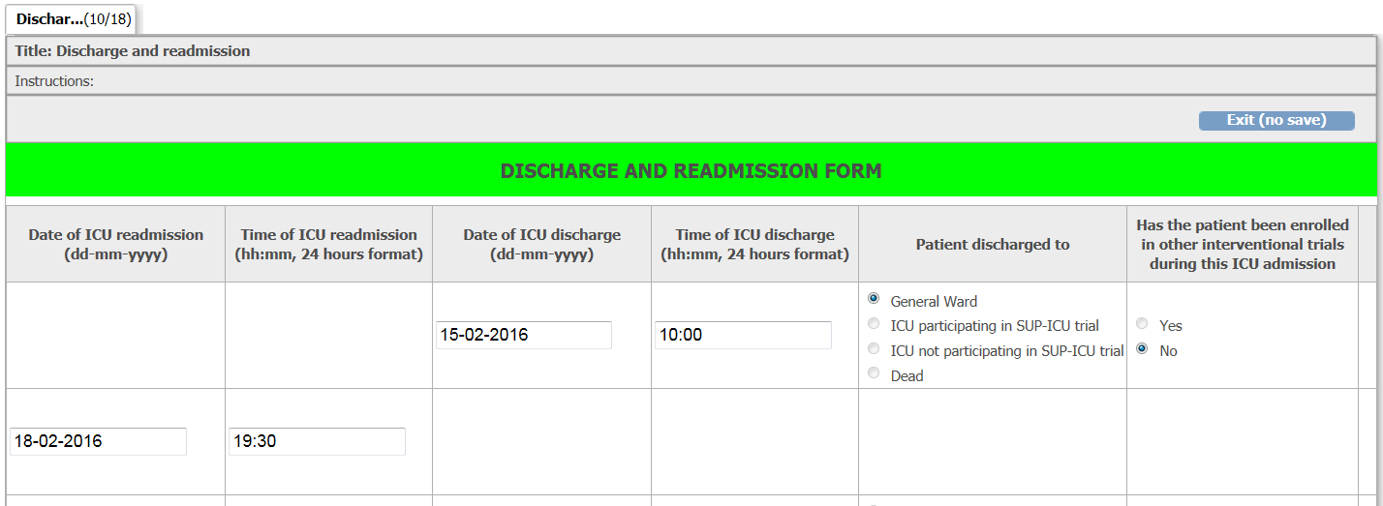
Readmission
Please readmit the patient in the system when the patient is readmitted to your ICU.

Slide 6
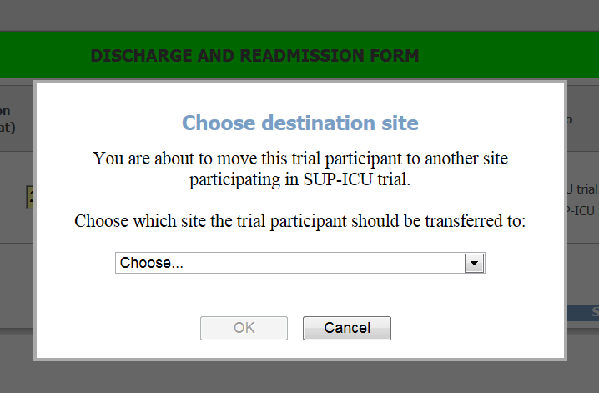
Discharge to participating ICU
When a patient is discharged from your ICU to another ICU participating in the SUP-ICU trial, you will be asked to specify the receiving ICU:

Slide 7
Discharge to participating ICU
If all data has been entered at your site, the patient will be transferred directly to the recipient site
Recipient site will need to readmit the patient
Remember to update the receiving site and the coordinating site about the status of informed consent and send copies of all obtained consent formulas to the receiving site!

Slide 8
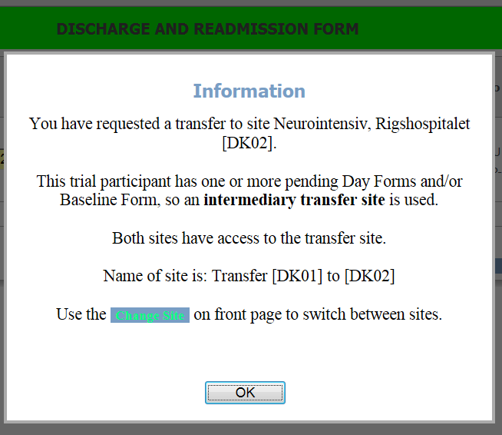
Discharge to participating ICU
If all forms have not been completed at your ICU, the patient will be transferred to a temporary transfer site
Coordinating investigators at both sites will receive a notification email and site can be accessed using the “change site” function:

Slide 9
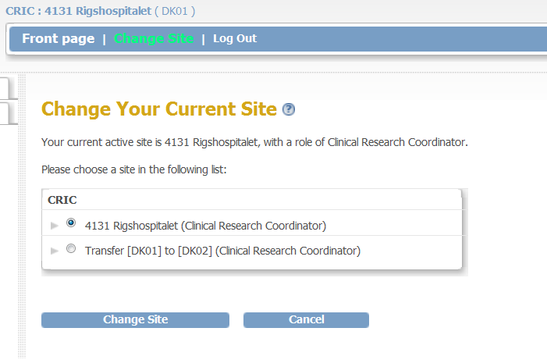
Discharge to participating ICU
Use the Change Site function to access the temporary transfer site:

Slide 10
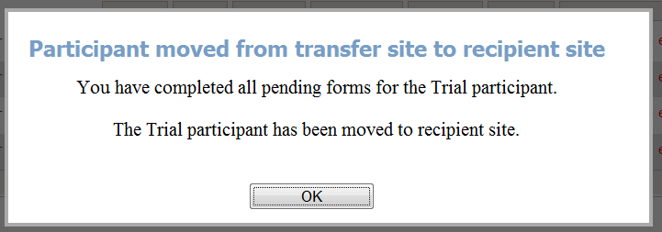
Discharge to participating ICU
Transfer site:
When all data have been entered, the patient will be transferred automatically from the transfer site to the recipient site:
Remember to update the coordinating site and the receiving site about the status regarding obtained informed consent and forward copies of the completed consent forms to the receiving site.

Slide 11
Discharge to participating ICU
Recipient site:
Complete a readmission form
Continue intervention (unless the patient has been withdrawn)
Obtain missing consents (i.e., informed consent from the patient).

