Slide 1
Agents Intervening against Delirium in the Intensive Care Unit (AID-ICU)
Nina Christine Andersen-Ranberg and Stine Estrup (coordinating investigators)
Lone Musaeus Poulsen (sponsor)
Department of Anaesthesiology and Intensive Care Medicine
Zealand University Hospital, Koege
Email: aid-icu@cric.nu
www.cric.nu/aid-icu

Slide 2
Delirium in the Intensive Care Unit
Critically ill patients are at risk of developing delirium during ICU stay incidence: 32-84%^{1,2}
Delirium is associated with:
Increased morbidity^{3,4}
Increased days on mechanical ventilation
Longer hospital admittances
Long-term cognitive impairment
Long-term disability
Higher cost of care
And is an independent predictor of mortality⁵
Delirium is expensive to the individual and society
1) Salluh, J.I., et al., Outcome of delirium in critically ill patients: systematic review and meta-analysis. BMJ, 2015. 350: p. h2538.
2) Brummel, N.E., et al., Delirium in the ICU and subsequent long-term disability among survivors of mechanical ventilation. Crit Care Med, 2014. 42(2): p. 369-77.
3) Pandharipande, P.P., et al., Long-term cognitive impairment after critical illness. N Engl J Med, 2013. 369(14): p. 1306-16.
4) Lat, I., et al., The impact of delirium on clinical outcomes in mechanically ventilated surgical and trauma patients. Crit Care Med, 2009. 37(6): p. 1898-905.
5) Ely, E.W., et al., Delirium as a predictor of mortality in mechanically ventilated patients in the intensive care unit. JAMA, 2004. 291(14): p. 1753-62.

Slide 3
Delirium and mortality
Kaplan-Meier survival curve for 1-year mortality post-intensive care unit (ICU) admission (ICU delirium days predictor).
Pisani, Kong, Kasl, et al.: Delirium and Mortality in Older ICU Patients. American Journal of respiratory and critical care 2009.

Slide 4
Current guidelines
The Danish society of Anaesthesiology and Intensive Care Medicine
The Intensive Care Society in the UK
German guidelines
Haloperidol
Olanzapin
Risperidon
The American College of Critical Care Medicine and the Society of Critical Care Medicine (USA)
No evidence of haloperidol
Olanzapin may reduce delirium duration

Slide 5
Current evidence
Review article: Sedation and Delirium in the Intensive Care Unit.
Reade et al. NEJM, 2014
”There is very little evidence to guide the management of established delirium, and most existing trials were categorized as pilot studies.”
Intensive Care Unit Delirium – A review of diagnosis, prevention and treatment.
Hayhurst et al. Anaesthesiology 2016
”Despite the abundance of litterature and research on delirium, there remains a paucity of large, randomized controlled trials of pharmacologic treatment of delirium.”
Pharmacological prevention and treatment of delirium in intensive care patients: A systematic review.
Rodrigo et al. Journal of Critical Care, 2016.
”No single pharmacologic intervention was associated with reduction in mortality or hospital length of stay.”
No evidence based treatment of ICU acquired delirium is currently available

Slide 6
AID-ICU
Systematic Review
Inception cohort study
AID-ICU RCT
haloperidol vs. placebo
AID-ICU involves 3 studies

Slide 7
Overview of reviews
Conclusion: The overall quality and quantity of the present evidence underline the necessity of conducting a truly systematic review on haloperidol and the urgent need for a large pragmatic trial with overall low risk of bias. This trial should examine treatment of delirium with haloperidol or dexmedetomidine on patient important outcomes (days alive out of hospital, mortality, duration of delirium, etc.).

Slide 8
Inception cohort study
14 day inception cohort study in 99 ICUs worldwide
Most frequent used agents to treat delirium:
Haloperidol
Benzodiazepines
Dexmedetomidine
Power calculations for AID-ICU RCT

Slide 9
Aim of the AID-ICU trial
To assess the benefits and harms of haloperidol treatment in critically ill adults with delirium
Benefits
Harms
Mortality

Slide 10
Methods
Design: Investigator-initiated, randomised multicentre placebo-controlled clinical trial with blinding
Setting: approx. 25 ICUs in Europe
Population: Adult ICU patients with diagnosed delirium
Start 2018 March, Zealand University Hospital Køge

Slide 11
Design
1000 patients
Intervention
Control
Haloperidol 2.5mg x 3 daily
Placebo: isotonic saline
Primary outcome: Days alive out of the hospital within 90 days

Slide 12
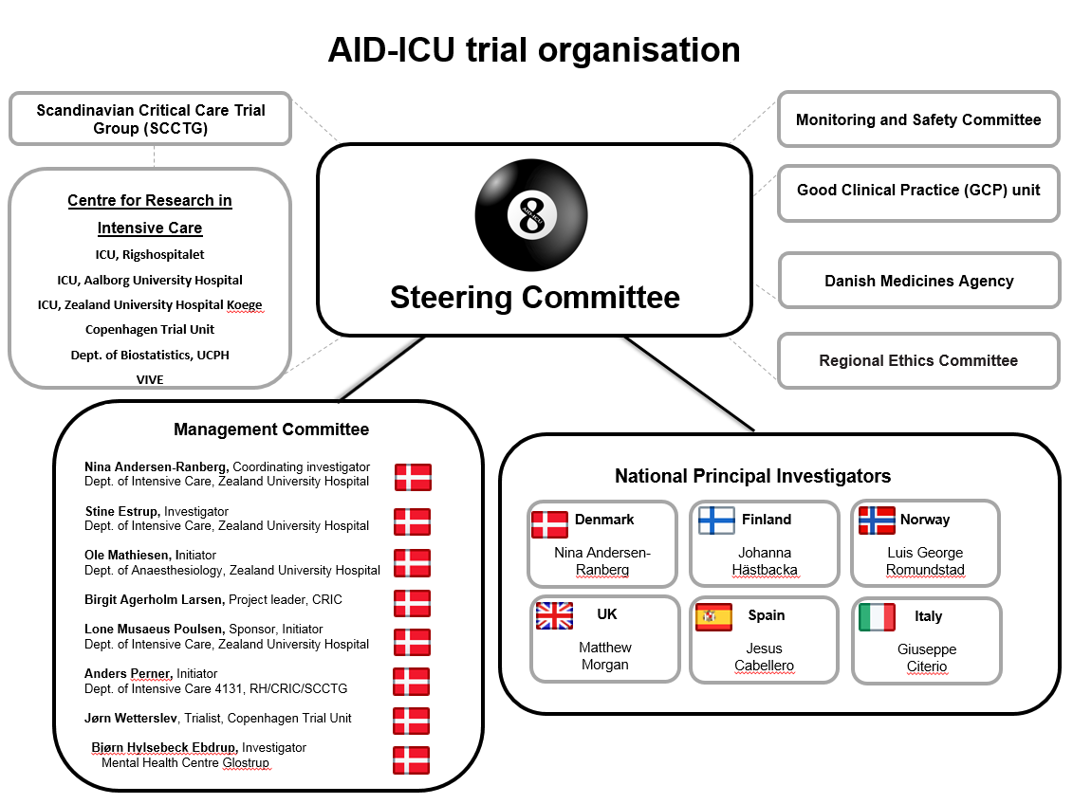

Slide 13
Contacts
Coordinating Investigators
Nina Christine Andersen-Ranberg, MD
Stine Estrup, MD
Department of Anaesthesiology and Intensive Care Medicine
Zealand University Hospital, Koege
Phone: +45 9357 7750 (available 24/7)
Email: aid-icu@cric.nu
Sponsor
Lone Musaeus Poulsen, MD, Head of ICU
Department of Anaesthesiology and Intensive Care Medicine
Zealand University Hospital, Koege
Phone: +45 4732 6451
Email: lmp@regionsjaelland.dk
www.cric.nu/aid-icu

Slide 14
Inclusion criteria
Acute (unplanned) admission to the ICU
Aged 18 years or above
Diagnosed delirium with validated screening tool (CAM-ICU, ICDSC)

Slide 15
Exclusion criteria
Contraindications to haloperidol
Habitual treatment with any antipsychotic medication or treatment with antipsychotics in the ICU prior to inclusion
Permanently incompetent (e.g. dementia, mental retardation)
Delirium assessment non-applicable (language barriers, blind, deaf)
Withdrawal from active therapy or brain death
Fertile women (<50 years) with positive urine hCG or plasma hCG
Patients under coercive measures by regulatory authorities
Patients with alcohol induced delirium (delirium tremens)
Consent unobtainable according to national regulations

Slide 16
Delirium screening is essential!
Screening for delirium twice daily should be implemented as standard care
1 time during the morning shift
1 time during the evening shift
Screen with validated screening tool → CAM-ICU or ICDSC
When a patient is diagnosed with delirium → check if the patient comply with inclusion criteria.

Slide 17
CAM-ICU

Slide 18
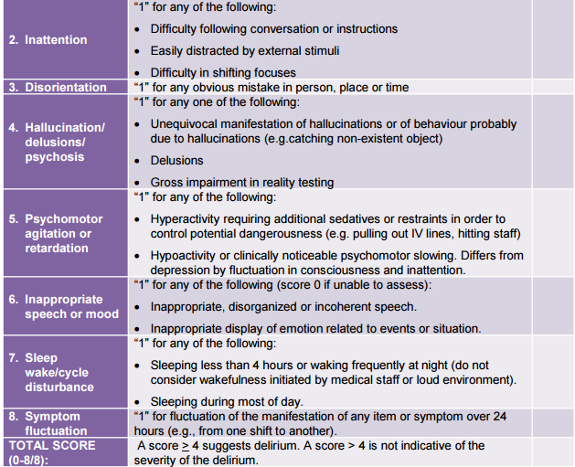
ICDSC

Slide 19
Screening for participation in AID-ICU
When patient is diagnosed with delirium → please check other inclusion criteria
If the patient fulfils all inclusion criteria, go to
www.cric.nu/aid-icu
Where you can access the electronic CRF (eCRF) with your personal username and password.

Slide 20
Consent - primary trial guardian
ALWAYS REMEMBER TO OBTAIN CONSENT FROM THE PRIMARY TRIAL GUARDIAN (‘FØRSTE FORSØGSVÆRGE’) BEFORE RANDOMISATION.
Can initially be oral consent
State the full name of the primary trial guardian in the patient’s medical journal
Informed consent should be obtained as soon as possible from the patient’s next of kin and the second trial guardian

Slide 21
Interventions
Acute ICU admittance
Positive for delirium
Delirium screening x 2 daily
Screening
Haloperidol 2.5 mg (0.5ml) x 3
Does not meet exclusion criteria
Randomisation
Placebo: NaCl 0.5 ml x 3
P.n. haloperidol/placebo to a total of 20 mg daily
(5 additional administrations)
Escape medicine:
Propofol sedation, benzodiazepines and dexmedetomidine/α2-agonist

Slide 22
Pausing and stopping
Pausing criteria: 2 consecutive negative delirium scores in the same day
OR unexplained coma (and all other relevant medication stopped)
Stopping criteria:
Discharge from the ICU
Transfer to another ICU (non AID-ICU trial site)
Maximum of 90 day intervention period
Death

Slide 23
Administration of trial medicine
Dispensed from the database with a common login
Packs of 3 vials, all of which are used for a single patient
Extra packs can be drawn as needed
Educational material is available from www.cric.nu/aid-icu

Slide 24
Day forms
Found in the eCRF at www.cric.nu/aid-icu
An ICU day is defined to be from 06:00 am to 06:00 am
Daily forms should be filled out continuously throughout ICU admission

Slide 25
Withdrawal
A patient can be withdrawn from the trial if:
Consent is withdrawn or not given
The patient experiences intolerable adverse reactions (including SAR and SUSAR) suspected to be related to the trial intervention.
Clinicians discretion in conjunction with the coordinating investigator decide it is in the patient’s interest
The patient after inclusion is subject to involuntary hospitalization (coercive measures)
The patient after inclusion experiences QTc prolongation.
Fill in the withdrawal form in the eCRF (www.cric.nu/aid-icu)
Continue data registration (day forms) unless consent for this is also withdrawn

Slide 26
Discharge, transfer and death
When a patient is discharged from the ICU, transferred to another ICU or dies within the ICU
Complete the Discharge and Readmission form at www.cric.nu/aid-icu

Slide 27
90-day follow-up
Complete the 90-day follow-up form at
www.cric.nu/aid-icu
Mortality (including date of death)
Discharge from hospital (date of discharge)
Readmission to hospital (days readmitted within the 90-day period)

Slide 28
One-year follow-up
Complete the one-year follow-up form at
www.cric.nu/aid-icu
Mortality (also drawn from the CPR registry in Denmark)
EuroQoL (EQ-5D-5L + EQ-VAS)
RBANS (cognitive function score) at selected sites

Slide 29
Trial documents
www.cric.nu/aid-icu

Slide 30
Contact
Do you need help?
Call the AID-ICU hotline at:
+45 9357 7750
Available 24/7

Slide 31
Thank you!
AID-ICU@CRIC.NU
WWW.CRIC.NU/AID-ICU

