Slide 1


The Conservative vs. Liberal Approach to fluid therapy of Septic Shock in Intensive Care CLASSIC Trial
Tine Sylvest Meyhoff, MD
Department of Intensive Care 4131
Copenhagen University Hospital, Rigshospitalet
Centre for Research in Intensive Care, CRIC
classic@cric.nu
www.cric.nu/classic
Phone: +45 3545 0606

Slide 2
Disposition
Background
Design
Screening – inclusion and exclusion criteria
Intervention and control group
Data registration – withdrawal, SAR/SUSAR, day forms
Follow-up
Questions

Slide 3
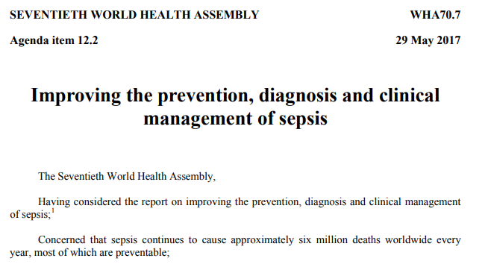




Sepsis is a major global health problem

Slide 4
Surviving Sepsis Campaign guideline
IV fluid recommendations
We recommend that … “at least 30 ml/kg of IV crystalloid
fluid be given”¹
(strong recommendation, low quality evidence)
We recommend that … “fluid administration is continued as long as
hemodynamic factors continue to improve” ¹
(best practice statement)
1. Rhodes et al. Intensive Care Med 2017

Slide 5
Fluid resuscitation volumes varied between sites in the 6S trial
1
Median (IQR) IV resuscitation fluid volumes 3 days after randomisation
1. Hjortrup et al. PloS ONE 2016

Slide 6
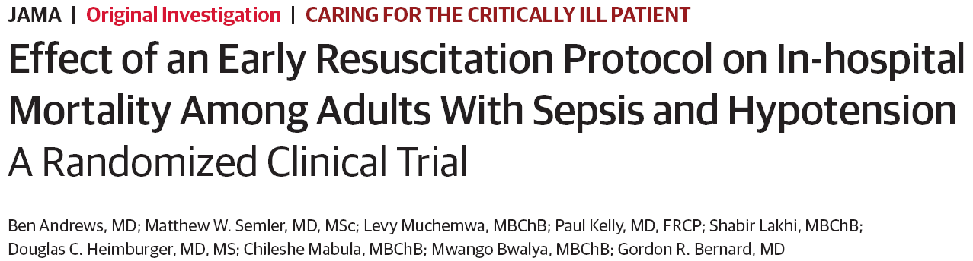
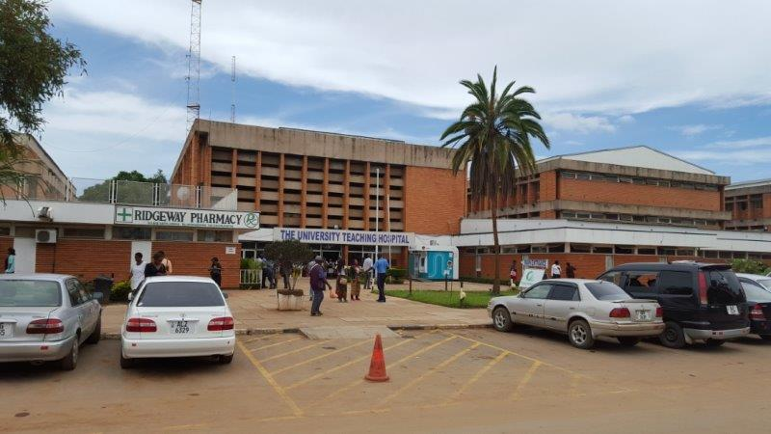
‘EGDT-light’ in emergency dept. in Zambia
1
Intervention
Early resuscitation protocol for sepsis
  IV fluids 2 L
    + 2 L monitored by JVP, RF and SAT
  Vasopressors to MAP of 65 mmHg
  Transfusion at 7 g/dL
Control
Usual care
1. Andrews et al. JAMA 2017

Slide 7
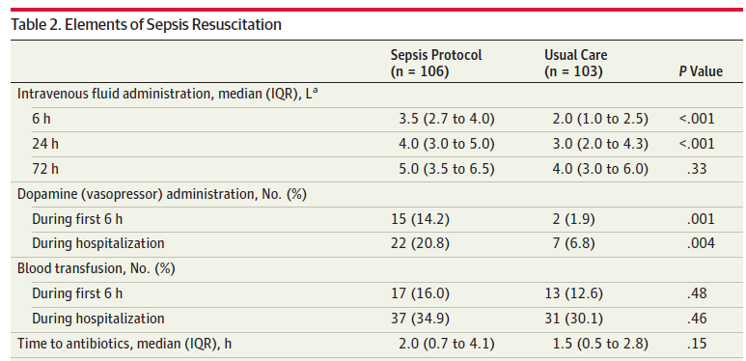
Interventions given

Slide 8
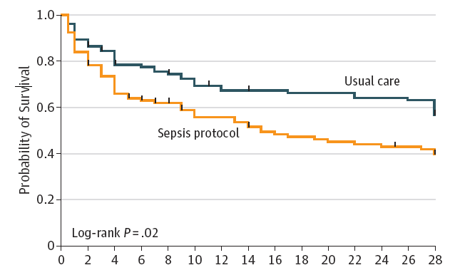
Survival
Days

Slide 9
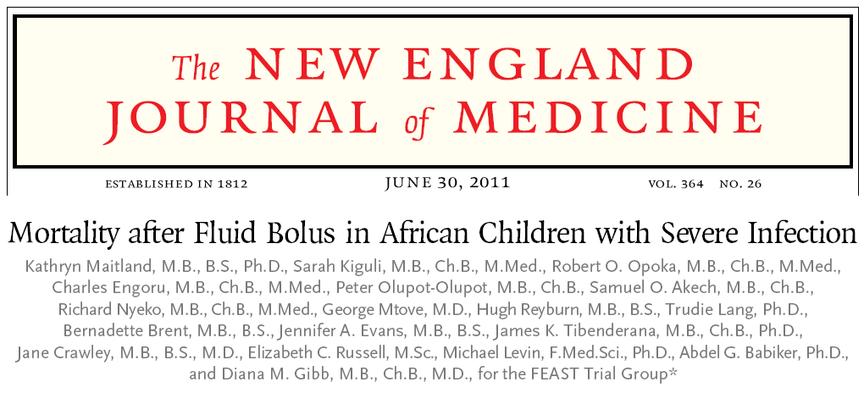
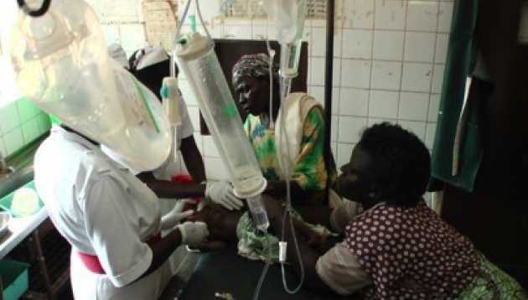
Current knowledge from RCTs in other populations
Interventions
No bolus vs NaCl bolus vs albumin bolus
3000 febrile African children with impaired circulation
1
1. Maitland et al. NEJM 2011

Slide 10
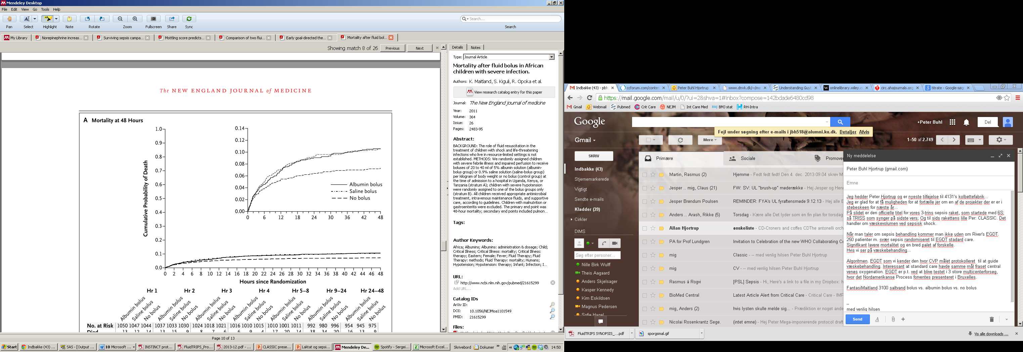
FEAST trial
Mortality at 48 hrs

Slide 11
Background
No RCTs in early resuscitation of adults
with sepsis with IV fluid as the only intervention

Slide 12
2014
2018
RCT
Pilot trial
2020
Updated systematic review
2017
Systematic review

Slide 13
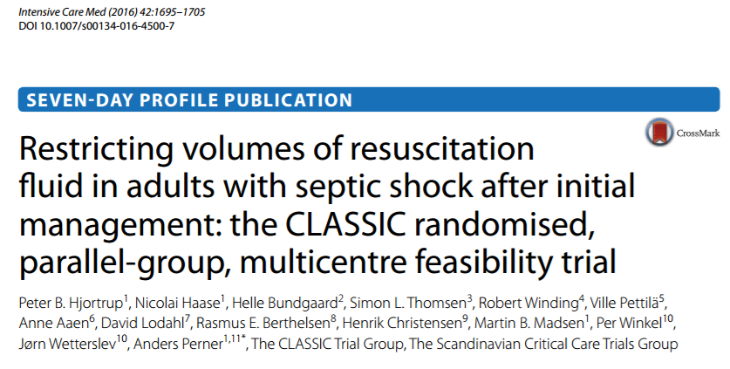
The CLASSIC feasibility trial
9 ICUs in DEN and FIN
153 patients with septic shock randomised to restrictive IV fluid therapy vs standard care for resuscitation
1
1. Hjortrup et al. Intensive Care Med 2016

Slide 14
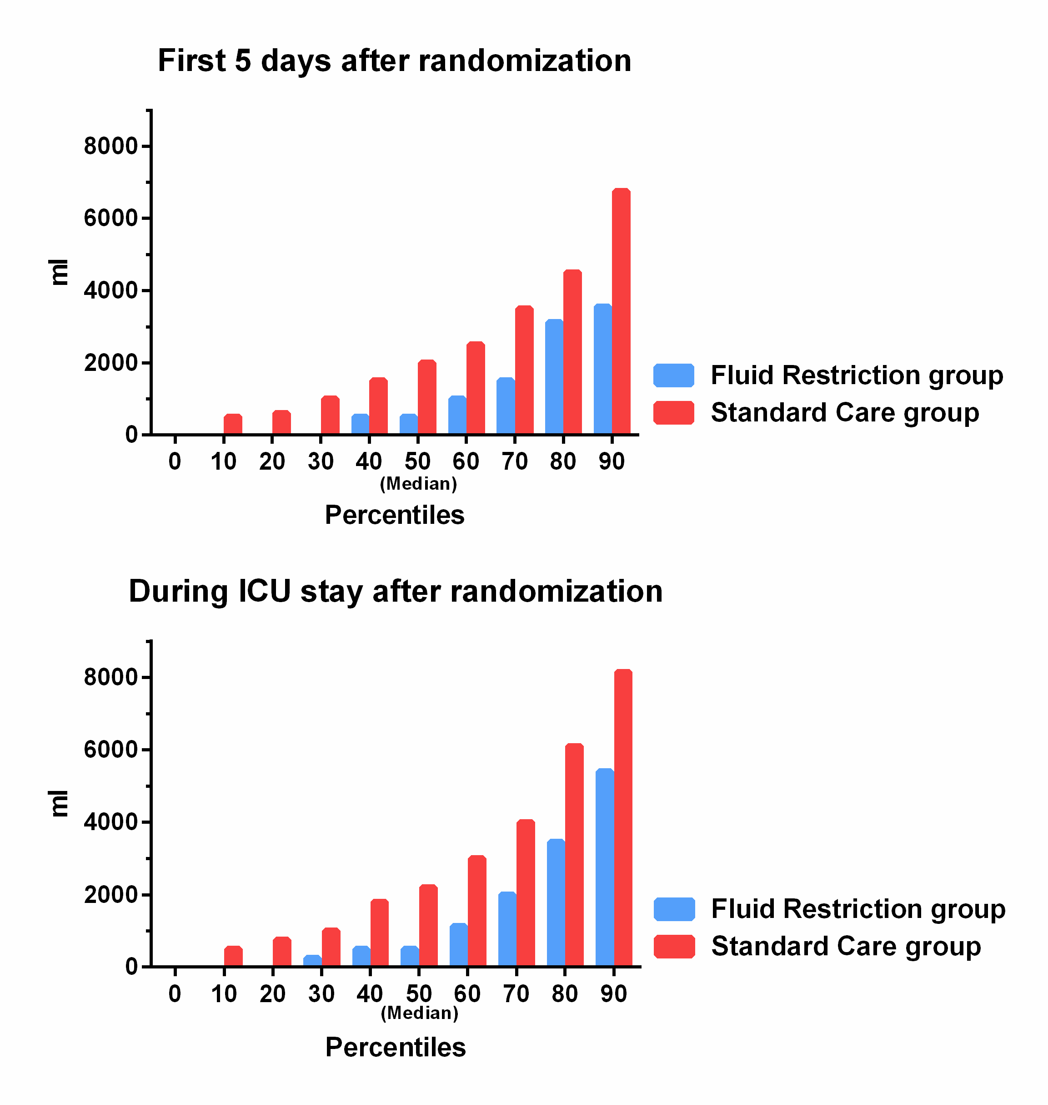
Primary outcome (feasibility)
 | Fluid Restriction Group (N=75) | Standard Care Group (N=76) |  | P-Value
Volumes of resuscitation fluid (ml)
First 5 days after randomization | 500 (0-2,500) [1,687] | 2,000 (1,000-4,100) [2,928] |  | <0.001

Slide 15
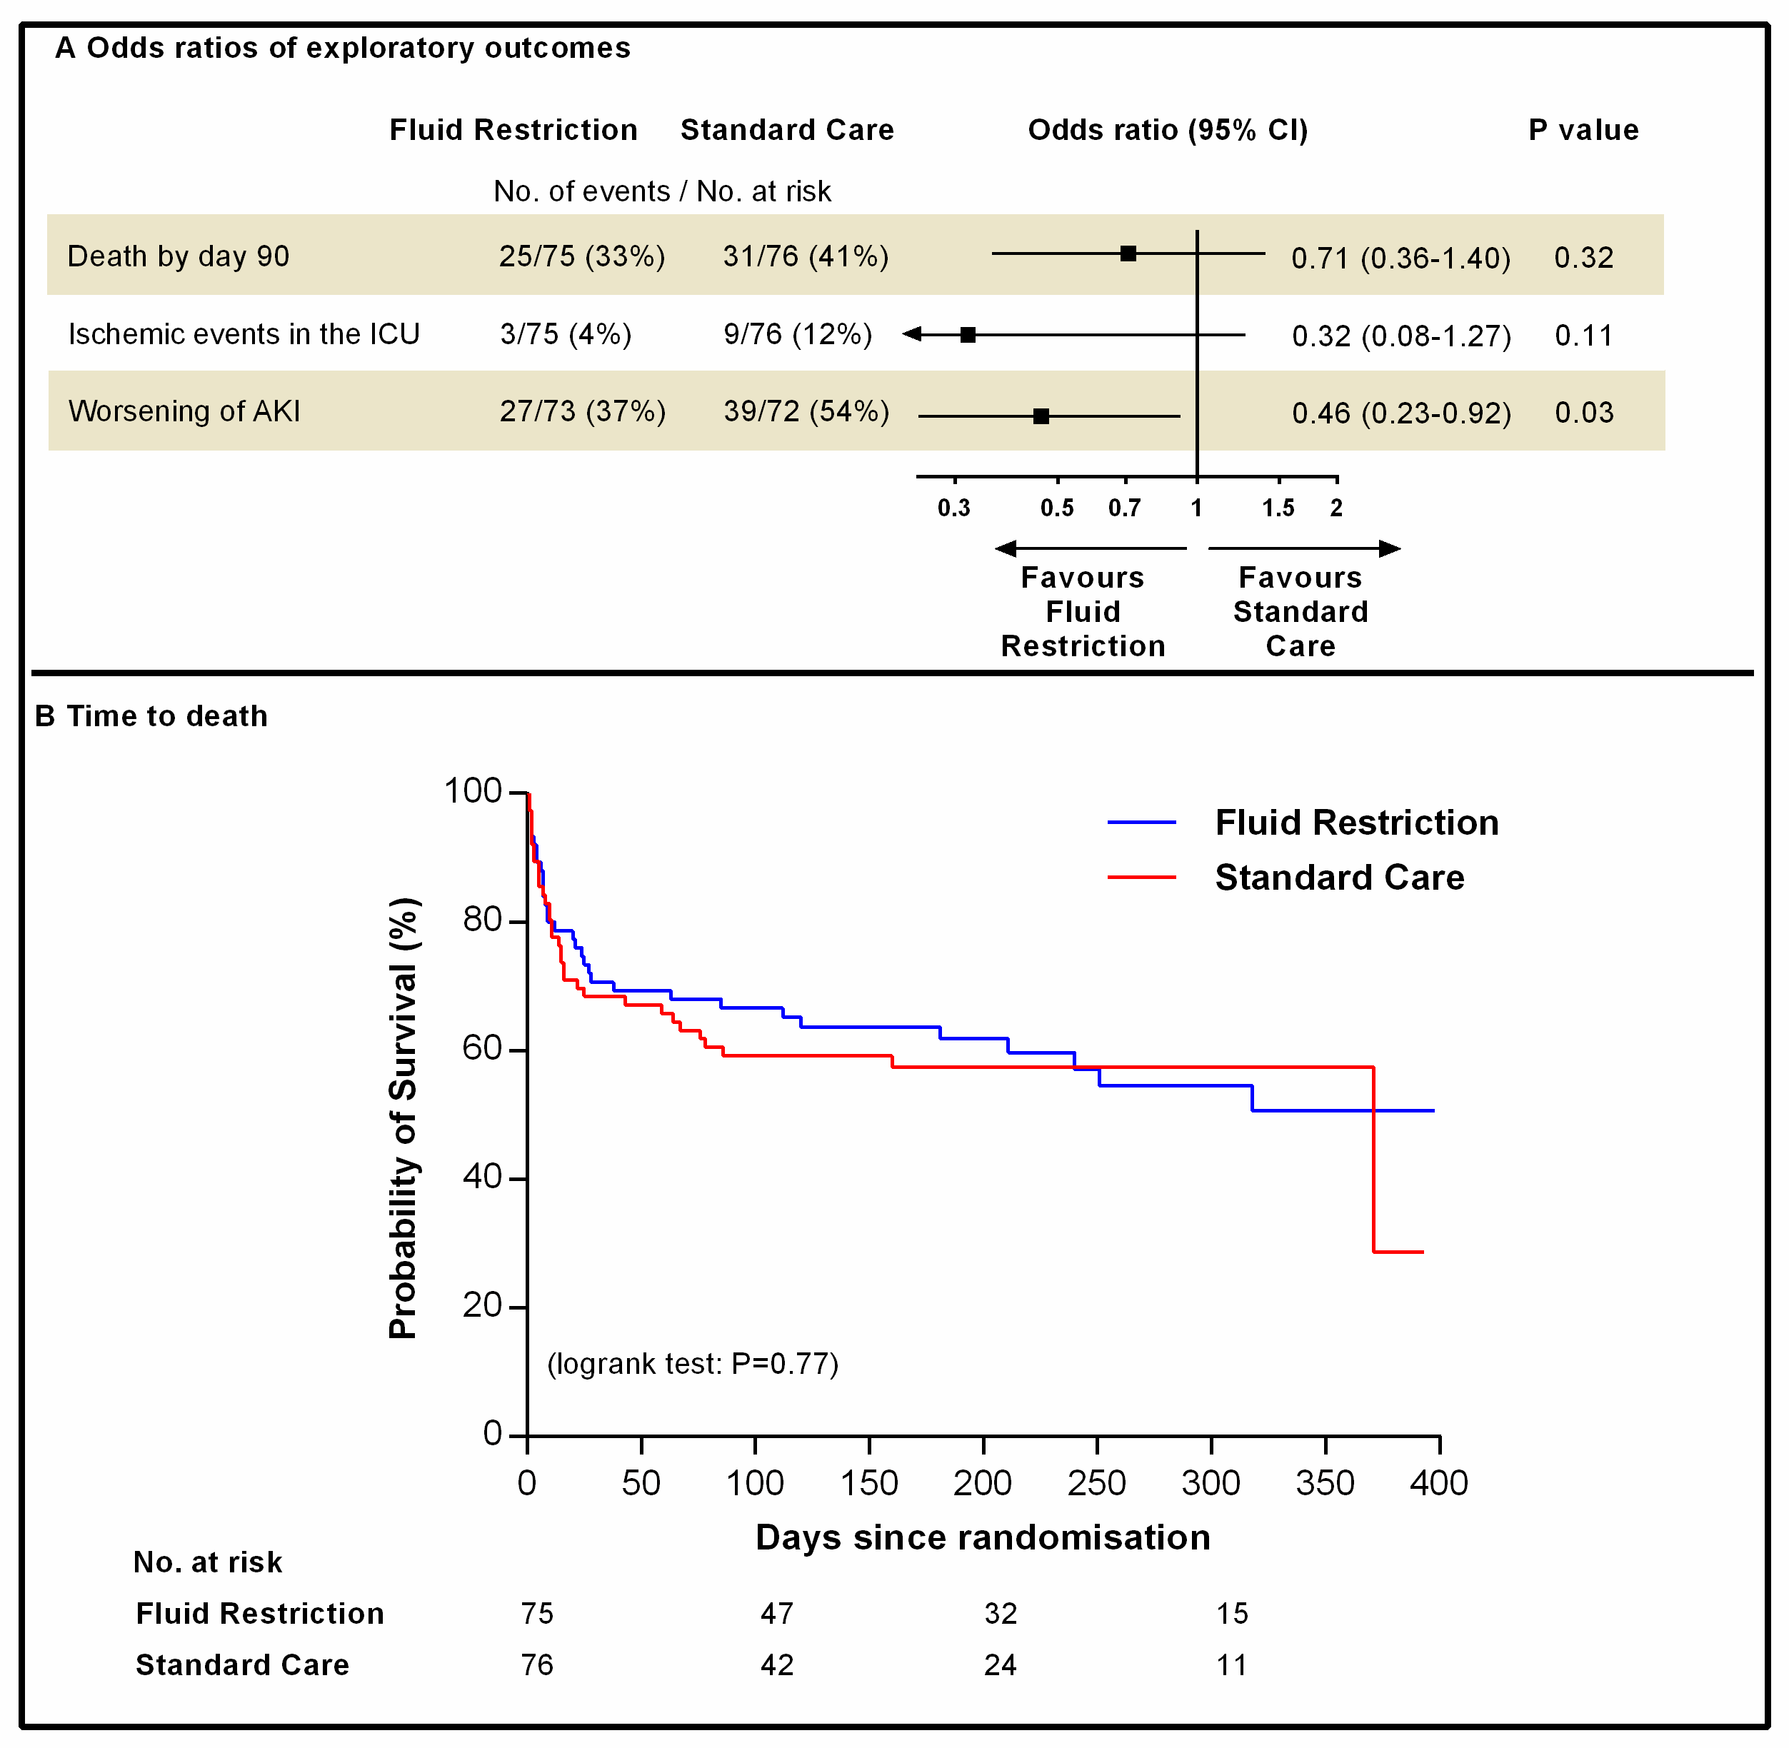
Background
Exploratory outcomes

Slide 16
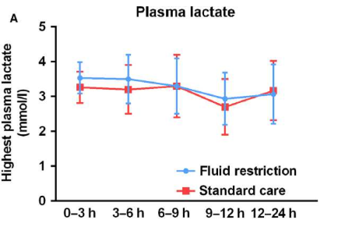
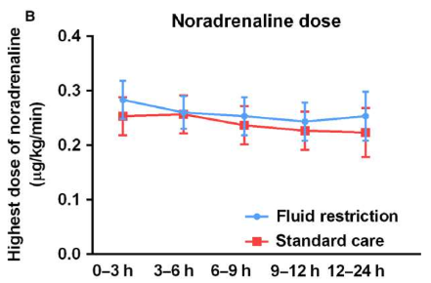
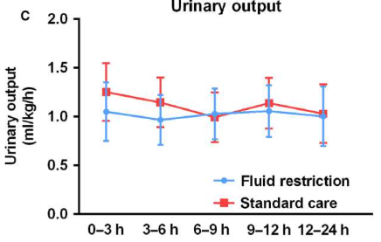
No ‘physiological effects’
1. Hjortrup et al. Acta Anaest Scand 2017

Slide 17
2014
2018
RCT
Pilot trial
2020
Updated systematic review
2017
Systematic review

Slide 18
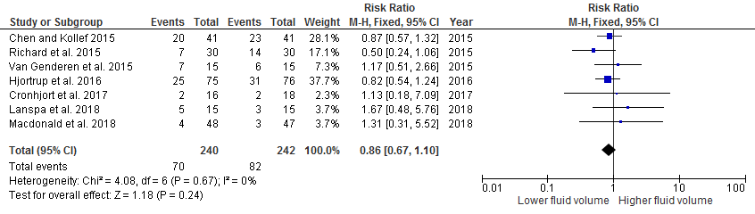
Systematic review with meta-analysis
The quantity and quality of evidence supporting the better volume of fluids in patients with sepsis is very low
Unknown balance between benefits and harms and clinical equipoise
1
1. Meyhoff et al. In prep.

Slide 19
2014
2018
RCT
Pilot trial
2020
Updated systematic review
2017
Systematic review

Slide 20


Aim
To assess benefits and harms of IV fluid restriction vs. standard of care in adult ICU patients with septic shock
Potential benefit
Reduced organ oedema Kidneys, gut, lungs
Potential harm
Impaired perfusion
Mortality?

Slide 21

Design
1554 Patients
Intervention
Control
IV fluid restriction
Standard care
n = 777
n = 777
Primary outcome 90-day mortality (all-cause)

Slide 22











Design
Randomised, open-labelled, outcome assessor-blinded trial of restrictive IV fluid therapy vs standard care
Setting: 50 European ICUs (12 in DK)
Start November 2018, Copenhagen University Hospital Rigshospitalet

Slide 23
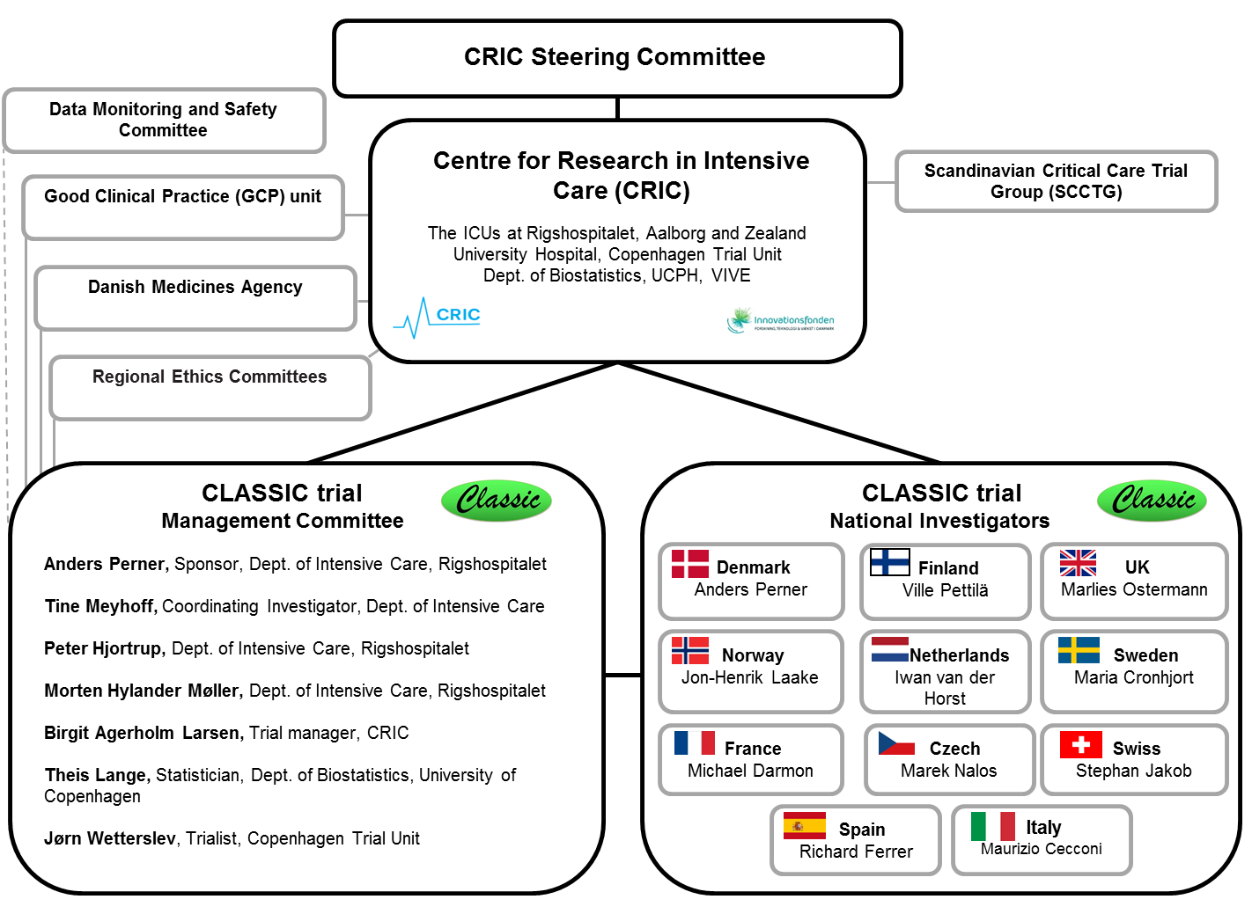
Organisation

Slide 24

Screening
Screen all adult patients with septic shock (inclusion criteria)

Slide 25
Inclusion criteria
Age 18 years or above
In ICU or planned admission to the ICU
Septic shock (SEPSIS-3 Criteria) - Suspected or confirmed infection AND - Vasopressor/inotrope ongoing to maintain MAP 65 mmHg or above AND - Lactate ≥ 2 mmol/L in the last 3-h
Received at least 1L of IV fluid (crystalloids, colloids or blood products) in the last 24-h
1
1. Singer et al. JAMA 2016

Slide 26
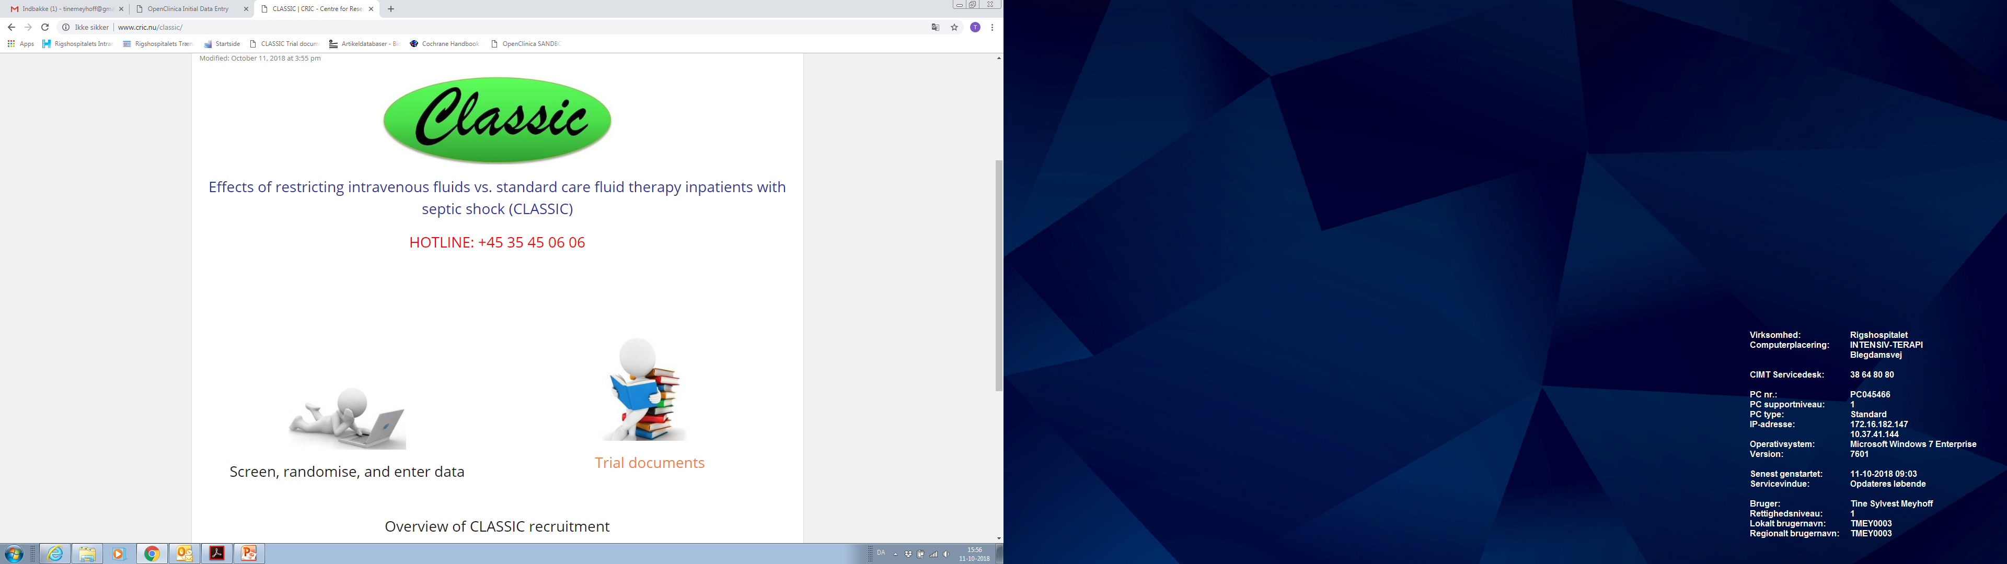
Screening
  When a patient fulfils all inclusion criteria, go to
  www.cric.nu/CLASSIC
  Where you access the electronic case report form (eCRF)

Slide 27
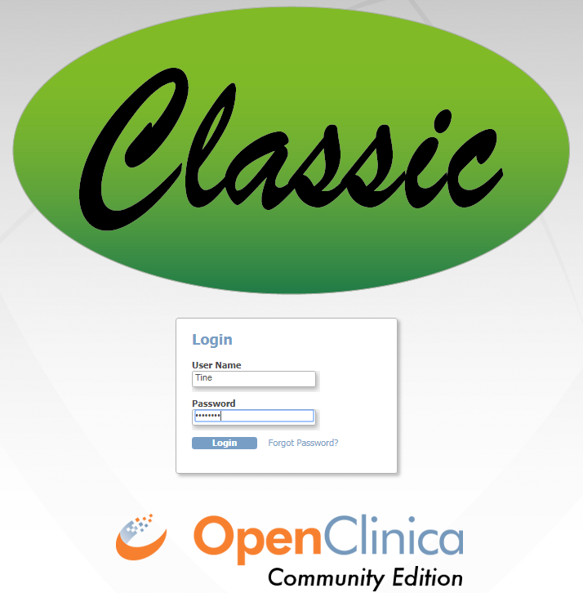
Screening

Slide 28
Randomisation
  ALWAYS obtain consent from the first trial guardian (første forsøgsværge) BEFORE randomisation
  Consent can initially be oral
  State full name of the primary trial guardian in the patient’s medical journal
  Informed consent from next of kin and the second trial guardian as soon as possible

Slide 29
Exclusion criteria
  Septic shock for more than 12h
  Life-threatening bleeding
  Acute burn injury of more than 10% of the body surface area
  Known pregnancy
  Consent not obtainable

Slide 30
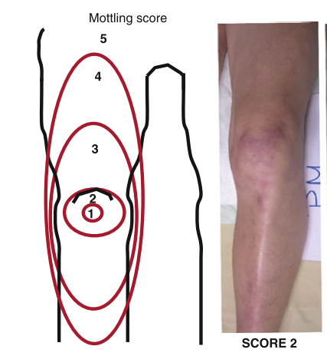
IV fluid restriction
NO IV fluids unless:
1) In case of severe hypoperfusion or severe circulatory impairment:
→ Lactate ≥4 mmol/L
→ MAP <50 mmHg (+/- vasopressor/inotrope)
→ Mottling beyond edge of kneecap (mottling score>2)
→ Urinary output <0.1mL/kg body weight/h (only first 2 hrs after randomisation)
IV fluid bolus (250-500mL) may be given (not mandated)
Followed by re-evaluation
1
1. Ait-Oufella et al. Intensive Care Med 2011

Slide 31
IV fluid restriction
2) In case of overt fluid losses (e.g. vomiting, large aspirates, diarrhoea, drain losses, bleeding or ascites tap)
IV fluids may be given to correct for the loss only

Slide 32
IV fluid restriction
3) In case the enteral route has failed (or is contraindicated)
IV fluids may be given to:
→ Correct dehydration or electrolyte deficiencies
→ Ensure a total fluid input of 1L per 24h (incl. all fluids with medication and nutrition)

Slide 33
IV drugs + nutrition + oral fluid in CLASSIC pilot
 | Median | Lower quartile | Upper quartile
Day1 | 978 | 415 | 1700
Day2 | 2272 | 1433 | 3245
Day3 | 2382 | 1690 | 3231
Day4 | 2545 | 1616 | 3169
Day5 | 2436 | 1676 | 3023
Day6 | 2336 | 1566 | 3096
Day7 | 2154 | 1502 | 2889
1
Hjortrup et al. Liberal group.
Data not published.

Slide 34
Standard care
No upper limit for the use of either IV or enteral fluids. IV fluids should be given:
1) In case of hypoperfusion and continued as long as hemodynamic variables (as chosen by clinicians) improve¹
2) As maintenance if the ICU has a protocol recommending so
3) To substitute expected or observed loss, dehydration or electrolyte derangements
1. Rhodes et al. Intensive Care Med 2017

Slide 35
Co-interventions
Types of fluids to be used in both groups:
Circulatory impairment: Isotonic crystalloids¹
Overt loss: Isotonic crystalloids. Human albumin may be used if large amounts of ascites are tapped
Dehydration: Water or isotonic glucose
Electrolyte disturbances: Substitute the specific deficiency
Blood products: Specific indications → severe bleeding, severe anaemia, prophylactic if severe coagulopathy
Perner et al. Acta Anaest Scand 2014

Slide 36
Adherence
The allocated fluid therapy applies throughout the ICU stay to a maximum duration of 90 days
ICU readmisions within 90 days → continue the allocated group
The fluid protocol should be upheld at all means possible during e.g. transportation and radiological examinations

Slide 37
Data entry

Slide 38
Withdrawal
A patient can be withdrawn from the trial if:
1) Consent is withdrawn or not given (patient, next-of-kin)
→ Ask permission for continued data registration
2) Clinicians or investigators choice (SAR/SUSAR/clinical decision)
3) Patient is subject to involuntary hospitalisation

Slide 39
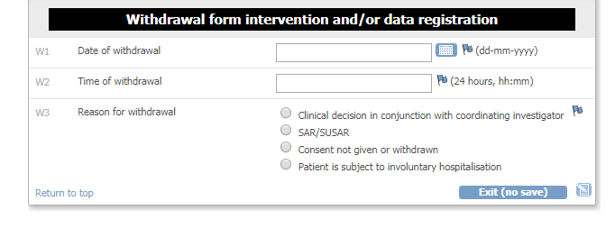
Withdrawal
Fill in withdrawal form in eCRF

Slide 40
SAR
Serious Adverse Reactions (SAR) described in the product characteristics of IV crystalloids
Generalised tonic-clonic seizures
Anaphylactic reactions
Central pontine myelinolysis
Severe hypernatremia (p-Na > 159 mmol/L)
Severe hyperchloraemic acidosis (pH < 7.15 AND p-chloride > 115 mmol/L)
Severe metabolic alkalosis (defined as pH > 7.59 AND SBE > 9 mmol/L)

Slide 41
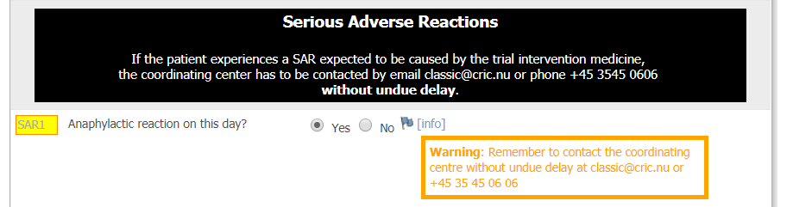
SAR
Contact the sponsor or coordinating investigator without undue delay (classic@cric.nu or +45 3545 0606)

Slide 42
SUSAR
Suspected Unexpected Serious Adverse Reactions (SUSAR)
Serious adverse reactions which are not described in the product characteristics of IV crystalloids
Contact the sponsor or coordinating investigator without undue delay (classic@cric.nu or +45 3545 0606)
Fill in the SUSAR report form (#14 in the Site Master File) and e-mail it to sponsor classic@cric.nu

Slide 43
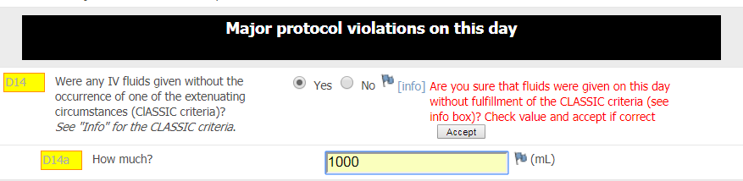
Day forms/ Protocol violations
NB! Restrictive group: Any fluids given on this day without one of the extenuating circumstances? ‘CLASSIC criteria’
A WARNING will be displayed in the eCRF

Slide 44
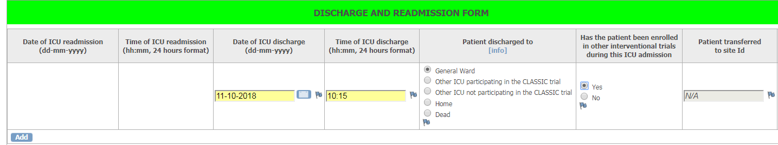
Discharge, transfer and death
When a patient is transferred, discharged or dies in ICU, complete the ‘Discharge and readmission’ form

Slide 45

90-day follow-up
Complete the 90-day follow-up form
Mortality (including date of death)
Discharge from hospital (date of discharge)
Readmission to hospital (days readmitted within the 90-day period)

Slide 46

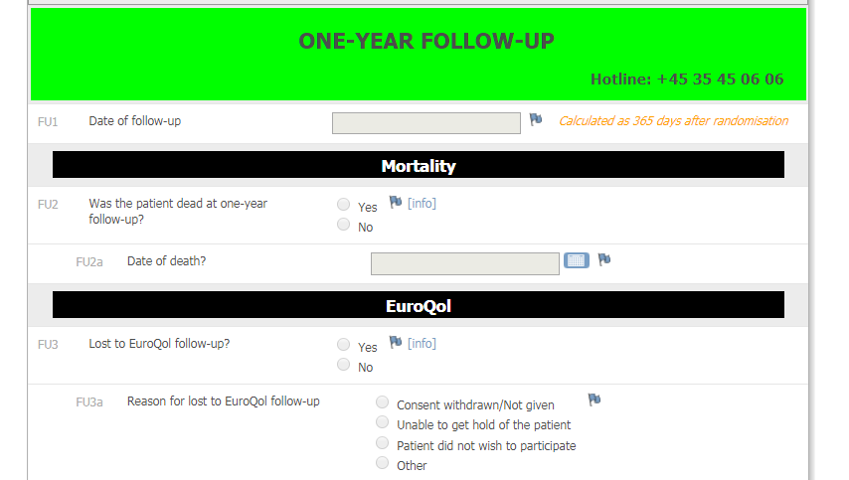

One-year follow up
Complete the 1-year follow-up form
Mortality (centrally drawn from the National Patient Registry in DEN)
HRQoL (EQ-5D-5L + EQ-VAS)
Cognitive function MoCA MINI

Slide 47
Trial Documents
www.cric.nu/CLASSIC

Slide 48
Contact
  Do you need help?
  Call the CLASSIC hotline at:
+45 3545 0606
Available 24/7
or
classic@cric.nu

Slide 49

Thank you!
Tine Sylvest Meyhoff, MD
Department of Intensive Care 4131
Copenhagen University Hospital, Rigshospitalet
Centre for Research in Intensive Care, CRIC
classic@cric.nu
www.cric.nu/classic
Phone: +45 3545 0606

Slide 50
Thank you!
Tine Sylvest Meyhoff, MD
Department of Intensive Care 4131
Copenhagen University Hospital, Rigshospitalet
Centre for Research in Intensive Care, CRIC
classic@cric.nu
www.cric.nu/classic
Phone: +45 3545 0606

