Slide 1


The Conservative vs. Liberal Approach to fluid therapy of Septic Shock in Intensive Care CLASSIC Trial
Tine Sylvest Meyhoff, MD
Department of Intensive Care 4131
Copenhagen University Hospital, Rigshospitalet
Centre for Research in Intensive Care, CRIC
classic@cric.nu
www.cric.nu/classic
Phone: +45 3545 0606

Slide 2
Disposition
Background
Design
Screening – inclusion and exclusion criteria
Intervention and control group
Follow-up
Questions?

Slide 3
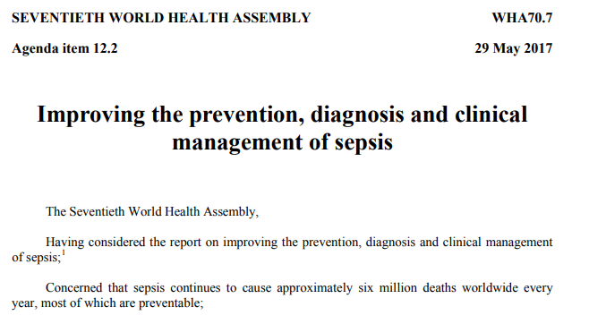




Sepsis is a major global health problem

Slide 4
Surviving Sepsis Campaign guideline
IV fluid recommendations
We recommend that … “at least 30 ml/kg of IV crystalloid
fluid be given”¹
(strong recommendation, low quality evidence)
We recommend that … “fluid administration is continued as long as
hemodynamic factors continue to improve” ¹
(best practice statement)
1. Rhodes et al. Intensive Care Med 2017

Slide 5
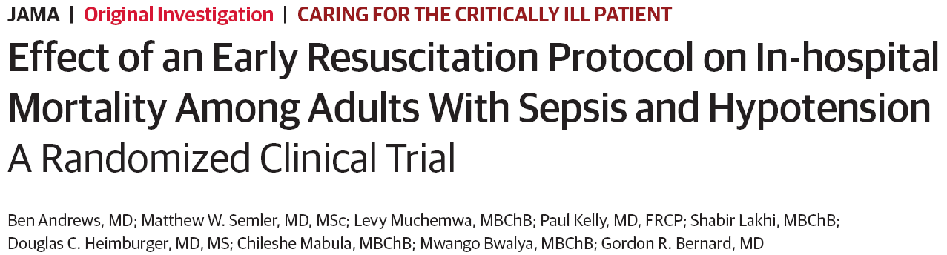
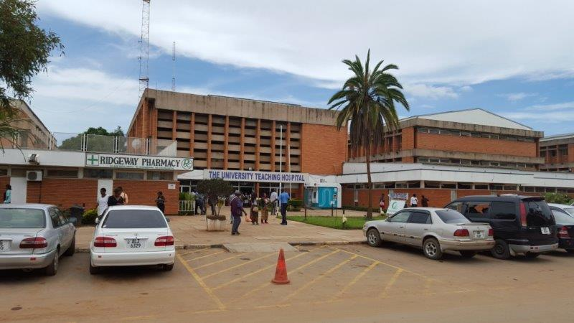
‘EGDT-light’ in emergency dept. in Zambia
1
Intervention
Early resuscitation protocol for sepsis
  IV fluids 2 L
    + 2 L monitored by JVP, RF and SAT
  Vasopressors to MAP of 65 mmHg
  Transfusion at 7 g/dL
Control
Usual care
1. Andrews et al. JAMA 2017

Slide 6
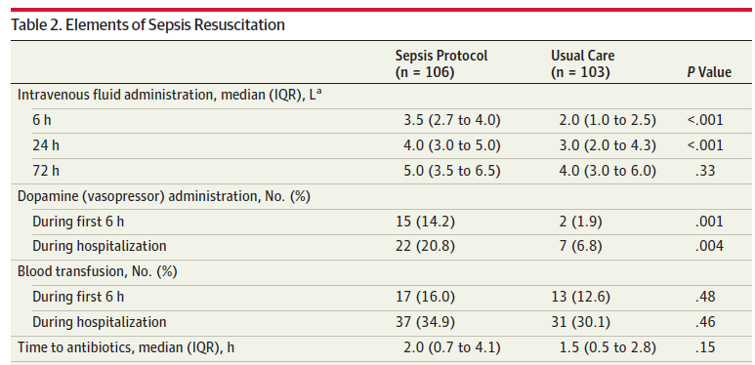
Interventions given

Slide 7
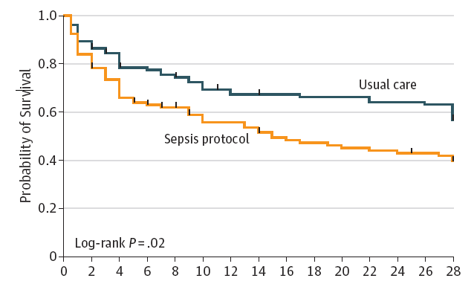
Survival
Days

Slide 8
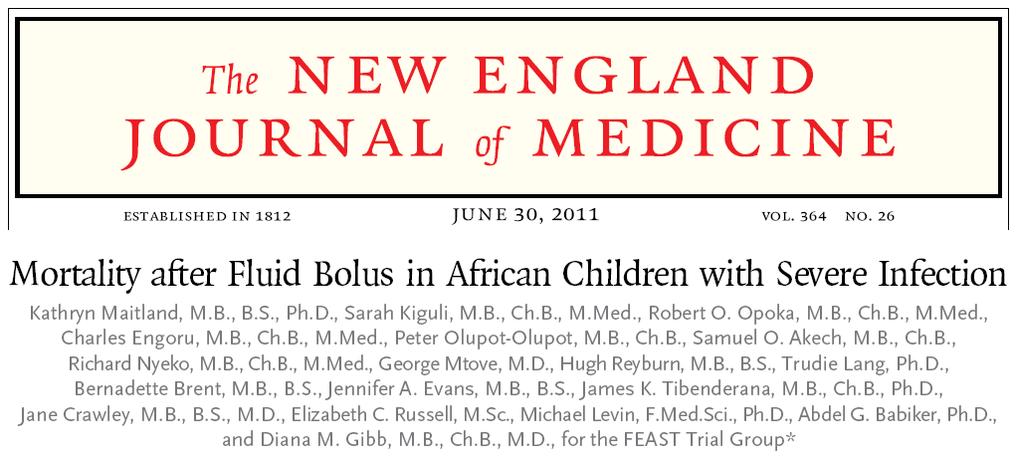
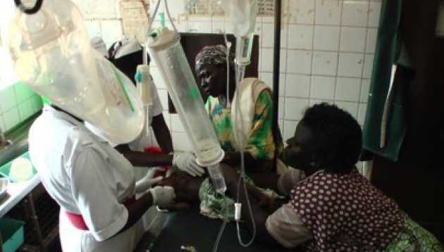
Current knowledge from RCTs in other populations
Interventions
No bolus vs NaCl bolus vs albumin bolus
3000 febrile African children with impaired circulation
1
1. Maitland et al. NEJM 2011

Slide 9
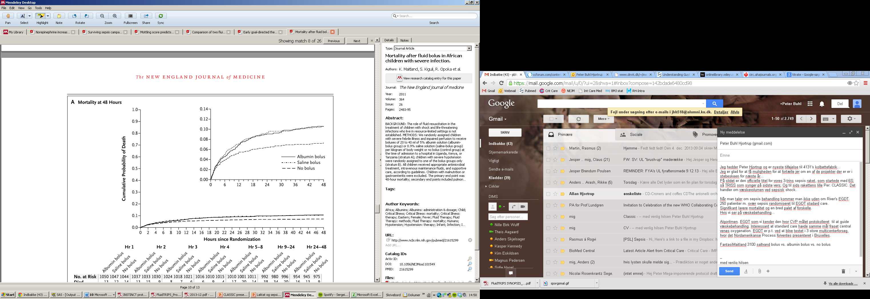
FEAST trial
Mortality at 48 hrs

Slide 10
Background
No RCTs in early resuscitation of adults
with sepsis with IV fluid as the only intervention

Slide 11
2014
2018
RCT
Pilot trial
2020
Updated systematic review
2017
Systematic review

Slide 12
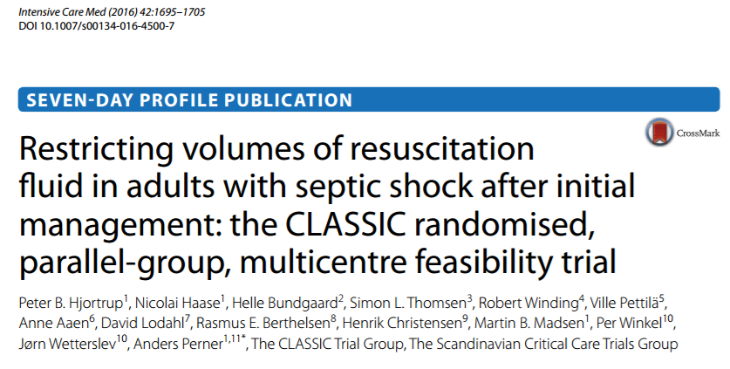
The CLASSIC feasibility trial
9 ICUs in DEN and FIN
153 patients with septic shock randomised to restrictive IV fluid therapy vs standard care for resuscitation
1
1. Hjortrup et al. Intensive Care Med 2016

Slide 13
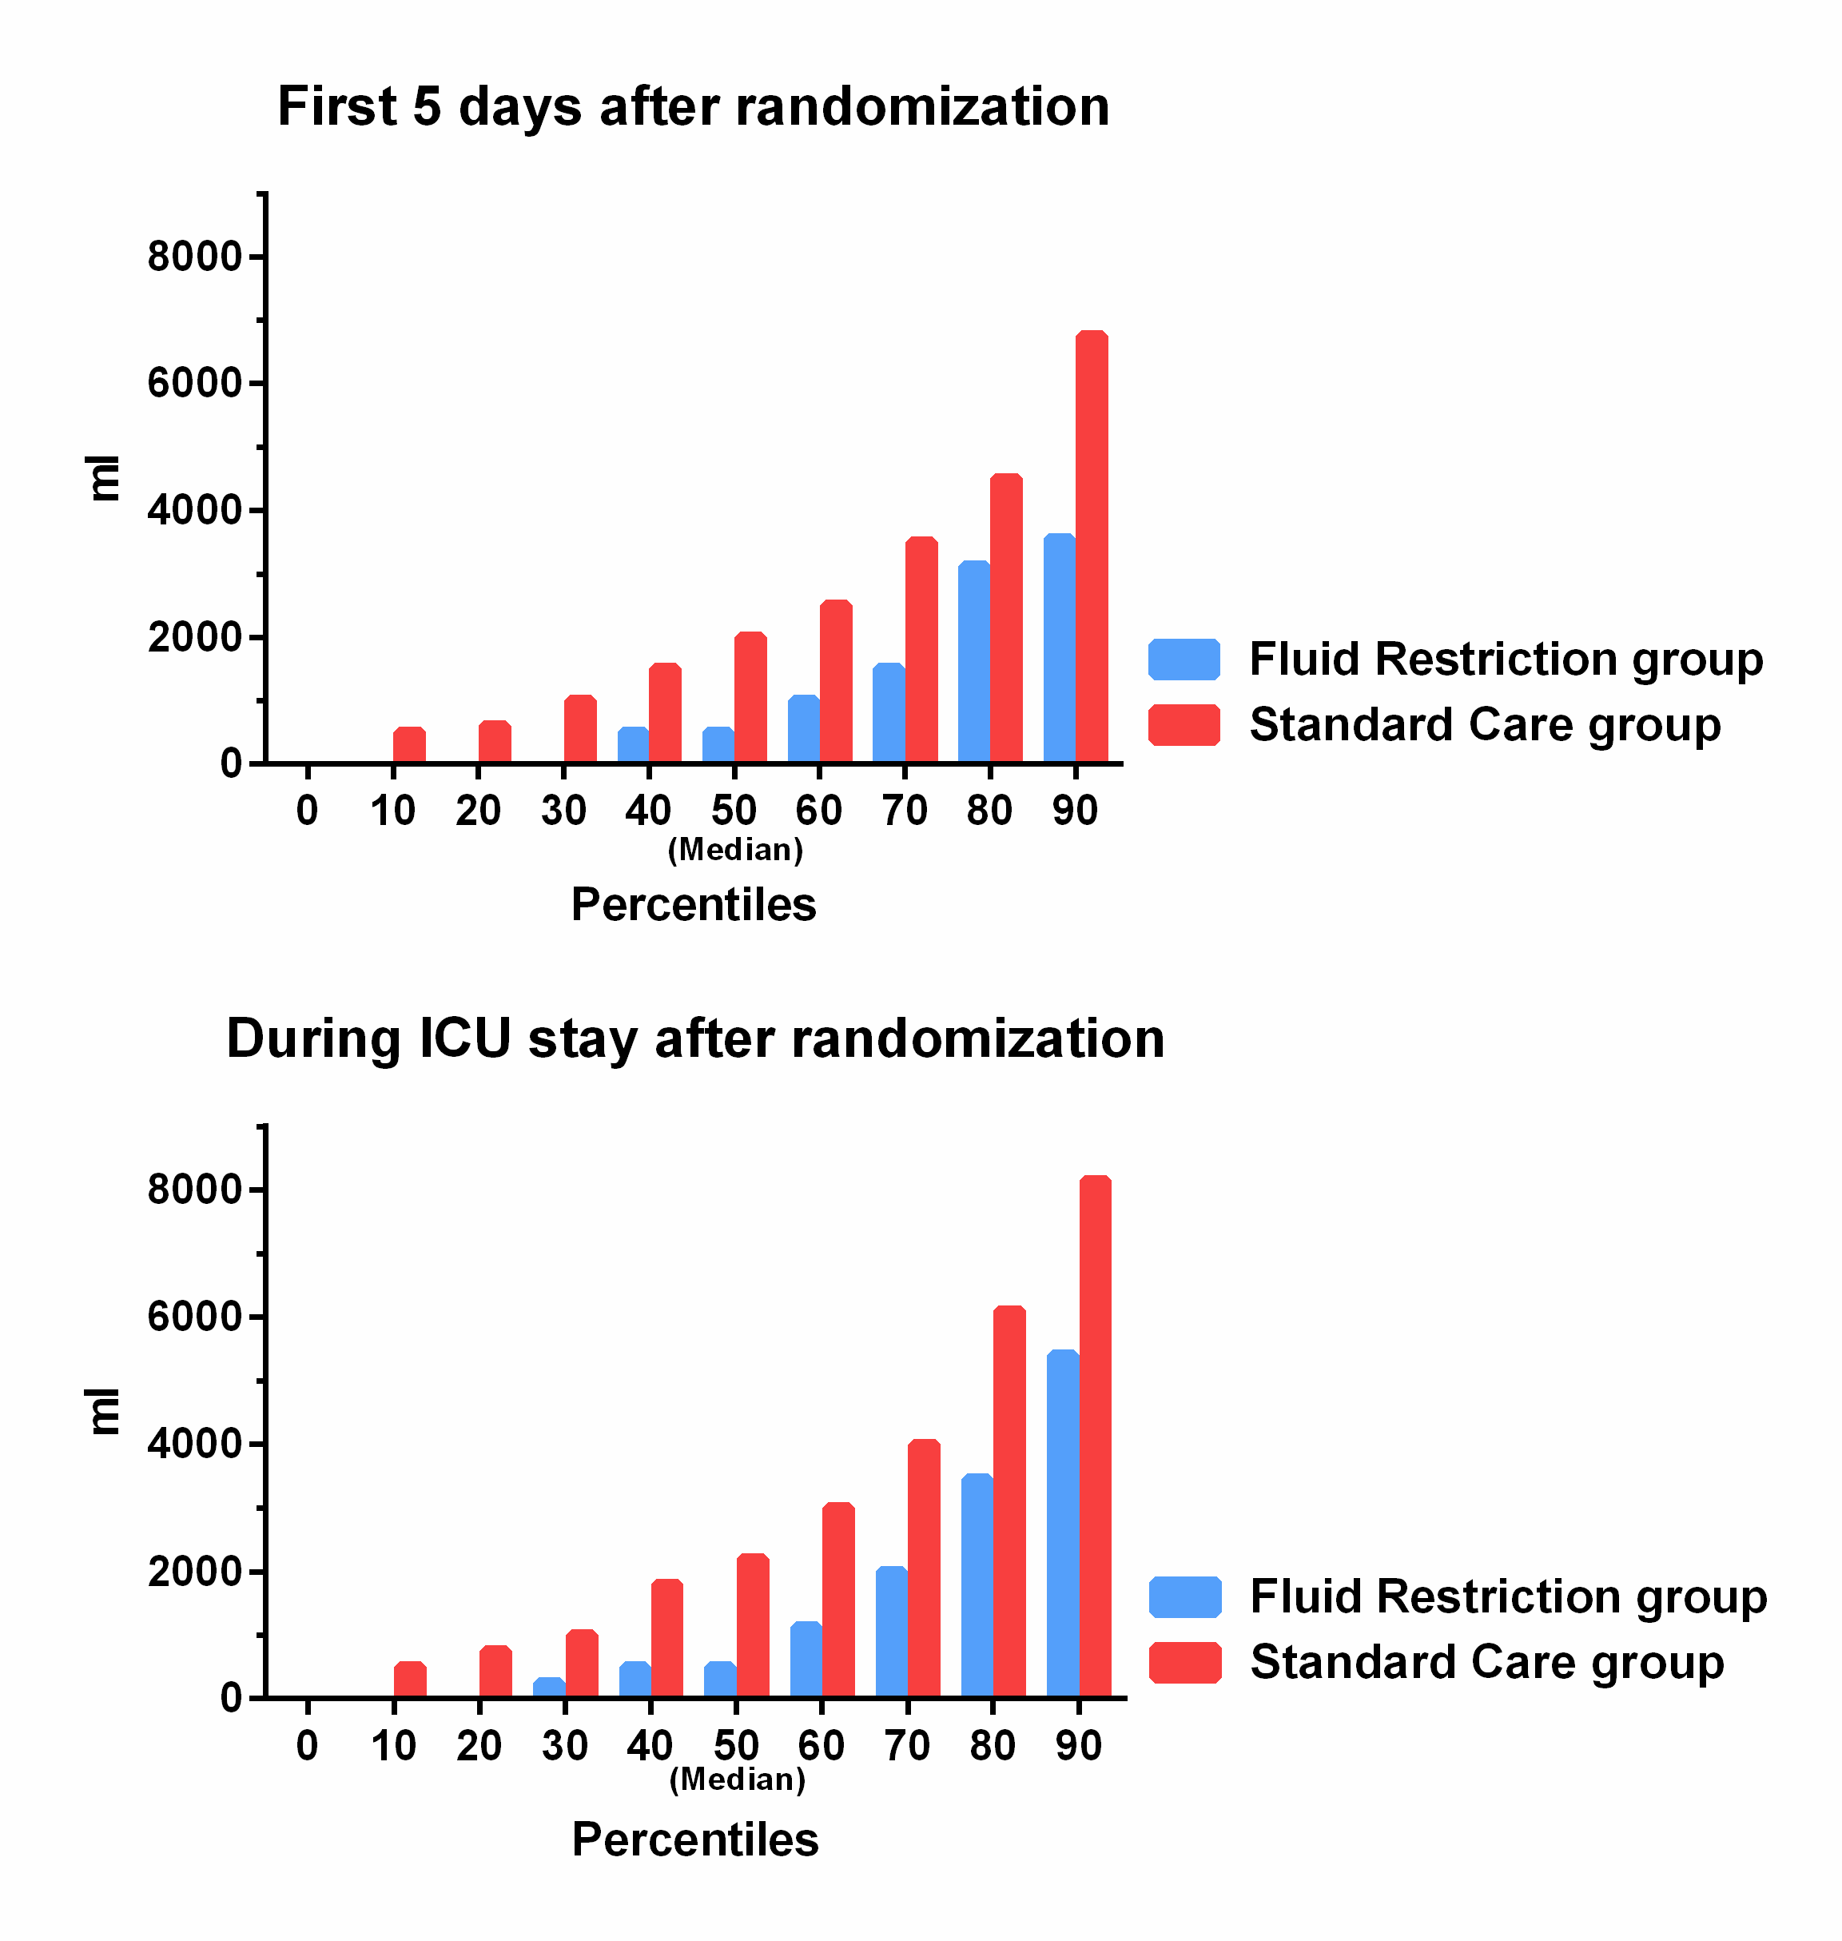
Primary outcome (feasibility)
 | Fluid Restriction Group (N=75) | Standard Care Group (N=76) |  | P-Value
Volumes of resuscitation fluid (ml)
First 5 days after randomization | 500 (0-2,500) [1,687] | 2,000 (1,000-4,100) [2,928] |  | <0.001

Slide 14
2014
2018
RCT
Pilot trial
2020
Updated systematic review
2017
Systematic review

Slide 15
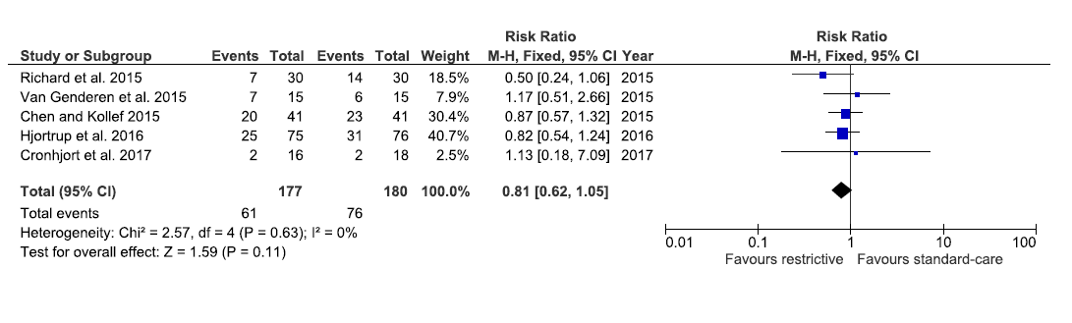
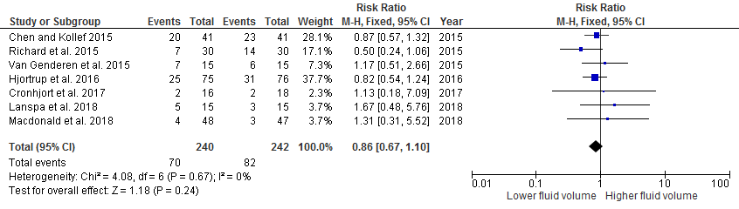
Systematic review with meta-analysis
The quantity and quality of evidence supporting the better volume of fluids in patients with sepsis is very low
Unknown balance between benefits and harms and clinical equipoise
1
1. Meyhoff et al. In prep.

Slide 16
2014
2018
RCT
Pilot trial
2020
Updated systematic review
2017
Systematic review

Slide 17


Aim
To assess benefits and harms of IV fluid restriction vs. standard of care in adult ICU patients with septic shock
Potential benefit
Reduced organ oedema Kidneys, gut, lungs
Potential harm
Impaired perfusion
Mortality?

Slide 18

Design
1554 Patients
Intervention
Control
IV fluid restriction
Standard care
n = 777
n = 777
Primary outcome 90-day mortality (all-cause)

Slide 19











Design
Randomised, open-labelled, outcome assessor-blinded trial of restrictive IV fluid therapy vs standard care
Setting: 50 European ICUs (12 in DK)
Start November 2018, Copenhagen University Hospital Rigshospitalet

Slide 20

Screening
Screen all adult patients with septic shock (inclusion criteria)

Slide 21
Inclusion criteria
Age 18 years or above
In ICU or planned admission to the ICU
Septic shock (SEPSIS-3 Criteria) - Suspected or confirmed infection AND - Vasopressor/inotrope ongoing to maintain MAP 65 mmHg or above AND - Lactate ≥ 2 mmol/L in the last 3-h
Received at least 1L of IV fluid (crystalloids, colloids or blood products) in the last 24-h
1
1. Singer et al. JAMA 2016

Slide 22
Exclusion criteria
  Septic shock for more than 12h
  Life-threatening bleeding
  Acute burn injury of more than 10% of the body surface area
  Known pregnancy
  Consent not obtainable

Slide 23
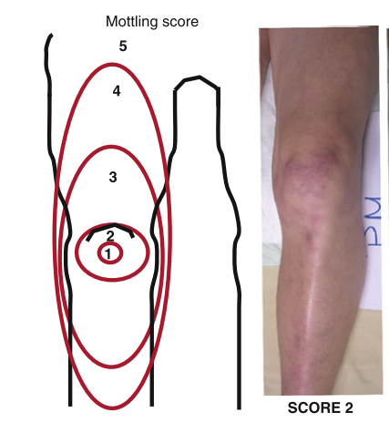
IV fluid restriction
NO IV fluids unless:
1) In case of severe hypoperfusion or severe circulatory impairment:
→ Lactate ≥4 mmol/L
→ MAP <50 mmHg (+/- vasopressor/inotrope)
→ Mottling beyond edge of kneecap (mottling score>2)
→ Urinary output <0.1mL/kg body weight/h (only first 2 hrs after randomisation)
IV fluid bolus (250-500mL) may be given (not mandated)
Followed by re-evaluation
1
1. Ait-Oufella et al. Intensive Care Med 2011

Slide 24
IV fluid restriction
2) In case of overt fluid losses (e.g. vomiting, large aspirates, diarrhoea, drain losses, bleeding or ascites tap)
IV fluids may be given to correct for the loss only

Slide 25
IV fluid restriction
3) In case the enteral route has failed (or is contraindicated)
IV fluids may be given to:
→ Correct dehydration or electrolyte deficiencies
→ Ensure a total fluid input of 1L per 24h (incl. all fluids with medication and nutrition)

Slide 26
Standard care
No upper limit for the use of either IV or enteral fluids. IV fluids should be given:
1) In case of hypoperfusion and continued as long as hemodynamic variables (as chosen by clinicians) improve¹
2) As maintenance if the ICU has a protocol recommending so
3) To substitute expected or observed loss, dehydration or electrolyte derangements
1. Rhodes et al. Intensive Care Med 2017

Slide 27
Adherence
The allocated fluid therapy applies throughout the ICU stay to a maximum duration of 90 days
ICU readmisions within 90 days → continue the allocated group
The fluid protocol should be upheld at all means possible during e.g. transportation and radiological examinations

Slide 28

90-day follow-up
Complete the 90-day follow-up form
Mortality (including date of death)
Discharge from hospital (date of discharge)
Readmission to hospital (days readmitted within the 90-day period)

Slide 29


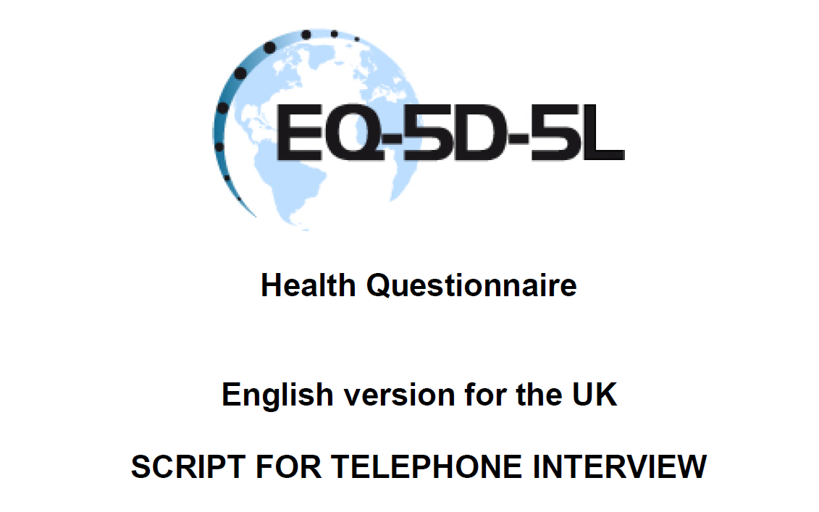
One-year follow up
Complete the 1-year follow-up form
Mortality (centrally drawn from the National Patient Registry in DEN)
HRQoL (EQ-5D-5L + EQ-VAS)
Cognitive function MoCA MINI

Slide 30
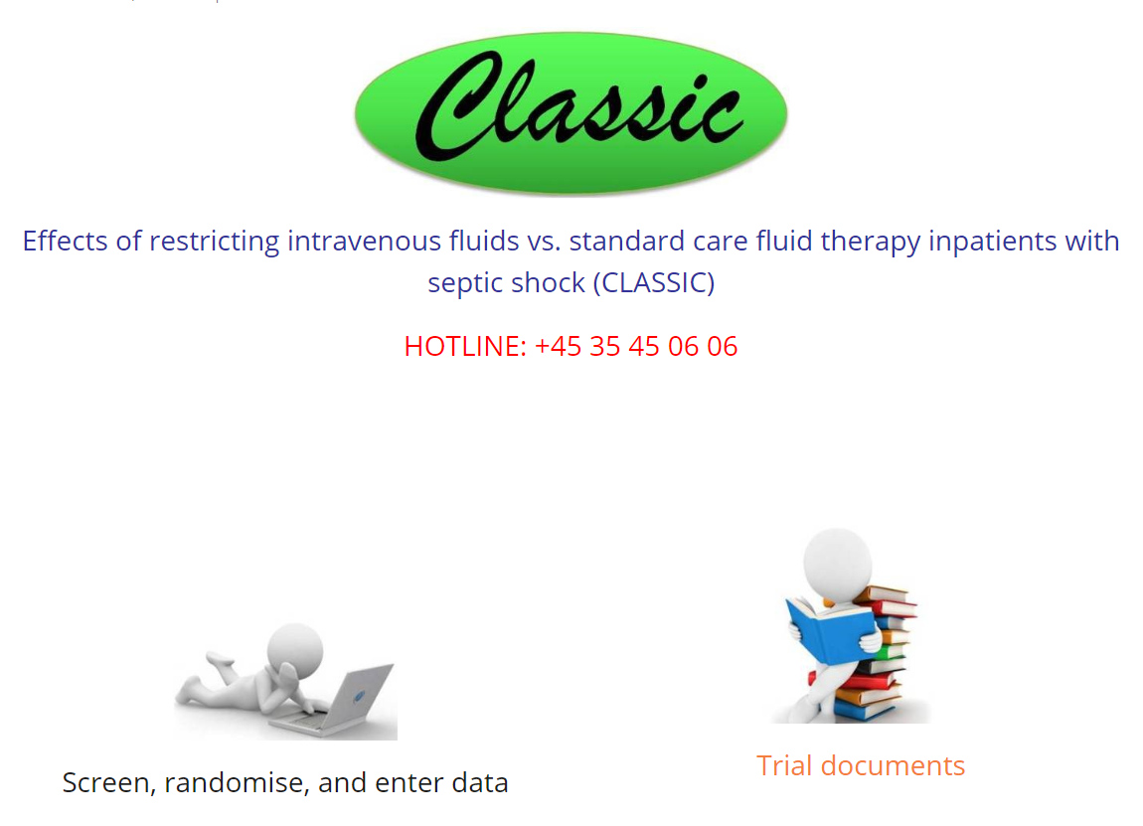
Trial Documents
www.cric.nu/CLASSIC

Slide 31
Contact
  Do you need help?
  Call the CLASSIC hotline at:
+45 3545 0606
Available 24/7
or
classic@cric.nu

Slide 32

Thank you!
Tine Sylvest Meyhoff, MD
Department of Intensive Care 4131
Copenhagen University Hospital, Rigshospitalet
Centre for Research in Intensive Care, CRIC
classic@cric.nu
www.cric.nu/classic
Phone: +45 3545 0606

Slide 33
Thank you!
Tine Sylvest Meyhoff, MD
Department of Intensive Care 4131
Copenhagen University Hospital, Rigshospitalet
Centre for Research in Intensive Care, CRIC
classic@cric.nu
www.cric.nu/classic
Phone: +45 3545 0606

