Slide 1


Daily clinical screening
Every morning
Clinicians point out new eligible patients who fullfill all inclusion criteria
All patients fulfilling all inclusion criteria must be screened in eCRF
But first…

Slide 2

Informed consent
It is legal to include inhabited participants in clinical trials if surrogate consent is obtained (Komitéloven §4)
All patients with COVID-19 and severe hypoxia will be temporarily incompetent
Acute illness
Low oxygen saturation
Stress-response associated with lack of oxygen
The first trial guardian (doctor)
independent of the trial
knowledge of the clinical condition
familiar with the trial protocol

Slide 3
Informed consent
Procedure
1. Obtain informed consent from the first trial guardian before randomisation (oral consent by telephone is permitted)
2. Note date, time and name of first trial guardian in electronic medical journal
3. Obtain written consent from the first trial guardian by post or e-mail as soon as possible

Slide 4

After consent – screen & include
Log into the electronic medical journal
Screening of inclusion and exclusion criteria for new eligible patients
Log on to the web based eCRF
Screening of inclusion and exclusion criteria
Notes:
Husk ALLE patienter, der opfylder inklusionskriterierne skal screenes, også selvom de opfylder ét eller flere af eksklusionskriterierne.

Slide 5

Randomisation
Informed consent is obtained from first trial guardian
AND
Patient fulfill all inclusion criteria and none of the exclusion criteria
THEN
Randomise the patient in the web based eCRF

Slide 6
Informed consent
Next of kin and second trial guardian
Obtain consent as soon as possible from the next of a kin by phone and a second trial guardian
Next of kin is defined as relatives, friends or other acquaintances in regular contact with the trial partcipant
Second trial guardian must fulfill the same criteria as the first trial guardian
Trial participant
Consent must be obtained as soon as patient regains competence, preferably during admission
http://www.nvk.dk/emner/information-og-samtykke-i-forsoeg/vejledning-om-samtykke-i-forsoeg
Notes:
VIGTIGT: Vi kontakter kun pårørende pr telefon og sender dem samtykkepapirerne enten med e-mail eller post. Dette er af hensyn til smittefare o så pårørende skal have deres sparede tid hos patienten, uden at vi forstyrrer. Det er ikke nemt at indhente samtykke fra pårørende i krise – så brug hinanden og os bag forsøget til sparring.
Vi forsøger at identificere pårørende i 2 uger. Hvis % pårørende, da trækkes patient ud.
Vi forsøger at indhente patientsamtykke, mens fortsat indlagt. Hvis udskrevet, da forsøges patientsamtykke indhentet inden hver follow up.

Slide 7
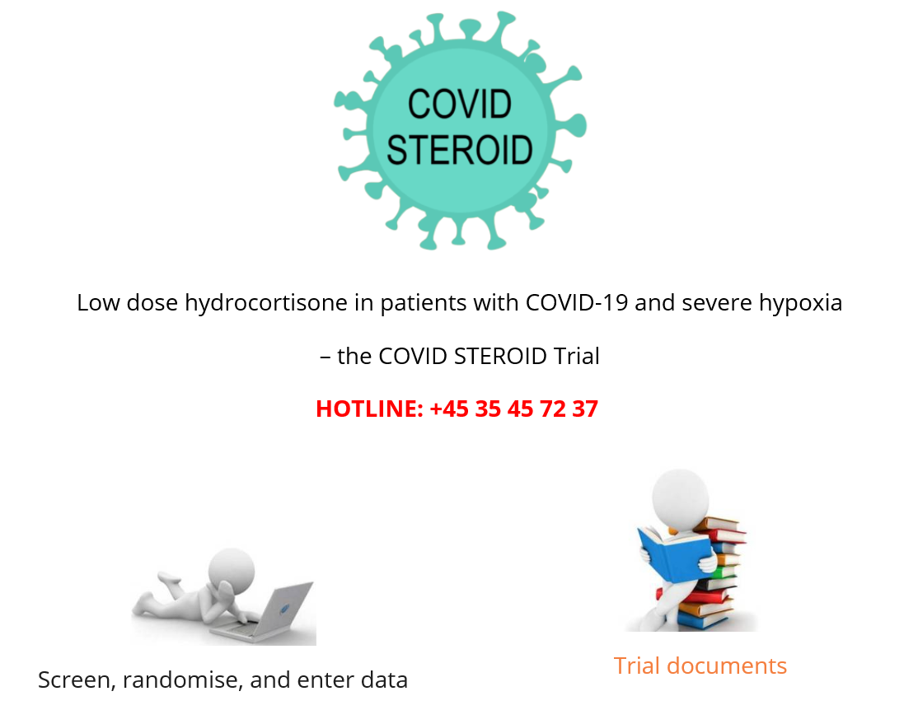
Screen, randomise and enter data
www.cric.nu/covid-steroid-trial
Notes:
Screening og randomisering udføres her.

