Slide 1


Data entry
Data entry performed by unblinded primary trial personnel
Screening form
Administered trial medication form (day 1-7)
Consent form
Data entry performed by blinded primary trial personnel
Day forms (day 1-14)
Discharge form
Follow up forms at day 28, 90 and 1 year
Data entry by both unblinded and blinded primary trial personnel
Baseline form
Withdrawal form

Slide 2
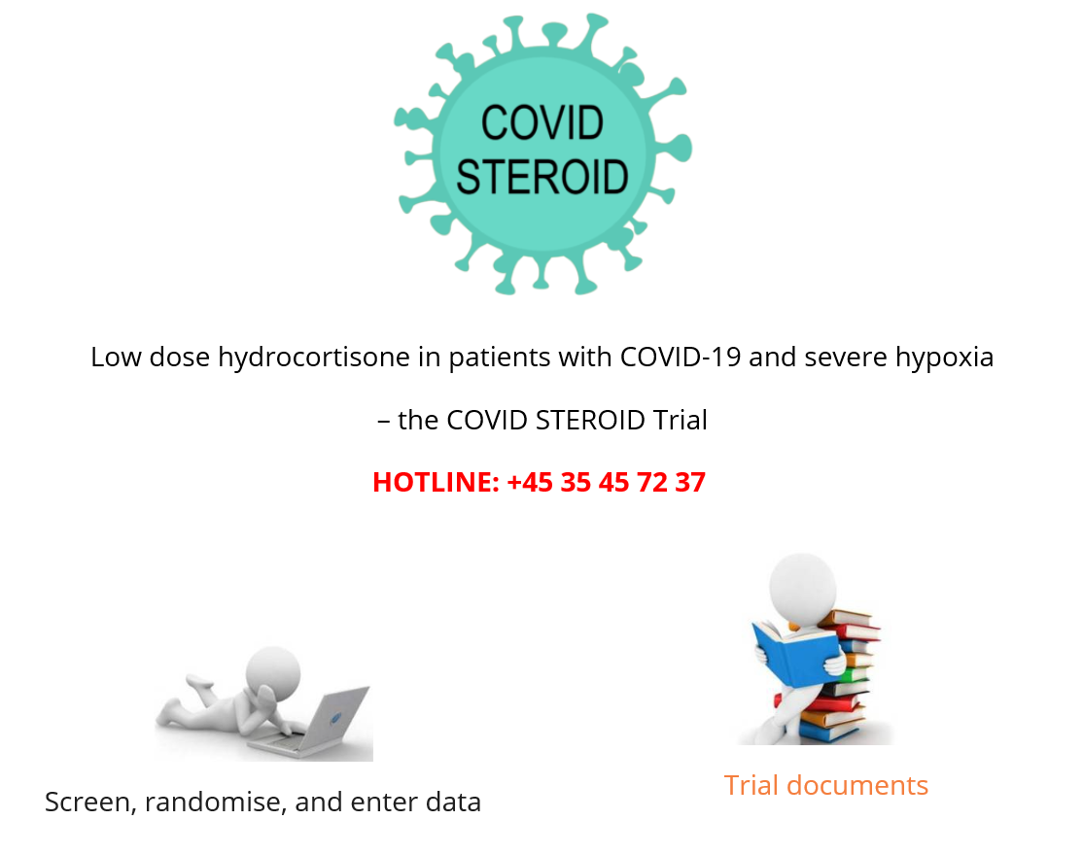
Screen, randomise and enter data
www.cric.nu/covid-steroid-trial

