Slide 1
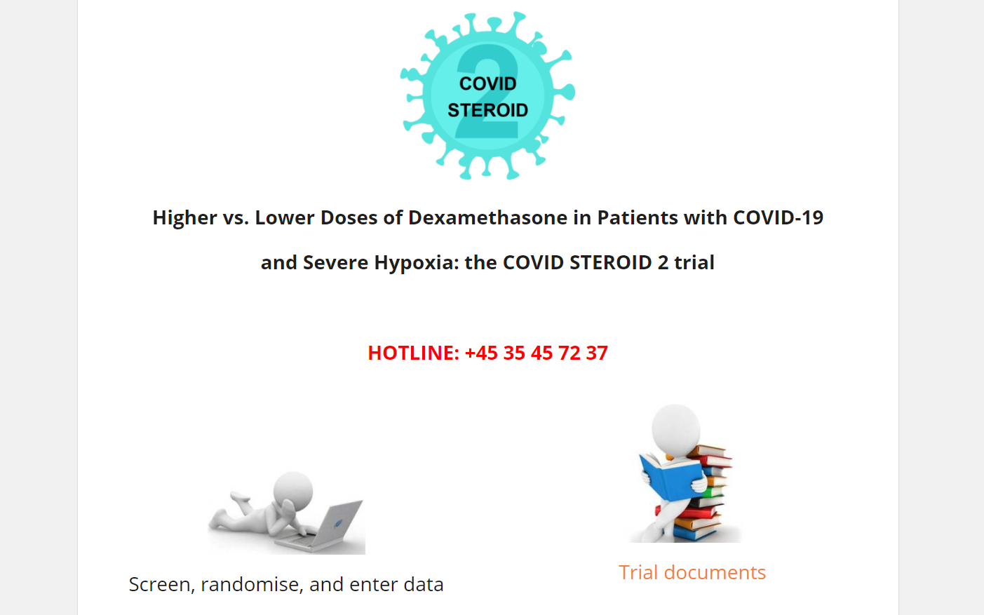
Screen, randomise and enter data
To screen, randomise or enter data, go to www.cric.nu/covid-steroid-2 and click on the ‘Screen, randomise and enter data’ icon

Slide 2

Data entry
For detailed information on how to use the electronic case report form (OpenClinica), go to http://www.cric.nu/covid-steroid-2-ecrf/

Slide 3
Data entry
Data entry performed by unblinded primary trial personnel
Screening form
Administered trial medication form (day 1-7)
Consent form
Data entry performed by blinded primary trial personnel
Dayforms (day 1-14)
Discharge form
Follow up forms at day 28, 90 and 1 year
Data entry performed by both unblinded and blinded primary trial personnel
Baseline form
Withdrawal form

Slide 4
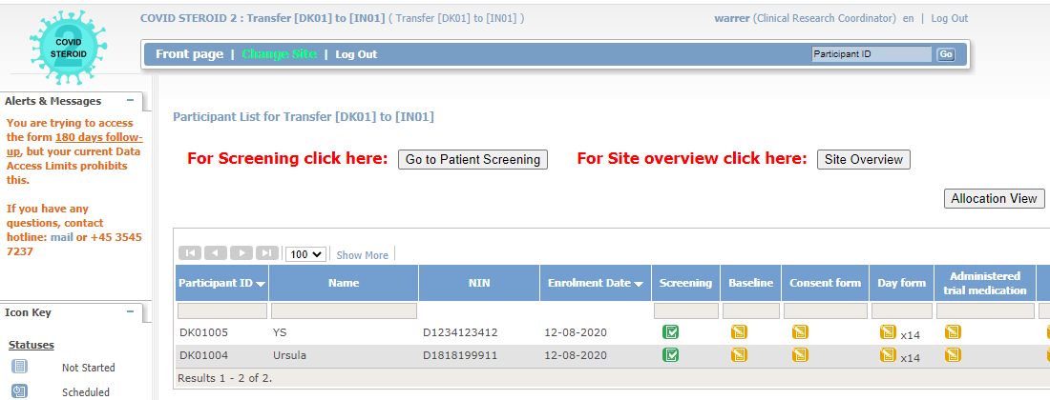
Data entry
If a user tries to enter data in a form that he/she do not have access to, the user will be directed back to the front page and a warning message will appear in the upper left corner of the screen:

