Slide 1
Higher vs. Lower Doses of Dexamethasone in Patients with COVID-19 and Severe Hypoxia: the COVID STEROID 2 trial
No conflicts of interest
Marie Warrer Petersen, MD, Ph.d.-student
Department of Intensive Care
Copenhagen University Hospital, Rigshospitalet
www.cric.nu/covid-steroid-2
Phone: +45 3545 7237

Slide 2
Disposition
Background
Design
Inclusion and exclusion criteria
Intervention and control group
Outcomes
Unblinded and blinded trial staff

Slide 3
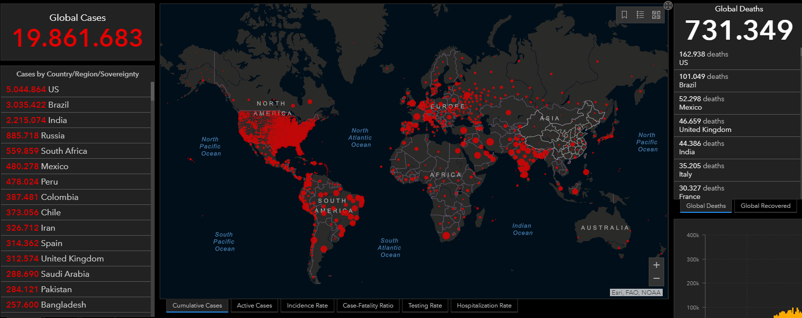
COVID-19 is a global health emergency
Aug 10, 2020

Slide 4
Treatment of COVID-19
Primarily supportive therapy

Slide 5
Low-dose hydrocortisone in patients with COVID-19 and severe hypoxia Adult patients with confirmed COVID-19 requiring oxygen therapy ≥ 10 L/min or mechanical ventilation Hydrocortisone 200 mg daily vs. placebo for 7 days April 15 to June 16, 2020: 30 patients randomised
Protocol: Petersen Acta Anaesthesiologica Scandinavica (in press)

Slide 6
Hospitalised patients with confirmed or suspected COVID-19 (n = 6,425) Dexamethasone 6 mg daily (n = 2,104) vs. usual care (n = 4,321) for 10 days
28-day mortality Overall: rate ratio 0.83 [0.75 to 0.93] Invasive mechanical ventilation: rate ratio 0.64 [0.51 to 0.81]
RECOVERY Collaborative Group N Engl J Med 2020

Slide 7
WHO meta-analysis
Prospective meta-analysis of systemic corticosteroids for critically ill patients with COVID-19
Outcomes: 28-day mortality and serious adverse reactions (SARs)

Slide 8
Updated clinical guidelines
Recommendations
Dexamethasone 6 mg for 10 days in patients receiving mechanical ventilation or supplementary oxygen
Recommend against using dexamethasone in patients not requiring supplementary oxygen

Slide 9
Clinical practice post-RECOVERY
26 COVID STEROID 2 trial sites
All sites had used corticosteroids for COVID-19
95% sites had used corticosteroids for all COVID-19 patients
Most often dexamethasone
Median dose 9.6 (IQR 6.0-15.0) mg

Slide 10
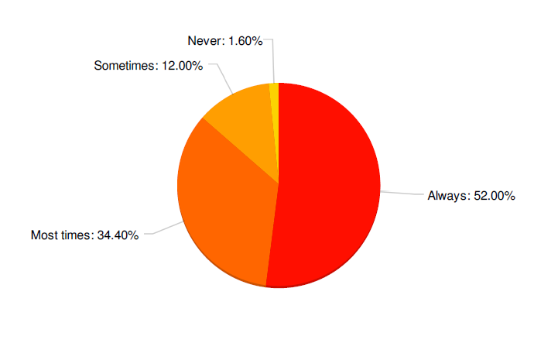
Clinical preferences post-RECOVERY
Would you use corticosteroids for patient with COVID-19 and hypoxia?
250 responders from DK, SE, CH, and IN
Notes:
56% would use 6 mg of dexamethasone or equivalent, and 36% would use a dose above 6 mg (unpublished results).

Slide 11
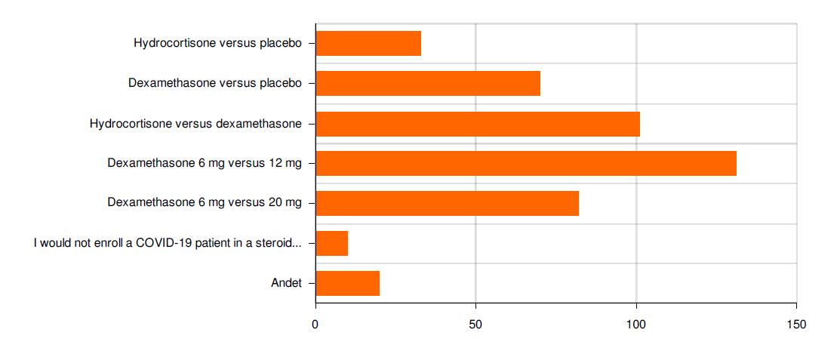
Clinical preferences post-RECOVERY
Which comparison would you accept in a trial in COVID-19 patients?
237 responders from DK, SE, CH, and IN

Slide 13
Aim
12 mg dexamethasone
Benefit?
Increase in days alive without life support
Increase in days alive and out of hospital
Mortality?
Harm?
Serious adverse reactions
Mortality?

Slide 14
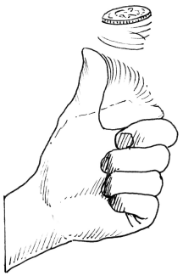
Design
International, parallel-grouped, stratified, blinded RCT
1,000 adult patients with COVID-19
Severe hypoxia
Dexamethasone 12 mg
Up to 10 days
Dexamethasone 6 mg
Up to 10 days

Slide 15
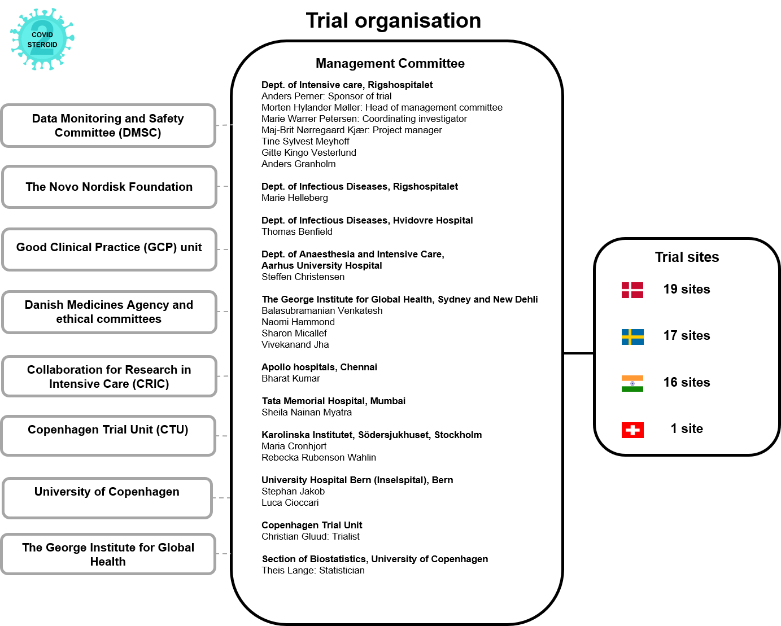
Organisation

Slide 16
Inclusion criteria
✓ Aged 18 years or above AND
✓ Confirmed COVID-19 requiring hospitalisation AND
✓ Use of one of the following:
Invasive mechanical ventilation OR
NIV or continuous use of CPAP for hypoxia OR
Oxygen supplementation with flow ≥10 L/min independent of delivery system

Slide 17
Exclusion criteria
Use of systemic corticosteroids for other indications than COVID-19 in doses higher than 6 mg dexamethasone equivalents
Use of systemic corticosteroids for COVID-19 for 5 consecutive days or more
Invasive fungal infection
Active tuberculosis
Fertile woman (< 60 years of age) with positive urine human gonadotropin (hCG) or plasma-hCG
Known hypersensitivity to dexamethasone
Previously randomised into the COVID STEROID 2 trial
Informed consent not obtainable

Slide 18
Intervention: 12 mg dexamethasone
12 mg dexamethasone in isotonic saline (0.9%)
Bolus injection (5 ml) every 24 hours
Mixture proportion according to local brand used

Slide 19
Control intervention: 6 mg dexamethasone
6 mg dexamethasone in isotonic saline (0.9%)
Bolus injection (5 ml) every 24 hours
Mixture proportion according to local brand used

Slide 20
Intervention period
Up to 10 days from randomisation depending on the number of consecutive days with steroid use for COVID-19 before randomisation, e.g.
Steroids before randomisation (days) | Intervention period (days)
0 | 10
1 | 9
2 | 8
3 | 7
4 | 6
5+ | Exclude

Slide 21
Intervention period
Up to 10 days from randomisation OR until discharge OR death
Transfer to other COVID STEROID 2 site within intervention period
CONTINUE intervention up to 10 days from randomisation
Transfer to non-trial site within intervention period
STOP intervention
Readmission to COVID STEROID 2 site within intervention period
CONTINUE intervention up to 10 days from randomisation

Slide 22
Protocol adherence
Daily registration of protocol violations during intervention period
Open-label corticosteroids?
Trial medication administered?

Slide 23
Outcomes
Primary outcome Days alive without life support at day 28 Mechanical ventilation Circulatory support Renal replacement therapy
Secondary outcomes SARs at day 28
New episodes of septic shock
Invasive fungal infection
Clinically important GI bleeding
Anaphylaxis
All-cause mortality at day 28, 90 and 180
Days alive without life support at day 90
Days alive and out of hospital at day 90
Health-related quality of life (HRQoL) at day 180
EQ-5D-5L
EQ-VAS

Slide 24
Participant timeline
Enrolment
Day 1-10
Day 10-14
Follow-up 28 days
Follow-up 90 days
Follow-up 180 days
Screening
Inclusion and exclusion criteria
Informed consent
Screening in eCRF
Randomisation
Daily trial medication up to day 10
Protocol violations
Use of life support
SARs
Use of life support
SARs
Use of life support
SARs
Mortality
Use of ECMO
Use of life support
Mortality
Days alive and out of hospital
Mortality
HRQoL

Slide 25
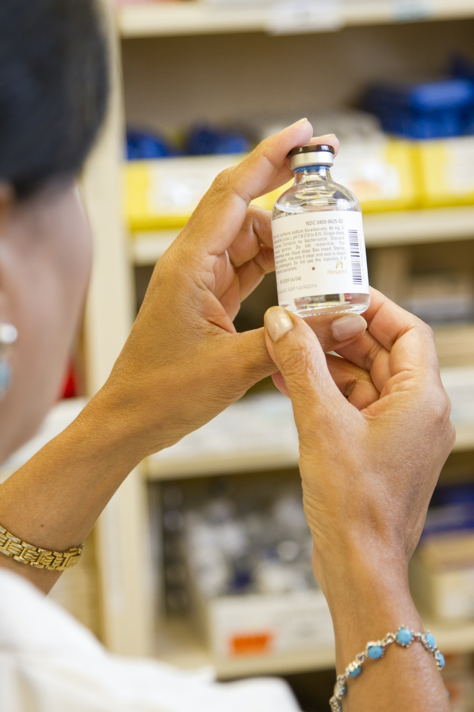
Trial staff
Unblinded staff
Screen and enrol
Prepare trial medications
Blinded staff
Care for patients
Give interventions
Outcome data entry
SAR/SAE/SUSAR reporting

Slide 26
Role of unblinded staff

Slide 27
Screening
All patients fullfilling all inclusion criteria must be screened in eCRF
Obtain informed consent according to national law
Fill out baseline form in the eCRF

Slide 28
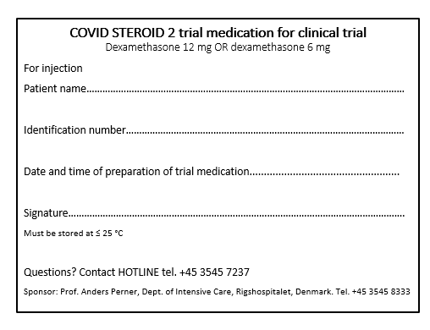
Blinding of trial medication
Trial medications are prepared once daily by two unblinded trial staff not involved in the care of the patients
Daily registration in Administered Trial Medication (ATM) form in eCRF

Slide 29
Role of blinded staff

Slide 30
Blinded staff
Give intervention
Outcome data entry
Dayforms 1-14
Follow-up forms at day 28, 90, 180
Discharge and re-admission form

Slide 31
Reporting of SAR (day 1-28)
Secondary outcome registered in dayforms and 28-day follow-up form
New episodes of septic shock (Sepsis-3 criteria)
Invasive fungal infections
Clinically important GI bleeding (≥ 2 units of RBCs)
Anaphylaxis

Slide 32
SAE and SUSAR
Report any serious adverse event (SAE) to sponsor within 24 hours
If SAE is deemed related to the intervention (SUSAR)
Contact the sponsor without undue delay
Fill in the SUSAR report form (#14a in the Trial Master File) and e-mail it to sponsor
COVID STEROID 2 hotline
+45 3545 7237 covid-steroid@cric.nu

Slide 33
Unblinding
Unblinding can be performed at any time
Contact the local sponsor
Local sponsor will contact the unblinded trial staff
COVID STEROID 2 hotline
+45 3545 7237 covid-steroid@cric.nu

Slide 34
Withdrawal
A participant may have the intervention stopped at any time
Withdrawal at the choice of the investigator
SARs or SUSARs
In the interest of the participant
Withdrawal from active therapy
Compulsory hospitalisation
Withdrawal at the choice of the participant or next of kin
Ask for permission to continue data registration

Slide 35
Role of primary investigator
Primary role Responsible for daily operation of trial at trial site
Remember to
Provide information for clinicians
Ensure that trial medication is available on site
Stay current with updates in Trial Master File
Notes:
PI er ansvarlige for daglige drift af forsøg på forsøgssite i samarbejde med de studerende.
Husk at PI skal videregive information til øvrige personale om forsøget og de enkelte personalegruppers opgaver. Vi har udarbejdet folder og udkast til mail til plejepersonale, som de må gerne må sende rundt. Vi sender en startmappe ud til alle forsøgssites i morgen indeholdende:
Folder, lommekort, sengeskilte
Medicinmappe indeholdende medicinlog, labels
Husk at PI skal sikre sig, at der er nok forsøgsmedicin på lager. Vi anvender hyldevare, så denne funktion varetages formentlig af sygehusapoteket, men dette skal undersøges.
PI må meget gerne oprette et standard forskningsnotat de studerende kan bruge. Vi opretter et tilgængeligt for alle hospitaler i Region H. I kan meget vel oprette et fælles notat for alle afdelinger eller hospitaler i jeres region. I dette journalnotat skal hotline fremgå.
Holde sig ajour med opdatering i TMF. Der udsendes mail, når denne opdateres til alle PI og studerende.
OBS PI får blindet adgang til eCRF, da det er et krav at PI har adgang til forsøgssites data.

Slide 36
Trial documents
Go to www.cric.nu/covid-steroid-2

Slide 37
To access eCRF
Go to www.cric.nu/covid-steroid-2

Slide 38
Contact
Do you need help?
Call the COVID STEROID 2 hotline
+45 3545 7237
Available 24/7
or
covid-steroid@cric.nu

Slide 39
THANK YOU!
?
Marie Warrer Petersen, MD
Department of Intensive Care 4131
Copenhagen University Hospital, Rigshospitalet
www.cric.nu/covid-steroid-trial
Phone: +45 3545 7237

