Slide 1
Goal directed fluid removal with furosemide in intensive care patients with fluid overload – A randomised, blinded, placebo-controlled trial (GODIF)
GODIF initiering_V.1.0_20.08.2020
Sine Wichmann, MD, ph.d.-student
Department of Anaesthesiology and Intensive Care
Nordsjællands hospital, Hillerød
www.cric.nu/godif
godif@cric.nu
Phone: +45 4829 6773

Slide 2
Disposition
Background
Design
Inclusion and exclusion criteria
Intervention and control group
Follow-up

Slide 3
Fluid overload
Very common
Fluid overload is an independent risk factor for organ failure and mortality.
Increasing fluid overload increases the risk.
Notes:
Beregning af overhydrering: kumuleret VB (L)/vægt (kg) x 100 = X%
Flere studier har påvist at FO er en risikofaktor for død og organ dysfunction. Volumina ned til 1% eller 1 liter I pos. VB kan have betydning.

Slide 4
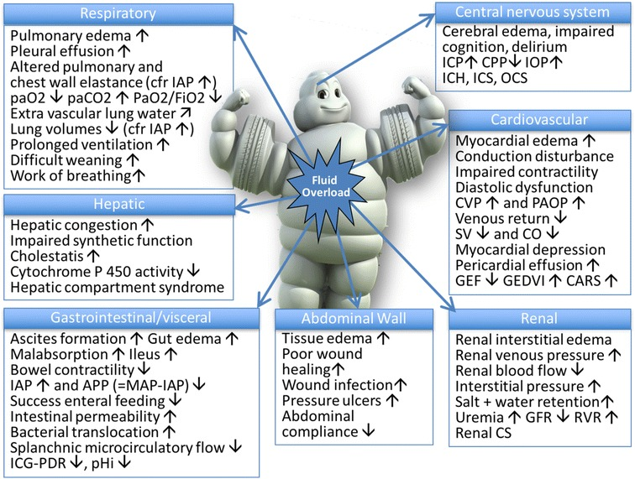
Malbrain et al. 2018
Notes:
Fortsat store mængder væske på intensive på trods af ændrede sepsis guidelines og focus på mindre væske. Pilot studiet til CLASSIC viste store mængder væske indgift – resuscitations væsken var relative lille.

Slide 5
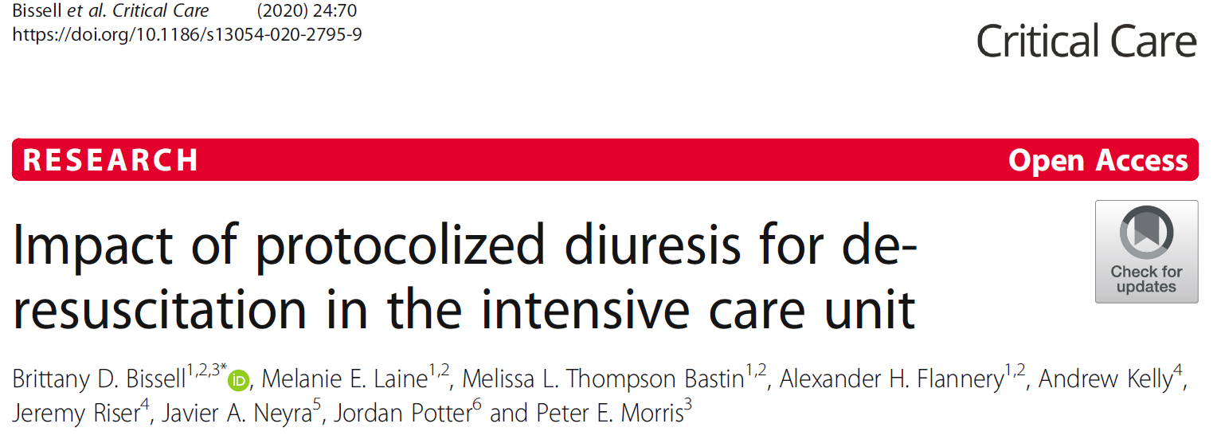
Deresuscitation
Notes:
Silverside: Retrospektivt studie 400 patienter. Ingen intervention. Viste at de mest overhydrerede havde højest mortalitet. Deresuscitation på 3. indlæggelsesdøgn på intensive var associeret med bedre outcomes.
Væskebalance på dag 3 var associeret til 30-dages mortalitet.
Bissell: Kohorte studie med historiske controller. 91 patienter fik interventionen og 273 controller. Inkl. Patienter med en positive VB af alle grader hvis der er tegn på FO på rtg eller fysisk undersøgelse. Viste at deresuscitations algoritme 72 timer post shock mindsker FO med mulige fordele på det kliniske outcome. Hospitals mortalitet var lavere i interventionsgruppen 5.5% vs 16.1% og kortere indlæggelsestid på ITA. Ingen significant forskel I respiratordage. Øget forekomst af hyprenatræmi og hypokaliæmi i interventionsgruppen

Slide 6
Deresuscitation – FACTT trial
Notes:
Comparison of two fluid-management strategies in acute lung injury. 1000 patienter. Baseline FO: 2700-2900 ml I de to grupper. Complicated protocol – intervention styret af indkilingstryk, CVP, status for shock MAP/vasopressor – 20 kasser man kan komme i. KVB de første 7 dage: -136(+/-491) i den restrictive gruppe og 6992 (+/-502) I den liberale gruppe. Ingen forskel I 60 dages mortalitet. De blev ekstuberet 2 dage tidligere og havde 2 dages kortere indlæggelsestid på ITA i den restrictive gruppe.

Slide 7
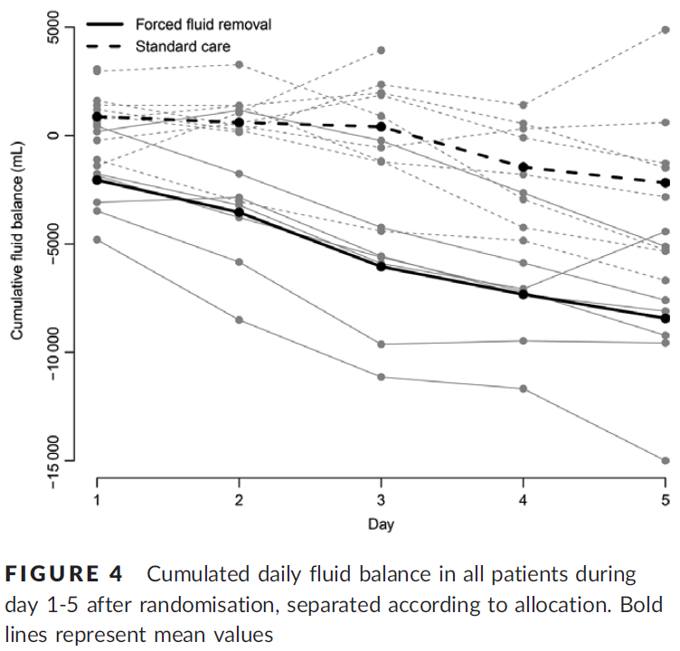
Pilot studie - FFAKI
Notes:
AKI patienter på intensive RH +NOH. Væsketræk med 1 ml/kg IBW/hour er mulig. Gjort med furuosemid og evt. CRRT.
23 patienter. Alle havde moderat til svær AKI og var > 10% overhydrerede.

Slide 8
Current knowledge
Fluid overload is a risk factor for organ dysfunctions and death
Goal directed and fast fluid removal is feasible
We don’t know when or how fluid removal should be done
Notes:
Beregning af overhydrering: kumuleret VB (L)/vægt (kg) x 100 = X%
Ovenstående opgørelse af 2 år på RH + NOH med pt med ny aki (uden CKD).

Slide 9
Design
Randomised, blinded, placebo-controlled trial of furosemide versus placebo.
Setting: 20-30 sites, starting in Denmark
Starting 17th of August 2020, Nordsjællands Hospital.
1000 patients.
Goal: Achieve neutral fluid balance as fast as possible and maintain it until discharge or 90 days.

Slide 10
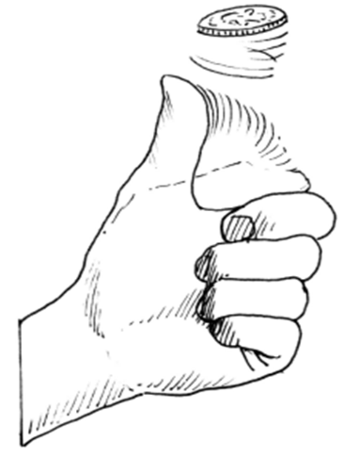
Design
1000 Patients
Intervention Control
Furosemide infusion Placebo
n= 500 n = 500
Primary outcome: Days alive and out of hospital at day 90 after randomisation

Slide 11
Aim
To assess benefits and harms of goal directed fluid removal with furosemide versus placebo in adult ICU patients with ≥ 5% of fluid overload.
Potential benefit
Reduced organ oedema, shorter time on mechanical ventilation, and shorter stay in the ICU.
Potential harm
Impaired perfusion, adverse reactions to furosemide.
Mortality?

Slide 12
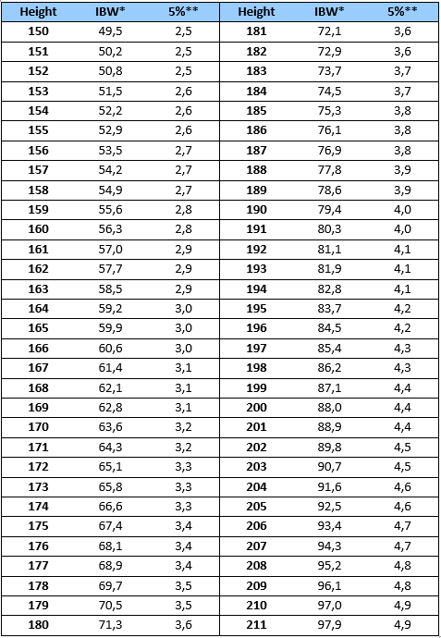
Inclusion criteria
All the following criteria must be fulfilled:
✓ Acute admission to the ICU AND
✓ Aged 18 years or above AND
✓ ≥ 5% fluid overload according to the cumulative fluid balance and ideal body weight AND
✓ Clinical stable defined by MAP > 50 mmHg, maximum noradrenaline infusion of 0.20 microg/kg/minute and lactate < 4.0 mmol/L
Notes:
Ideal body weight = 22 x (height in meters)2

Slide 13
Exclusion criteria
We will exclude patients who fulfil any of the following criteria:
✗ Known allergy to furosemide or sulphonamides
✗ Known pre-hospitalisation advanced chronic kidney disease (eGFR < 30 mL/minute/1.73 m² or chronic renal replacement therapy)
✗ Ongoing renal replacement therapy
✗ Anuria for ≥ 6 hours
✗ Ongoing life-threatening bleeding
✗ Acute burn injury of more than 10% of the body surface area
✗ Severe dysnatraemia (P-Na < 120 mmol/L or > 155 mmol/L)
✗ Severe hepatic failure
✗ Patients undergoing forced treatment
✗ Fertile woman (< 50 years of age) with positive urine human gonadotropin (hCG) or plasma-hCG
✗ Informed consent not obtainable

Slide 14
Randomisation
ALWAYS obtain consent from the first trial guardian BEFORE randomisation
Consent can initially be oral
State full name of the primary trial guardian in the patient’s medical file
Informed consent form next of kin and the second trial guardian as soon as possible

Slide 15
Start trial drug
4 ml trial drug as bolus-injection (only at start up)
Start infusion of trial drug on 2 ml/hour
Adjust infusion according to effect. 0-4 ml/hour.
Goal: Neutral fluid balance +/- 750 ml

Slide 16
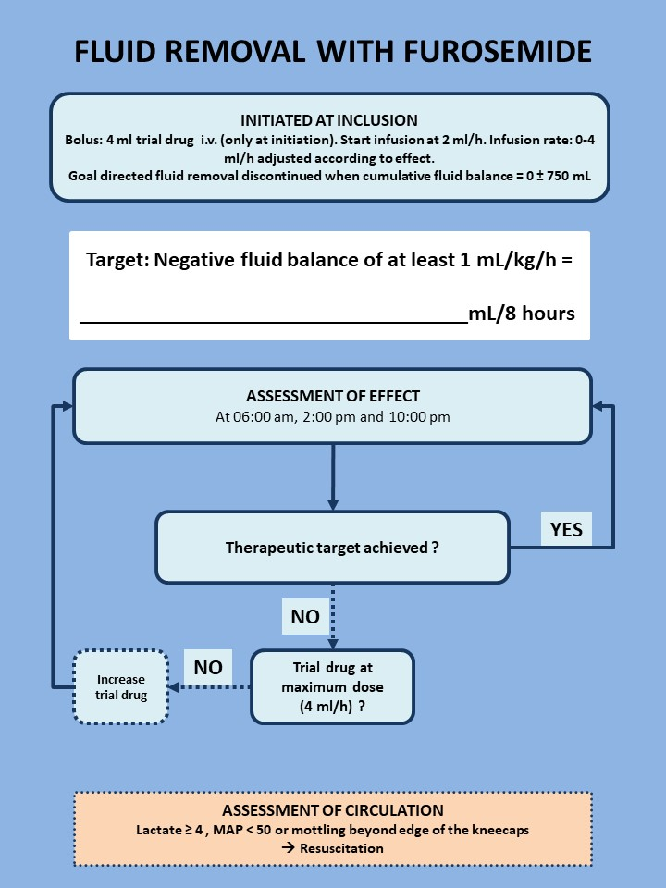

Slide 17
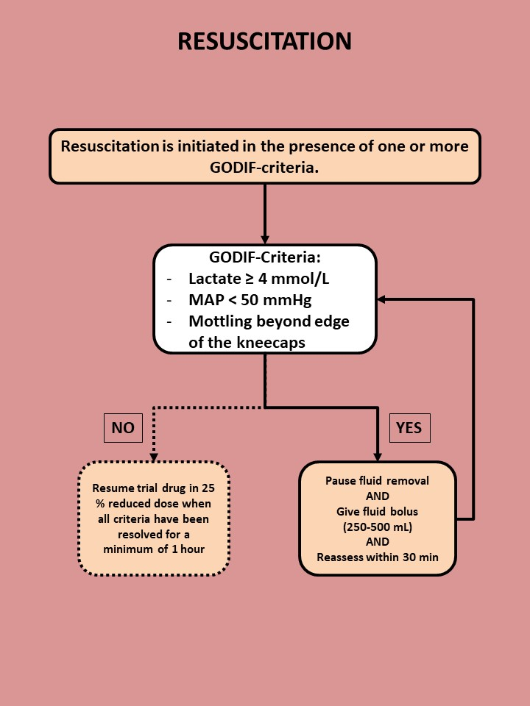

Slide 18
All habitual oral diuretics can be continued on indication
Habitual
diuretics
Only loop diuretics may be converted to iv furosemide
equivalent to 50% of oral dose
Treatment of hypernatraemia with thiazides is allowed
if the is the guideline at the clinical site

Slide 19
Hyperkalaemia (p-K > 6.0 mmol/L)
Escape medicine – open label furosemide
Respiratory failure (P/F-ratio < 26 kPa (200 mmHg) with pulmonary oedema due to fluid overload
Escape doses MUST be described in the medical record. Maximum dose of furosemide per 24 hours is 1500 mg. Infusion of trial drug must continue.

Slide 20
Hyperkalaemia (p-K > 6.0 mmol/L)
Escape renal replacement therapy
Respiratory failure (P/F-ratio < 26 kPa (200 mmHg) with pulmonary oedema due to fluid overload
Severe metabolic acidosis attributable to acute kidney injury (pH < 7,20 and SBE: < -10)
Persistent acute kidney injury > 72 hours (def. as: oliguria /anuria or s-creatinine has not declined to 50% from peak
Trial drug infusion must be paused during dialysis and restarted when stopped.

Slide 21
Re-evaluation of fluid status
IT MUST BE DOCUMENTED IN THE PATIENT FILE AND THE TREATMENT FOR THE REST OF THE ADMISSION MUST FOLLOW THIS NEW FLUID BALANCE!

Slide 22
Adherence
The trial drug must be administered throughout the ICU stay to a maximum of 90 days.
Goal: achievement and maintenance of neutral fluid balance
ICU readmissions within 90 days - the trial intervention must be re-started.
In case of transferal to another GODIF-site, the intervention continues.

Slide 23
Withdrawal
A patient can be withdrawn from the trial if:
Consent is withdrawn or not given (patient, next of kin)
Clinicians or investigators choice (SAR/SUSAR/clinical decision)
Patient is subject to involuntary hospitalization
Withdrawal form active therapy
Ask for permission to continue data registration (day forms and follow up in eCRF).

Slide 24
Serious Adverse Reactions (SAR)
Severe electrolyte disturbance (p-K < 2.5 mmol/L, p-Na < 120 mmol/L, p-Cl < 90 mmol/L)
Aplastic anaemia
Agranulocytosis
Pancreatitis
Circulatory collapse leading to cardiac arrest
Seizures because of furosemide induced low calcium or magnesium
Steven Johnsons syndrome
Toxic epidermal necrolysis
Hearing impairment/loss
Anaphylaxis

Slide 25
SAR
Contact the sponsor or coordinating investigator without undue delay by mail: godif@cric.nu or +45 4829 6773.
The report for SAR/SAE must be filled in and mailed to godif@cric.nu The report can be found under trial documents on www.cric.nu/godif (#14 in Site Master File)

Slide 26
SUSAR
Suspected Unexpected Serious Adverse Reactions (SUSAR)
Serious adverse reactions which are not described in the product characteristics of furosemide
Contact the sponsor or coordinating investigator without undue delay (godif@cric.nu or +45 4829 6773)
Fill in the SUSAR report form (#14 in the Site Master File) and e-mail it to sponsor godif@cric.nu

Slide 27
1-year follow-up
Mortality
Cognitive function MoCA mini
Certification at www.mocatest.org
HRQoL (EQ-5D-5L + EQ-VAS)
Subjective assessment of life quality after treatment in the ICU

Slide 28
www.cric.nu/godif
Trial documents, screening, randomisation, data registration, and trial medication.

Slide 29
Contact
Do you need help?
Call the GODIF hotline at:
+ 45 4829 6773
mail: godif@cric.nu

Slide 30
Sine Wichmann, MD, ph.d.-student
Department of Anaesthesiology and Intensive Care
Nordsjællands hospital, Hillerød
www.cric.nu/godif
godif@cric.nu
Phone: +45 4829 6773

