Slide 1

Goal directed fluid removal with furosemide in intensive care patients with fluid overload – A randomised, blinded, placebo-controlled trial (GODIF)
GODIF initiering_V.1.1_04.01.2021
Sine Wichmann, MD, ph.d.-student
Department of Anaesthesiology and Intensive Care
Nordsjællands hospital, Hillerød
www.cric.nu/godif
godif@cric.nu
Phone: +45 4829 6773

Slide 2
Disposition
Background
Design
Inclusion and exclusion criteria
Intervention and control group
Follow-up

Slide 3
Fluid overload
Very common
Fluid overload is an independent risk factor for organ failure and mortality.
Increasing fluid overload increases the risk.
Notes:
Beregning af overhydrering: kumuleret VB (L)/vægt (kg) x 100 = X%
Flere studier har påvist at FO er en risikofaktor for død og organ dysfunction. Volumina ned til 1% eller 1 liter I pos. VB kan have betydning.

Slide 4
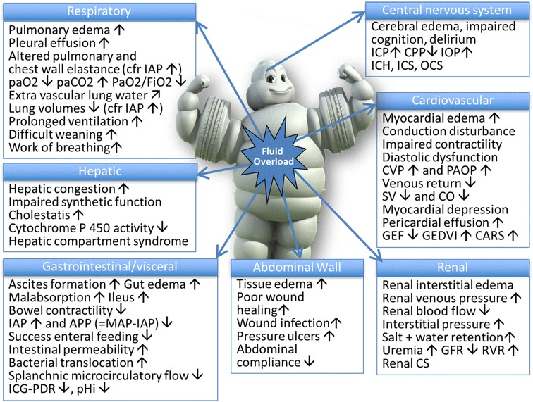
Malbrain et al. 2018
Notes:
Fortsat store mængder væske på intensive på trods af ændrede sepsis guidelines og focus på mindre væske. Pilot studiet til CLASSIC viste store mængder væske indgift – resuscitations væsken var relative lille.

Slide 5
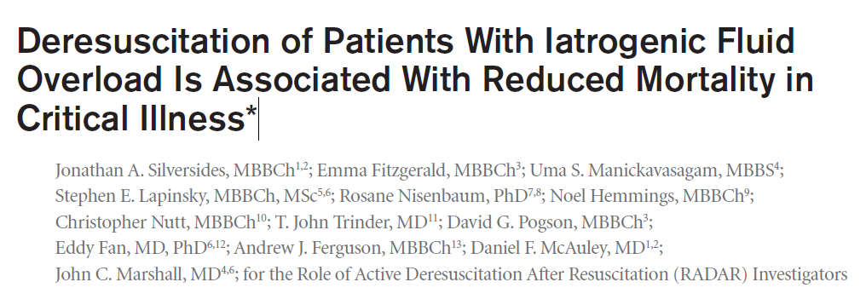
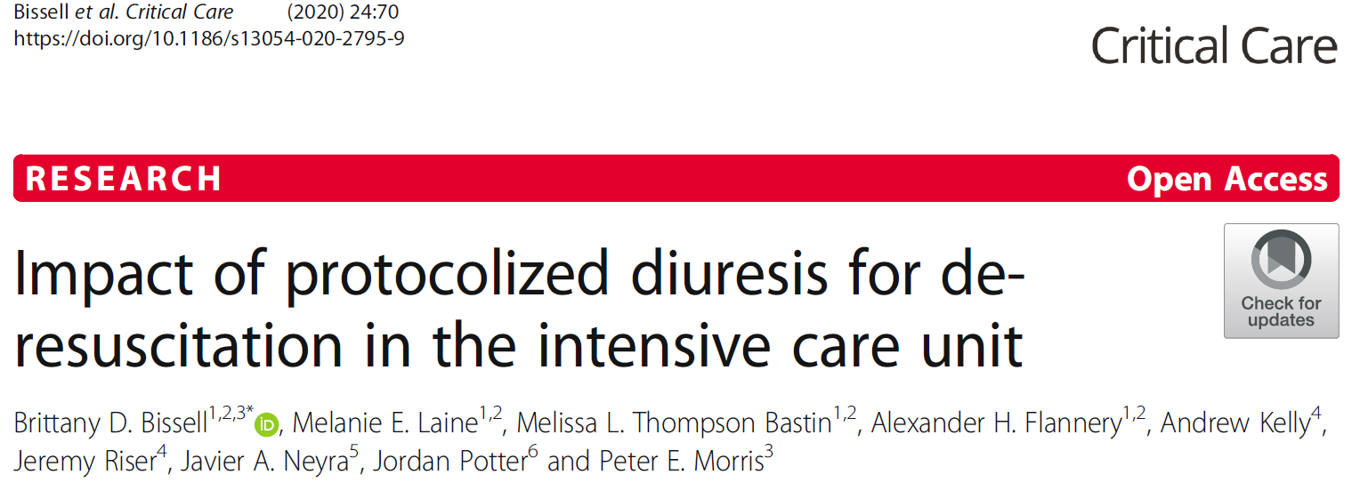
Deresuscitation
Notes:
Silverside: Retrospektivt studie 400 patienter. Ingen intervention. Viste at de mest overhydrerede havde højest mortalitet. Deresuscitation på 3. indlæggelsesdøgn på intensive var associeret med bedre outcomes.
Væskebalance på dag 3 var associeret til 30-dages mortalitet.
Bissell: Kohorte studie med historiske controller. 91 patienter fik interventionen og 273 controller. Inkl. Patienter med en positive VB af alle grader hvis der er tegn på FO på rtg eller fysisk undersøgelse. Viste at deresuscitations algoritme 72 timer post shock mindsker FO med mulige fordele på det kliniske outcome. Hospitals mortalitet var lavere i interventionsgruppen 5.5% vs 16.1% og kortere indlæggelsestid på ITA. Ingen significant forskel I respiratordage. Øget forekomst af hyprenatræmi og hypokaliæmi i interventionsgruppen

Slide 6
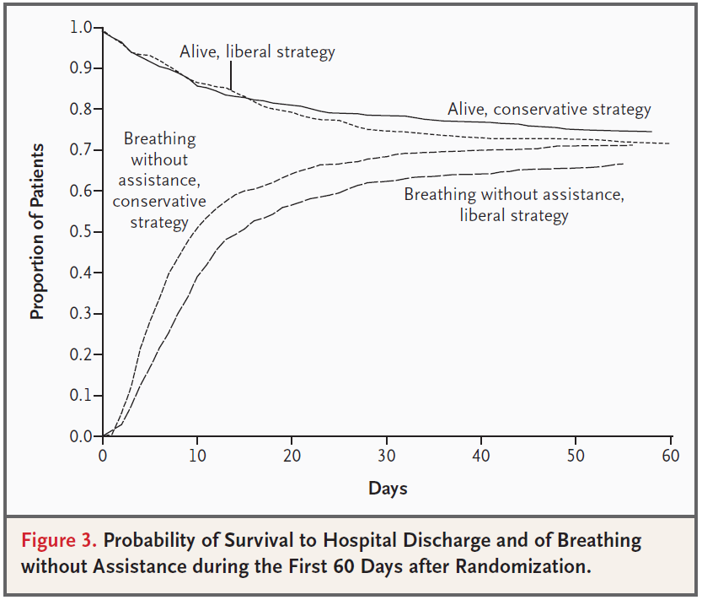
Deresuscitation – FACTT trial
Notes:
Comparison of two fluid-management strategies in acute lung injury. 1000 patienter. Baseline FO: 2700-2900 ml I de to grupper. Complicated protocol – intervention styret af indkilingstryk, CVP, status for shock MAP/vasopressor – 20 kasser man kan komme i. KVB de første 7 dage: -136(+/-491) i den restrictive gruppe og 6992 (+/-502) I den liberale gruppe. Ingen forskel I 60 dages mortalitet. De blev ekstuberet 2 dage tidligere og havde 2 dages kortere indlæggelsestid på ITA i den restrictive gruppe.

Slide 7
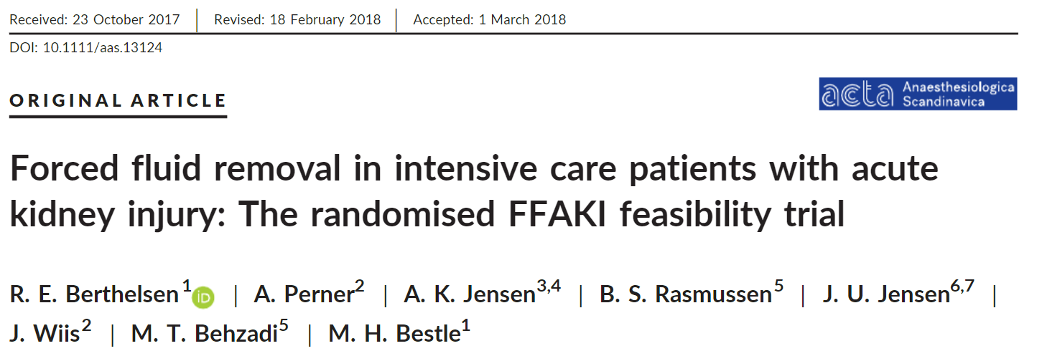
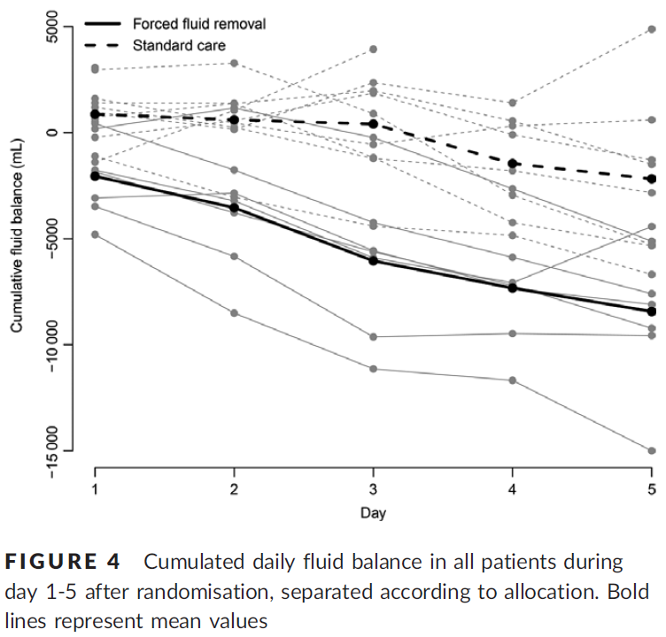
Pilot studie - FFAKI
Notes:
AKI patienter på intensive RH +NOH. Væsketræk med 1 ml/kg IBW/hour er mulig. Gjort med furuosemid og evt. CRRT.
23 patienter. Alle havde moderat til svær AKI og var > 10% overhydrerede.

Slide 8
Current knowledge
Fluid overload is a risk factor for organ dysfunctions and death
Goal directed and fast fluid removal is feasible
We don’t know when or how fluid removal should be done
Notes:
Beregning af overhydrering: kumuleret VB (L)/vægt (kg) x 100 = X%
Ovenstående opgørelse af 2 år på RH + NOH med pt med ny aki (uden CKD).

Slide 9
Design
Randomised, blinded, placebo-controlled trial of furosemide versus placebo.
Setting: 20-30 sites, starting in Denmark
Starting 17th of August 2020, Nordsjællands Hospital.
1000 patients.
Goal: Achieve neutral fluid balance as fast as possible and maintain it until discharge or 90 days.

Slide 10
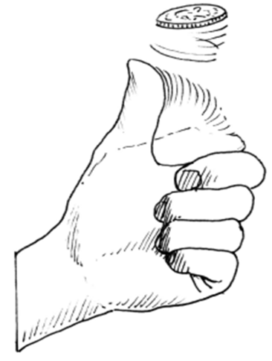
Design
  1000 Patients
  Intervention Control
  Furosemide infusion Placebo
  n= 500 n = 500
  Primary outcome: Days alive and out of hospital at day 90 after randomisation

Slide 11

Aim
To assess benefits and harms of goal directed fluid removal with furosemide versus placebo in adult ICU patients with ≥ 5% of fluid overload.
Potential benefit
Reduced organ oedema, shorter time on mechanical ventilation, and shorter stay in the ICU.
Potential harm
Impaired perfusion, adverse reactions to furosemide.
Mortality?

Slide 12
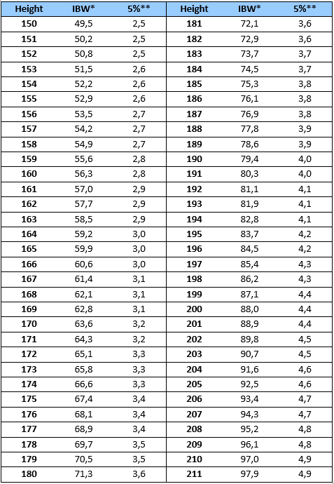
Inclusion criteria
All the following criteria must be fulfilled:
✓ Acute admission to the ICU AND
✓ Aged 18 years or above AND
✓ ≥ 5% fluid overload according to the cumulative fluid balance and ideal body weight AND
✓ Clinical stable defined by MAP > 50 mmHg, maximum noradrenaline infusion of 0.20 microg/kg/minute and lactate < 4.0 mmol/L
Notes:
Ideal body weight = 22 x (height in meters)2

Slide 13
Exclusion criteria
We will exclude patients who fulfil any of the following criteria:
✗ Known allergy to furosemide or sulphonamides
✗ Known pre-hospitalisation advanced chronic kidney disease (eGFR < 30 mL/minute/1.73 m² or chronic renal replacement therapy)
✗ Ongoing renal replacement therapy
✗ Anuria for ≥ 6 hours
✗ Rhabdomyolysis with indication for forced diuresis
✗ Ongoing life-threatening bleeding
✗ Acute burn injury of more than 10% of the body surface area
✗ Severe dysnatraemia (P-Na < 120 mmol/L or > 155 mmol/L)
✗ Severe hepatic failure
✗ Patients undergoing forced treatment
✗ Fertile woman (< 50 years of age) with positive urine human gonadotropin (hCG) or plasma-hCG
✗ Informed consent not obtainable

Slide 14
Randomisation
ALWAYS obtain consent from the first trial guardian BEFORE randomisation
Consent can initially be oral
State full name of the primary trial guardian in the patient’s medical file
Informed consent form next of kin and the second trial guardian as soon as possible

Slide 15
Start trial drug
0.5-4 ml trial drug as bolus-injection (only at start up)
Start infusion of trial drug on 2 ml/hour
Adjust infusion according to effect. 0-4 ml/hour.
Goal: A negative fluid balance of ≥1 ml/kg/hour until neutral fluid balance is achieved (+/- 750 ml)

Slide 16
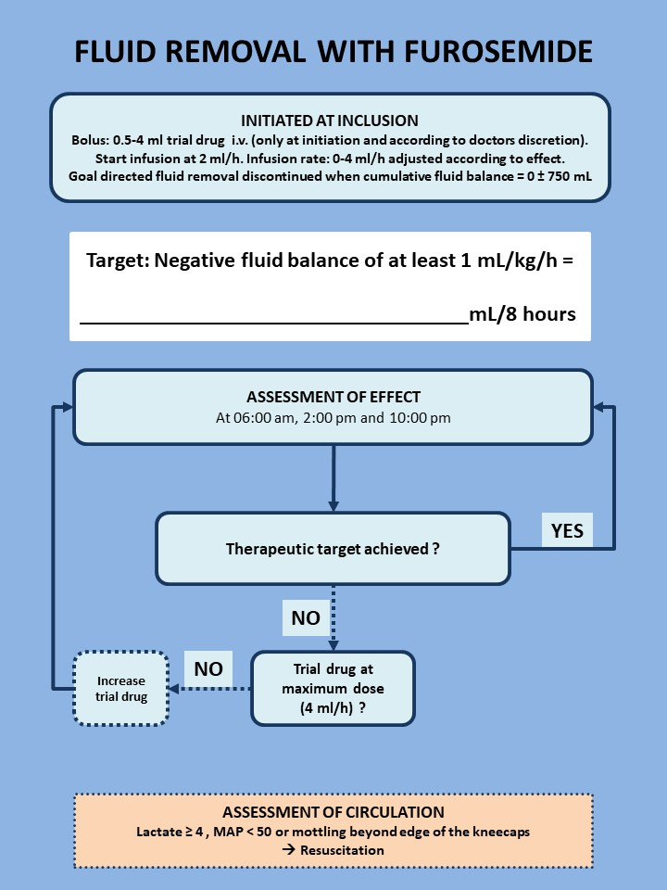

Slide 17
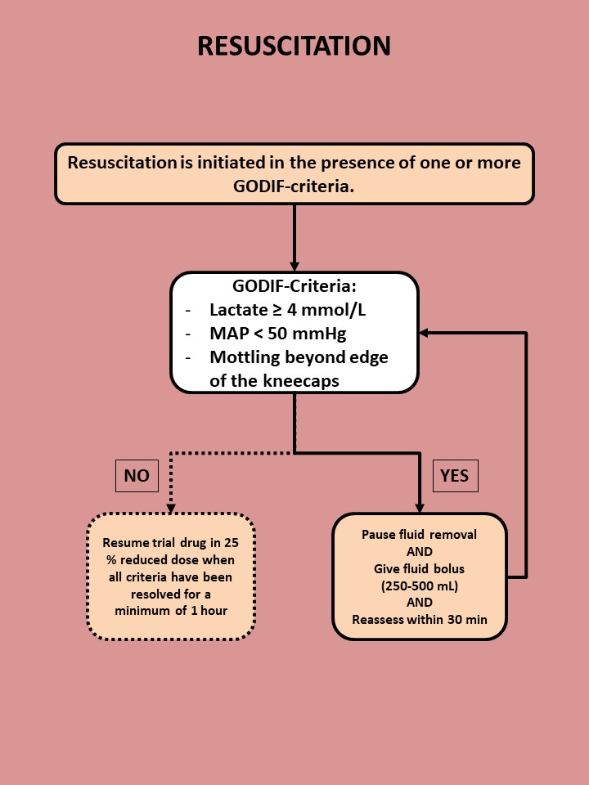
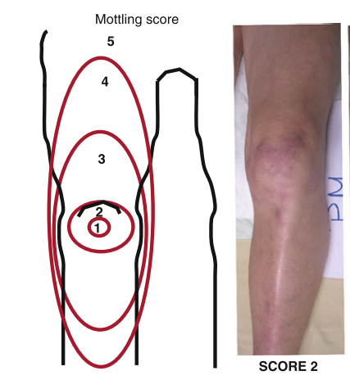

Slide 18
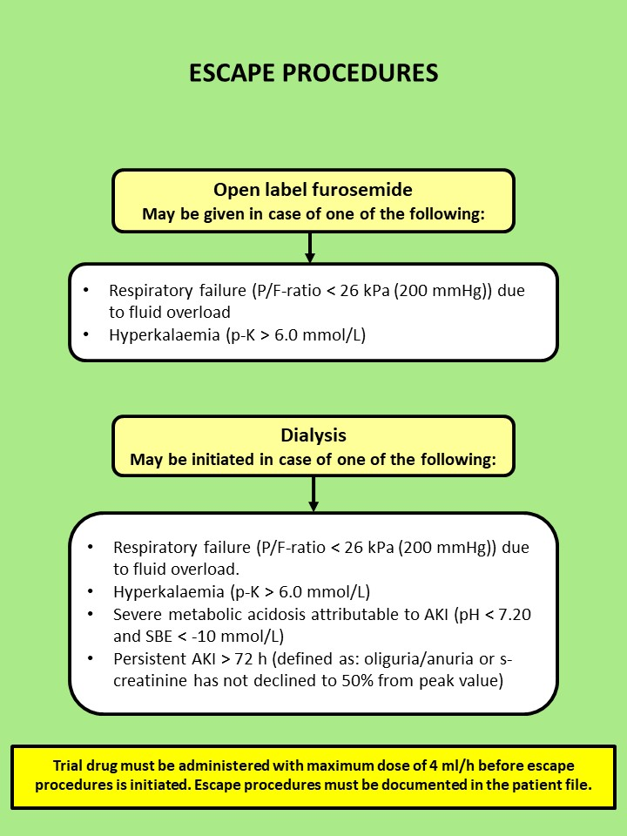

Slide 19

All habitual oral diuretics can be continued on indication
Habitual
diuretics
Only loop diuretics may be converted to iv furosemide
equivalent to 50% of oral dose
Treatment of hypernatraemia with thiazides is allowed
if the is the guideline at the clinical site

Slide 20
Re-evaluation of fluid status
IT MUST BE DOCUMENTED IN THE PATIENT FILE AND THE TREATMENT FOR THE REST OF THE ADMISSION MUST FOLLOW THIS NEW FLUID BALANCE!

Slide 21
Adherence
The trial drug must be administered throughout the ICU stay to a maximum of 90 days.
Goal: achievement and maintenance of neutral fluid balance
ICU readmissions within 90 days - the trial intervention must be re-started.
In case of transferal to another GODIF-site, the intervention continues.

Slide 22
Withdrawal
A patient can be withdrawn from the trial if:
Consent is withdrawn or not given (patient, next of kin)
Clinicians or investigators choice (SAR/SUSAR/clinical decision)
Patient is subject to involuntary hospitalization
Withdrawal form active therapy
Ask for permission to continue data registration (day forms and follow up in eCRF).

Slide 23
Serious Adverse Reactions (SAR)
Severe electrolyte disturbance (p-K < 2.5 mmol/L, p-Na < 120 mmol/L, p-Cl < 90 mmol/L)
Aplastic anaemia
Agranulocytosis
Pancreatitis
Circulatory collapse leading to cardiac arrest
Seizures because of furosemide induced low calcium or magnesium
Steven Johnsons syndrome
Toxic epidermal necrolysis
Hearing impairment/loss
Anaphylaxis

Slide 24
SAR
Contact the sponsor or coordinating investigator without undue delay by mail: godif@cric.nu or +45 4829 6773.
The report for SAR/SAE must be filled in and mailed to godif@cric.nu The report can be found under trial documents on www.cric.nu/godif (#14 in Site Master File)

Slide 25
SUSAR
Suspected Unexpected Serious Adverse Reactions (SUSAR)
Serious adverse reactions which are not described in the product characteristics of furosemide
Contact the sponsor or coordinating investigator without undue delay (godif@cric.nu or +45 4829 6773)
Fill in the SUSAR report form (#14 in the Site Master File) and e-mail it to sponsor godif@cric.nu

Slide 26
1-year follow-up
Mortality
Cognitive function MoCA mini
Certification at www.mocatest.org
HRQoL (EQ-5D-5L + EQ-VAS)
Subjective assessment of life quality after treatment in the ICU

Slide 27

www.cric.nu/godif
Trial documents, screening, randomisation, data registration, and trial medication.

Slide 28
Contact
Do you need help?
Call the GODIF hotline at:
+ 45 4829 6773
mail: godif@cric.nu

Slide 29

Sine Wichmann, MD, ph.d.-student
Department of Anaesthesiology and Intensive Care
Nordsjællands hospital, Hillerød
www.cric.nu/godif
godif@cric.nu
Phone: +45 4829 6773

